Slide 1
2:1-20

Slide 2
2:1-20

Slide 3
2:1-20

Slide 4
2:1-20
Matthew ~ presents Jesus as the Messiah of God
More references to Old Testament
Mark ~ presents Jesus as Servant of God
Contains more action
Luke ~ presents Jesus as the Son of Man
Their idea of “god” was the perfect man
John ~ presents Jesus as the Son of God
the Word was God

Slide 5
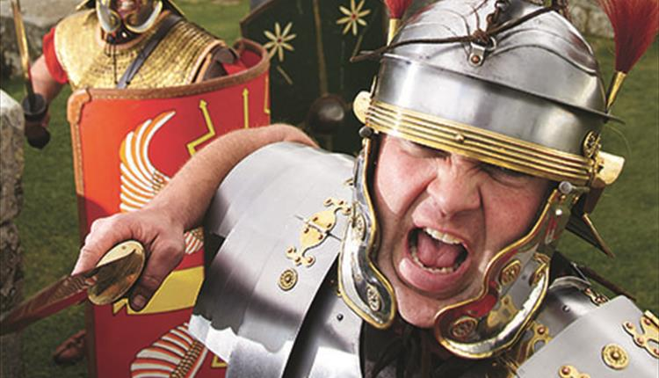
2:1-20
Pax Romana (peace of the Romans)
with an iron fist

Slide 6
2:1-20

Slide 7
2:1-20
Matt. 2:1 ~ Now after Jesus was born in Bethlehem of Judea in the days of Herod the king, behold, wise men from the East came to Jerusalem,
Herod died in 4 BC
Quirinius became governor (hēgemoneuō) of Syria in AD 6
He was also military governor from 12-BC-1BC

Slide 8
2:1-20

Slide 9
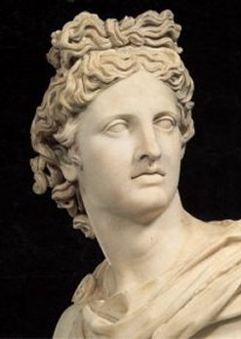
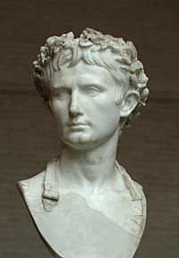
2:1-20
Apollo
Augustus

Slide 10
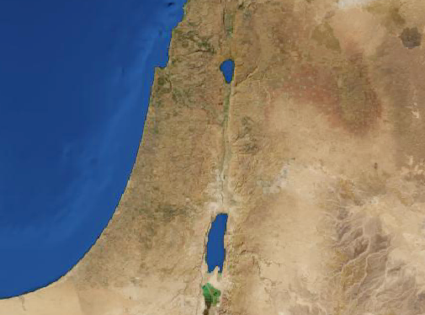
2:1-20
Nazareth
70 mi
Bethlehem
Route of Joseph and Mary

Slide 11
2:1-20
Mic. 5:2 ~ “But you, Bethlehem Ephrathah,
Though you are little among the thousands of Judah,
Yet out of you shall come forth to Me
The One to be Ruler in Israel,
Whose goings forth are from of old,
From everlasting.”

Slide 12
2:1-20

Slide 13
2:1-20
Bethlehem ~ house of bread

Slide 14
2:1-20

Slide 15
2:1-20
par·a·dox – [par-uh-doks] – n.
1. something absurd or contradictory;
2. self-contradictory statement;
3. person of opposites

Slide 16
2:1-20
Col. 1:15-17 ~ ¹⁵ He is the image of the invisible God, the firstborn over all creation. ¹⁶ For by Him all things were created that are in heaven and that are on earth, visible and invisible, whether thrones or dominions or principalities or powers. All things were created through Him and for Him. ¹⁷ And He is before all things, and in Him all things consist.

Slide 17
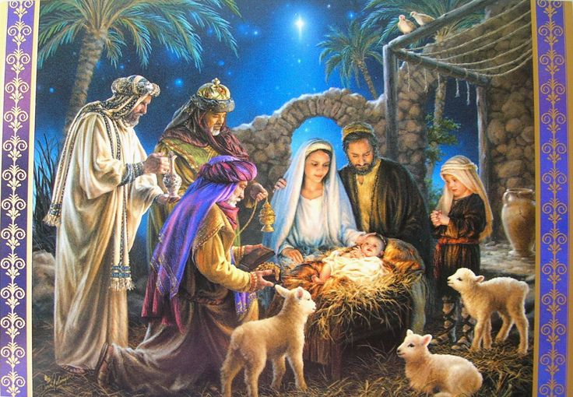
2:1-20
Thing
Thing
God
Thing
Thing
Thing
Thing
Thing
Thing

Slide 18
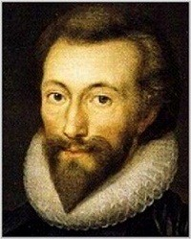
2:1-20
John Donne (1572–1631) ~ ‘Twas much, that man was made like God before.
But, that God should be made like man, much more.

Slide 19
2:1-20

Slide 20
2:1-20

Slide 21
2:1-20

Slide 22
2:1-20
Or, “peace to men in whom God is pleased”
NIV ~ “and on earth peace to men on whom his favor rests.”
NASB ~ “on earth peace among men with whom He is pleased.”
But Pax Dei
~ The Peace of God
Not Pax Romana
~ The Peace of Rome
d
d

Slide 23
2:1-20

Slide 24
2:1-20
Is. 9.6 ~ For unto us a Child is born, unto us a Son is given;
And the government will be upon His shoulder.
And His name will be called Wonderful, Counselor, Mighty God,
Everlasting Father, Prince of Peace.

Slide 25
2:1-20
Is. 53:7 ~ He was oppressed and He was afflicted,
Yet He opened not His mouth;
He was led as a lamb to the slaughter,
And as a sheep before its shearers is silent,
So He opened not His mouth.

Slide 26
2:1-20

Slide 27
2:1-20
Mal. 3:1a ~ “Behold, I send My messenger, and he will prepare the way before Me.”
eyewitnesses ~ autoptēs

Slide 28
2:1-20

