Slide 1
1:39-80

Slide 2
1:39-80
Luke 1:35 ~ And the angel answered and said to her, “The Holy Spirit will come upon you, and the power of the Highest will overshadow you; therefore, also, that Holy One who is to be born will be called the Son of God.”
overshadow ~ epikiazō
Ex. 40:35 (LXX)~ And Moses was not able to enter the tabernacle of meeting, because the cloud rested above it, and the glory of the Lord filled the tabernacle.

Slide 3
1:39-80
Luke 1:39 ~ Then Mary said, “Behold the maidservant of the Lord! Let it be to me according to your word.” And the angel departed from her.
maidservant ~ doulē – feminine of doulos

Slide 4
1:39-80

Slide 5
1:39-80
Luke 1:28 ~ “Rejoice, highly favored one, the Lord is with you; blessed are you among women!”
highly favored ~ charitoō (verb form of charis)
Eph. 1:6 ~ to the praise of the glory of His grace, by which He made us accepted in the Beloved.

Slide 6
1:39-80

Slide 7
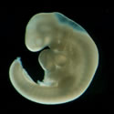
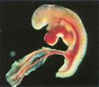
1:39-80
Fertilization ~ sperm (100% of the father) enters egg (100% of the mother) – new life begins
Week 4 ~ Neural tube forms (nervous system), heart/circulatory system begins
Week 5 ~ Heart begins beating, arm/leg buds appear
1st Trimester

Slide 8
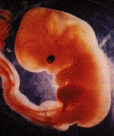
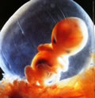
1:39-80
Week 6 ~ Brain, eye lenses, nostrils, intestines form
Week 7 ~ Elbows, fingers, feet, ears, eyes, nose – teeth begin to form
Week 8 ~ Cartilage and bone begins to form, intestines move to abdomen
1st Trimester

Slide 9
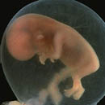
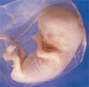
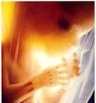
1:39-80
Week 9 ~ Fingerprints, begins grasping objects, moving constantly
Week 10 ~ Eyelids fuse shut and irises develop; placenta begins to function
Week 11 ~ All organs formed, gender is visible, intestines begin functioning
1st Trimester

Slide 10
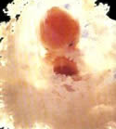
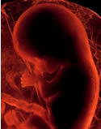
1:39-80
Week 12 ~ Vocal chords begin, liver and pancreas begins functioning
Week 13 ~ Begins inhaling/exhaling movements, using hands more
Week 14 ~ Begins producing hormones, thumb-sucking may begin
1st Trimester

Slide 11
1:39-80

Slide 12
1:39-80
Is. 44:24 ~ Thus says the Lord, your Redeemer,
And He who formed you from the womb:
“I am the Lord, who makes all things,
Who stretches out the heavens all alone,
Who spreads abroad the earth by Myself;
Jer. 1:5a ~ (God to Jeremiah) “Before I formed you in the womb I knew you;
Before you were born I sanctified you;”

Slide 13
1:39-80
Ps. 139:13-16 (David to God) ~ ¹³ For You formed my inward parts;
You covered me in my mother’s womb.
¹⁴ I will praise You, for I am fearfully and wonderfully made;
Marvelous are Your works,
And that my soul knows very well.
¹⁵ My frame was not hidden from You,
When I was made in secret,

Slide 14
1:39-80
Ps. 139:13-16 (David to God) ~ When I was made in secret,
And skillfully wrought in the lowest parts of the earth.
¹⁶ Your eyes saw my substance, being yet unformed.
And in Your book they all were written,
The days fashioned for me,
When as yet there were none of them.

Slide 15
1:39-80

Slide 16
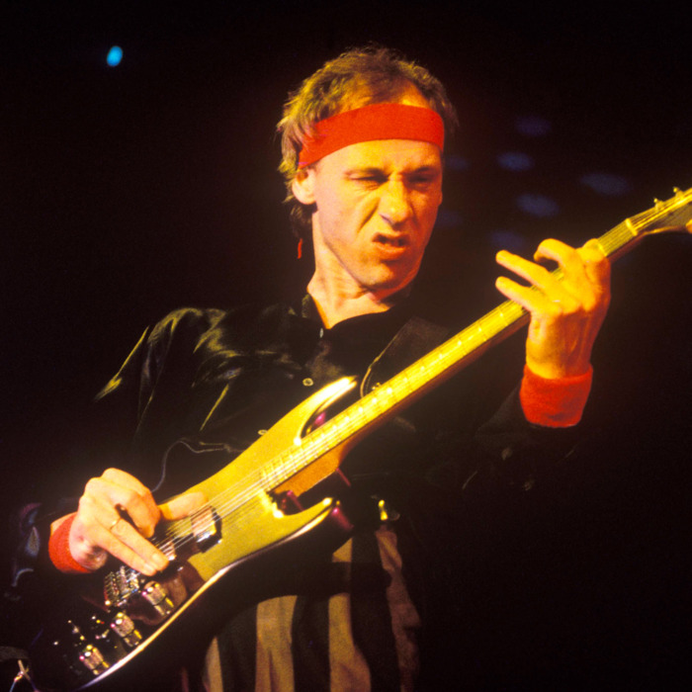
1:39-80

Slide 17
1:39-80

Slide 18
1:39-80
169 ~ 04/19/1995 Murrah Federal Building, OKC, OK
2996 ~ 09/11/2001 World Trade Centers, NYC, NY
32 ~ 04/16/2007 VA Tech, Blacksburg, VA
27 ~ 12/14/2012 Sandy Hook Elem., Newtown, CT
49 ~ 06/12/2016 Pulse Nightclub, Orlando, FL
58 ~ 10/01/1917 Mandalay Bay, Las Vegas, NV
+
26 ~ 11/05/2017 1st Bap. Ch., Sutherland Sprgs, TX
3,357
This number about 24 hours of operation in America’s abortion facilities
Mass killings in U.S.

Slide 19
1:39-80

Slide 20
1:39-80
Roe v. Wade ~ January 1973
Euphemisms: “uterine contents,” “product of conception,” “blob of protoplasm”
over 61,275,000 since 1973

Slide 21
1:39-80

Slide 22
1:39-80
All trucks have wheels
I drive a truck
Therefore, my truck has wheels
Syllogism

Slide 23
1:39-80
It’s sad, but sometimes the euthanizing of animals is necessary
People are animals
Therefore, it’s sad, but sometimes the euthanizing of people is necessary
Silly-gism
Syllogism

Slide 24
1:39-80

Slide 25
1:39-80
2 things are perfectly clear:
1. Your son/daughter is in heaven with Jesus
2. There is not only forgiveness but healing available through Him

Slide 26
1:39-80

Slide 27
1:39-80
David
~ because of his sin, his baby’s life was sacrificed
Esther
~ because she was willing to give her life for others (“If I perish, I perish”)
~ because he was a willing sacrifice when Abraham placed him on the altar
Isaac

Slide 28
1:39-80

Slide 29
1:39-80
2 sides of forgiveness:
1. Ps. 147:3 ~ He heals the brokenhearted
And binds up their wounds.
2. Eph. 4:32 ~ And be kind to one another, tenderhearted, forgiving one another, even as God in Christ forgave you.

Slide 30
1:39-80

Slide 31
1:39-80
Blessed ~ makarios – happy

Slide 32
1:39-80

Slide 33
1:39-80
Magnificat (vv. 46-55)
Ps. 35:9;
Hab. 3:18;
1 Sam. 1:11;
Ps. 138:6;
Ps. 71:19;
Ps. 126:2, 3
Ps. 111:9;
Gen. 17:7;
Ex. 20:6;
Ex. 34:6, 7;
Ps. 103:17;
Ps. 98:1;
Ps. 118:15;
Is. 40:10;
Ps. 33:10;
1 Sam. 2:7-8;
Is. 41:8;
Ps. 98:3;
Gen. 17:7;
Ps. 132:11;

Slide 34
1:39-80

Slide 35
1:39-80
61,281,421
01/22/1973 – 05/11/2019
1,380
so far today
+
61,282,831
to date
Over 1,535,000,000 worldwide since 1980

Slide 36
1:39-80

Slide 37
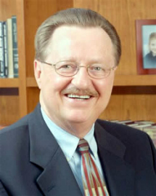
1:39-80
“Heavenly Father, we come before you today to ask Your forgiveness and to seek Your direction and guidance.
“We know Your word says, ‘Woe to those who call evil good,’ but that is exactly what we have done.
We have lost our spiritual equilibrium and
inverted our values.
“We confess that we have ridiculed the
absolute truth of Your word in the name of
moral pluralism.
“We have worshiped other gods and called
it ‘multiculturalism.’
Pastor Joe Wright 01/23/1996

Slide 38
1:39-80
“We have endorsed perversion and called it ‘an alternative lifestyle.’
“We have exploited the poor and called It ‘a lottery.’
“We have neglected the needy and
called it ‘self-preservation.’
“We have rewarded laziness and called it
‘welfare.’
“In the name of ‘choice,’ we have killed our
unborn.
“In the name of ‘right to life,’ we have
killed abortionists.
Pastor Joe Wright 01/23/1996

Slide 39
1:39-80
“We have neglected to discipline our children and called it ‘building esteem.’
“We have abused power and called it ‘political savvy.’
“We’ve coveted our neighbors’
possessions and called it ‘taxes.’
“We’ve polluted the air with profanity and
pornography and called it ‘freedom of
expression.’
“We’ve ridiculed the time-honored values
of our forefathers and called it
‘enlightenment.’
Pastor Joe Wright 01/23/1996

Slide 40
1:39-80
“Search us, oh God, and know our hearts today. Try us and show us any wicked way in us. Cleanse us from every sin and set us free.
“Guide and bless these men and women
who have been sent here by the people of
Kansas and who have been ordained by
You to govern this great state.
“Grant them Your wisdom to rule, and may
their decisions direct us to the center of
Your will.
“I ask it in the name of Your son, the
living Savior, Jesus Christ. Amen.”
Pastor Joe Wright 01/23/1996

Slide 41
1:39-80

