Slide 2
JUDGES 10-12
Jephtha

Slide 3
Judges 10
TOLA!

Slide 4
Judges 10
&
JAIR!

Slide 5
Canaanite Deities
Baals
Ashtoreths
The Gods of:
Syria
Moab
Ammon
Philistines

Slide 6
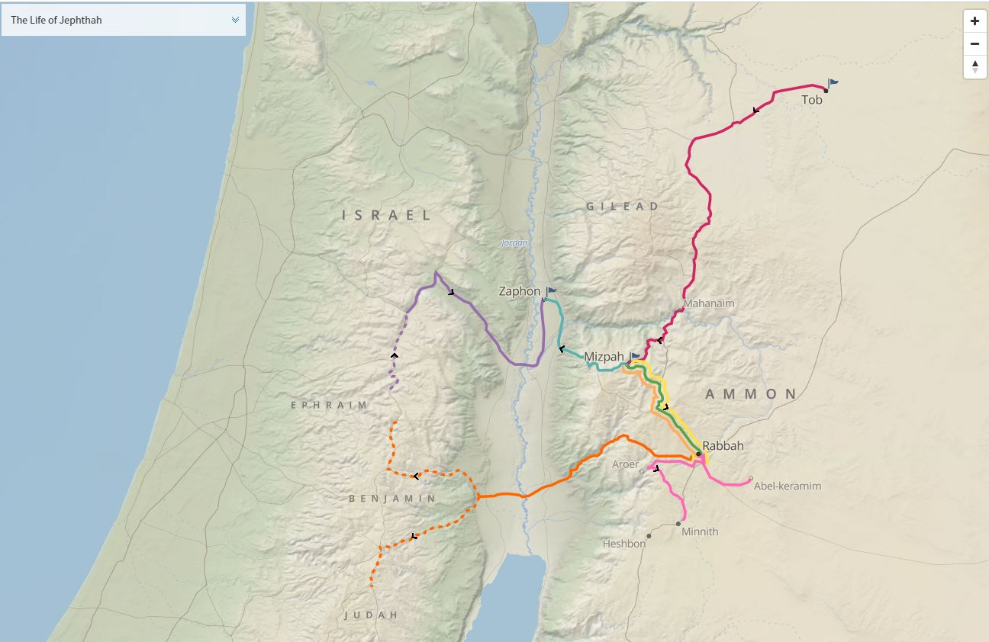
Map of Jephtha

Slide 7
Judges 10:10
"We have sinned against You, because we have both forsaken our God and served the Baals!"

Slide 8
Judges 10:11-12
1- Egyptians
2- Amorites
3- Ammon
4- Philistines
5- Sidonians
6- Amalekites
7- Maonites

Slide 9
Judges 10:13-14
“Yet you have forsaken Me and served other gods.
Therefore I will deliver you no more.
Go and cry out to the gods which you have chosen; let them deliver you in your time of distress."

Slide 10
1,700 Shekels of Gold
1,700 Shekels of gold = 43-70lbs
(depending on era)
Guzik - Over 50lbs
Clark - 70lbs, 10oz
As of 8/14/2019:
43lbs of Gold = $1,033,754.40
70lbs of Gold = $1,682,856.00

Slide 11
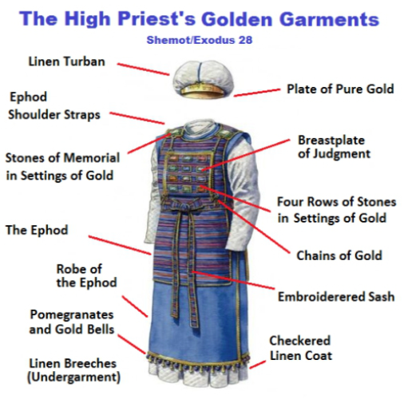

Slide 12
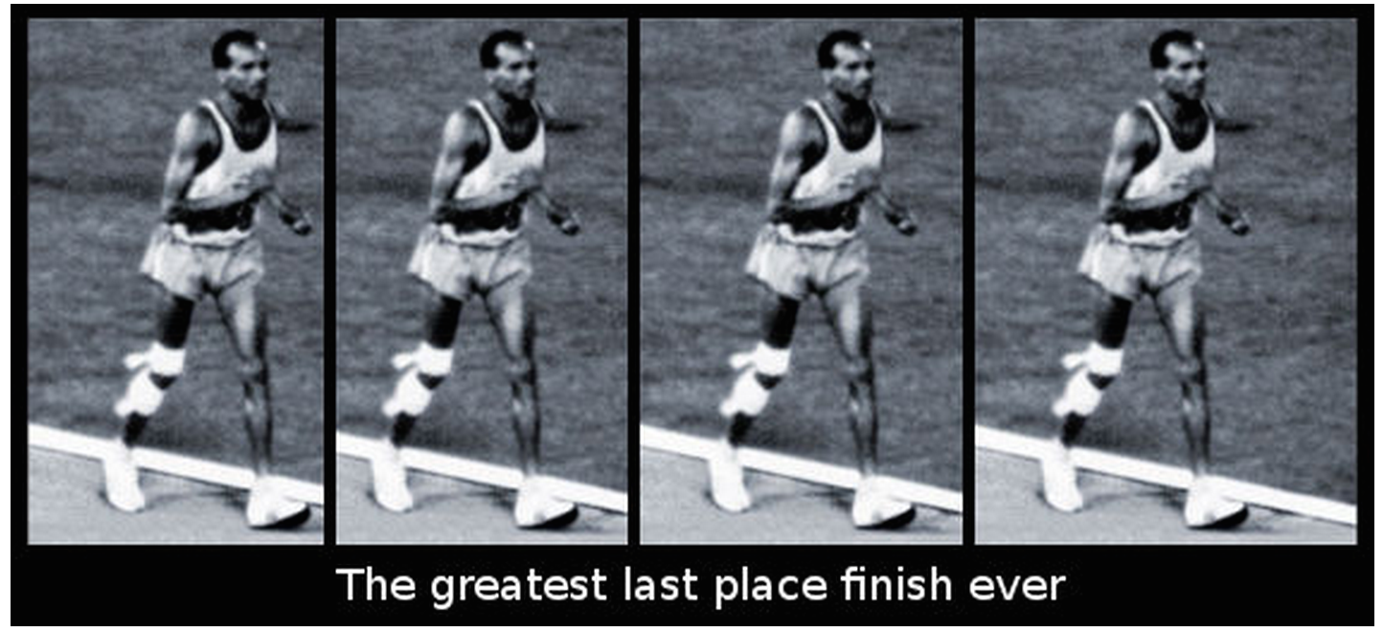
John Stephen Akhwari

Slide 13
Deuteronomy 17:17
And he shall not acquire many wives for himself, lest his heart turn away,
nor shall he acquire for himself excessive silver and gold.

Slide 14
"One false step of a good man leads multitudes astray"

Slide 15
“Give me five minutes with a person's checkbook, and I will tell you where their heart is.”
-Billy Graham

Slide 16
Monthly Supports
ACTS-SR
Baptist Village
CC Githurai Kenya
City Rescue Mission
Far Reaching Ministries
His Truth Transforms
Love Link Ministries (June, 2019)
Global Hope Network Int
Shepherd’s Staff
Syndeo Ministries
Village Ministries Int
Voice Of The Martyrs
Crossroads Clinic

Slide 17
Missions
Operation Christmas Child
Care Center Ministries
VBS Hands & Feet Outreach
Kenya Missions - CC Githurai
Mexico Missions
Numerous Missionaries from CCOKC

Slide 18
Special Events
Oklahoma Calvary Ministry Gathering
Pastor & Leaders Conference
Baptism
Men’s Retreat: Plano
Fusion Conference
Women’s Retreat: CC Wichita

Slide 20
Olive Tree
"The trees once went forth to anoint a king over them. And they said to the olive tree, 'Reign over us!'
But the olive tree said to them, 'Should I cease giving my oil, With which they honor God and men, And go to sway over trees?

Slide 21
Fig Tree
"Then the trees said to the fig tree, 'You come and reign over us!'
But the fig tree said to them, 'Should I cease my sweetness and my good fruit, And go to sway over trees?'

Slide 22
The Vine
"Then the trees said to the vine, 'You come and reign over us!'
But the vine said to them, 'Should I cease my new wine, Which cheers both God and men, And go to sway over trees?'

Slide 23
The Bramble
"Then all the trees said to the bramble, 'You come and reign over us!'
And the bramble said to the trees, 'If in truth you anoint me as king over you, Then come and take shelter in my shade; But if not, let fire come out of the bramble And devour the cedars of Lebanon!'

Slide 24
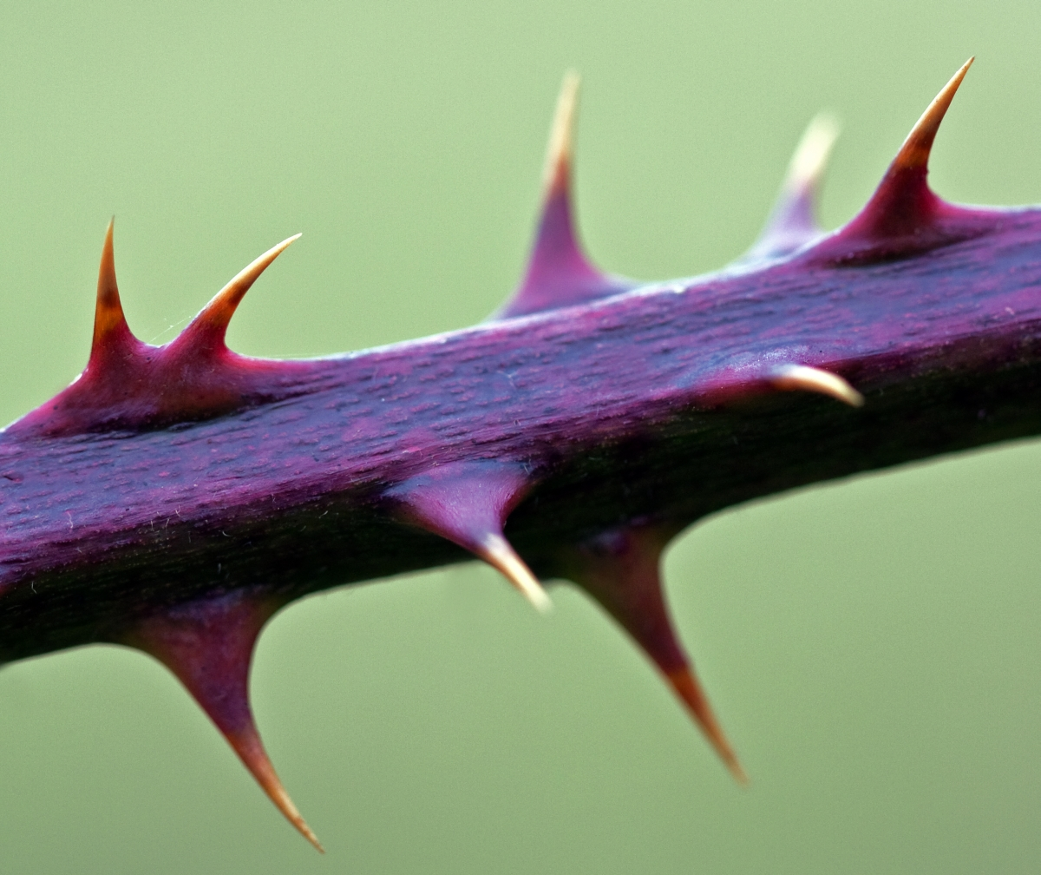

Slide 27
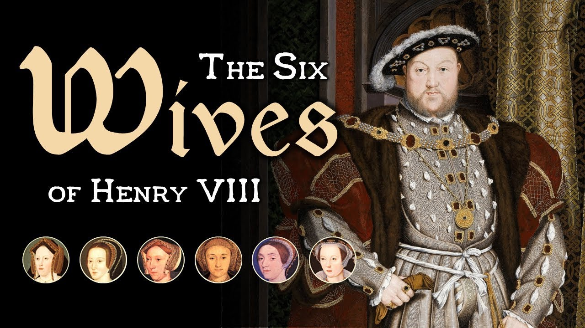

Slide 28
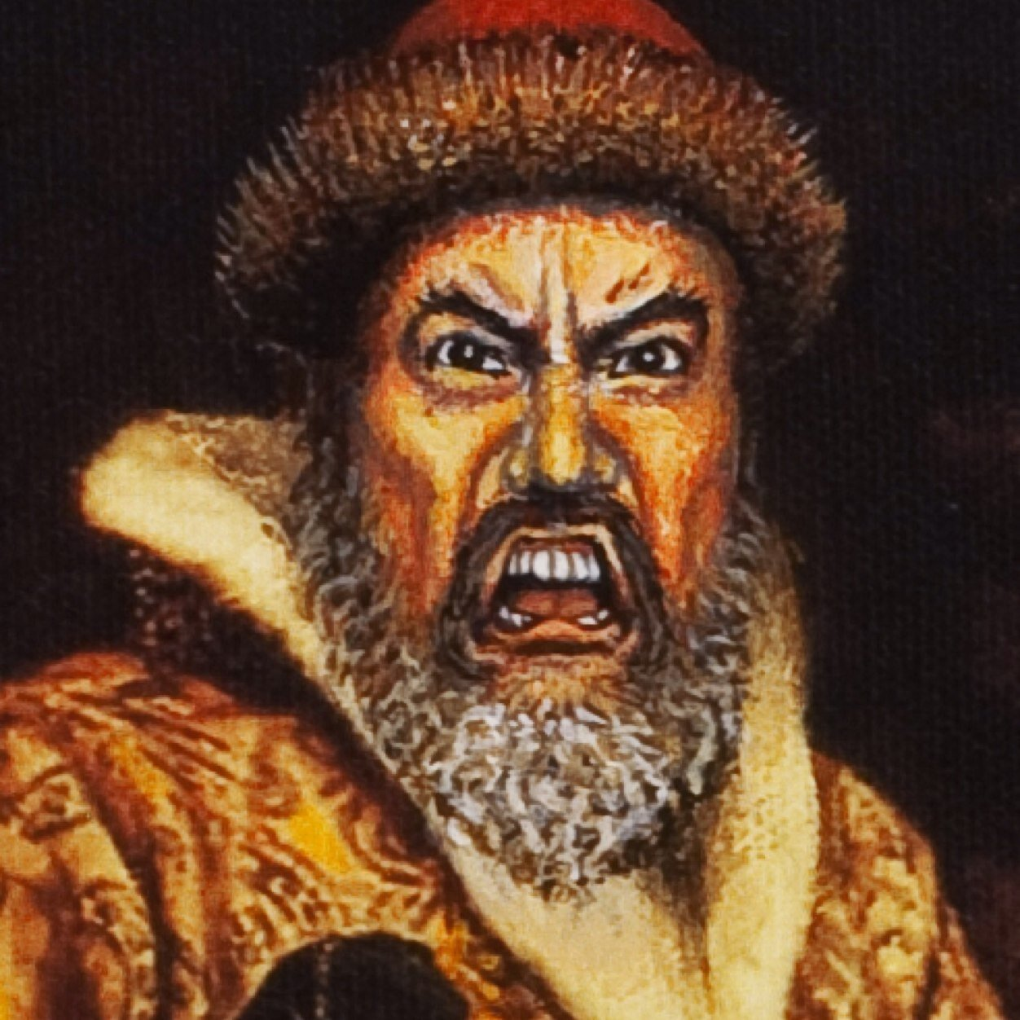

Slide 30
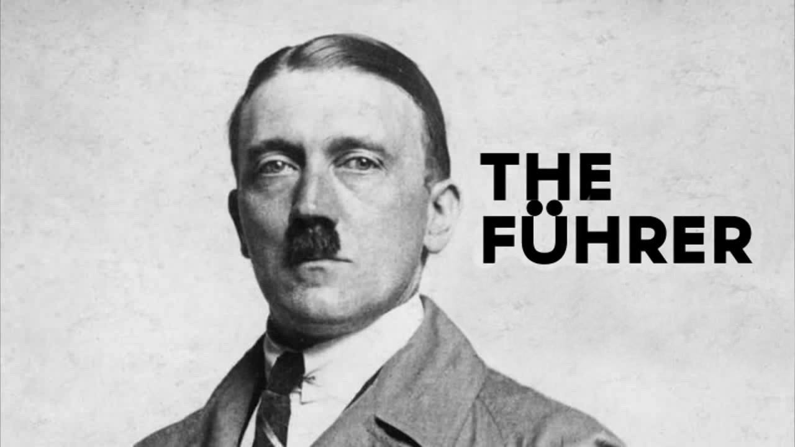

Slide 32
Matthew 5:13
“You are the salt of the earth”

