Slide 2
JUDGES 9
Abimelech

Slide 3
Gideon Recap
Met God face to face
Overcomes his lowly position in israel
Makes a sacrifice to God
Accepted his calling
Destroys the altar of Baal
Summons an Army
Faithfully lets 99% of the army go
Defeats 135,000 Midianites
Kills the two kings of Midian

Slide 4
Judges 8:23
Gideon said to them, "I will not rule over you, and my son will not rule over you; the LORD will rule over you."

Slide 5
1,700 Shekels of Gold
1,700 Shekels of gold = 43-70lbs
(depending on era)
Guzik - Over 50lbs
Clark - 70lbs, 10oz
As of 8/14/2019:
43lbs of Gold = $1,033,754.40
70lbs of Gold = $1,682,856.00

Slide 6
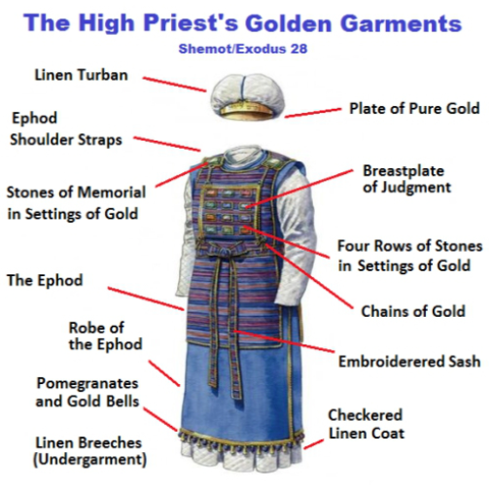

Slide 7
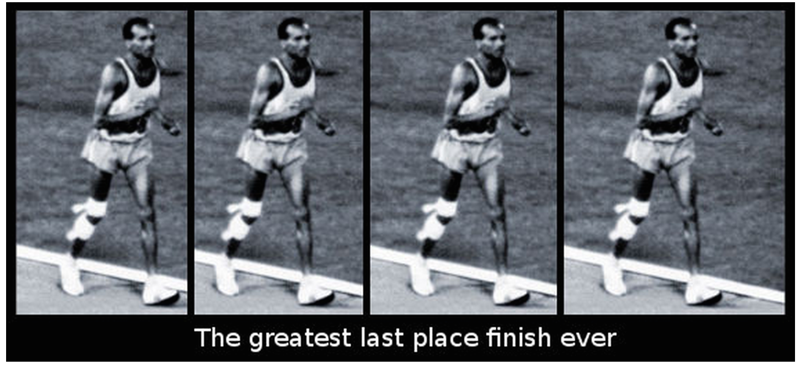
John Stephen Akhwari

Slide 8
Deuteronomy 17:17
And he shall not acquire many wives for himself, lest his heart turn away,
nor shall he acquire for himself excessive silver and gold.

Slide 9
"One false step of a good man leads multitudes astray"

Slide 10
“Give me five minutes with a person's checkbook, and I will tell you where their heart is.”
-Billy Graham

Slide 11
Monthly Supports
ACTS-SR
Baptist Village
CC Githurai Kenya
City Rescue Mission
Far Reaching Ministries
His Truth Transforms
Love Link Ministries (June, 2019)
Global Hope Network Int
Shepherd’s Staff
Syndeo Ministries
Village Ministries Int
Voice Of The Martyrs
Crossroads Clinic

Slide 12
Missions
Operation Christmas Child
Care Center Ministries
VBS Hands & Feet Outreach
Kenya Missions - CC Githurai
Mexico Missions
Numerous Missionaries from CCOKC

Slide 13
Special Events
Oklahoma Calvary Ministry Gathering
Pastor & Leaders Conference
Baptism
Men’s Retreat: Plano
Fusion Conference
Women’s Retreat: CC Wichita

Slide 15
Olive Tree
"The trees once went forth to anoint a king over them. And they said to the olive tree, 'Reign over us!'
But the olive tree said to them, 'Should I cease giving my oil, With which they honor God and men, And go to sway over trees?

Slide 16
Fig Tree
"Then the trees said to the fig tree, 'You come and reign over us!'
But the fig tree said to them, 'Should I cease my sweetness and my good fruit, And go to sway over trees?'

Slide 17
The Vine
"Then the trees said to the vine, 'You come and reign over us!'
But the vine said to them, 'Should I cease my new wine, Which cheers both God and men, And go to sway over trees?'

Slide 18
The Bramble
"Then all the trees said to the bramble, 'You come and reign over us!'
And the bramble said to the trees, 'If in truth you anoint me as king over you, Then come and take shelter in my shade; But if not, let fire come out of the bramble And devour the cedars of Lebanon!'

Slide 19
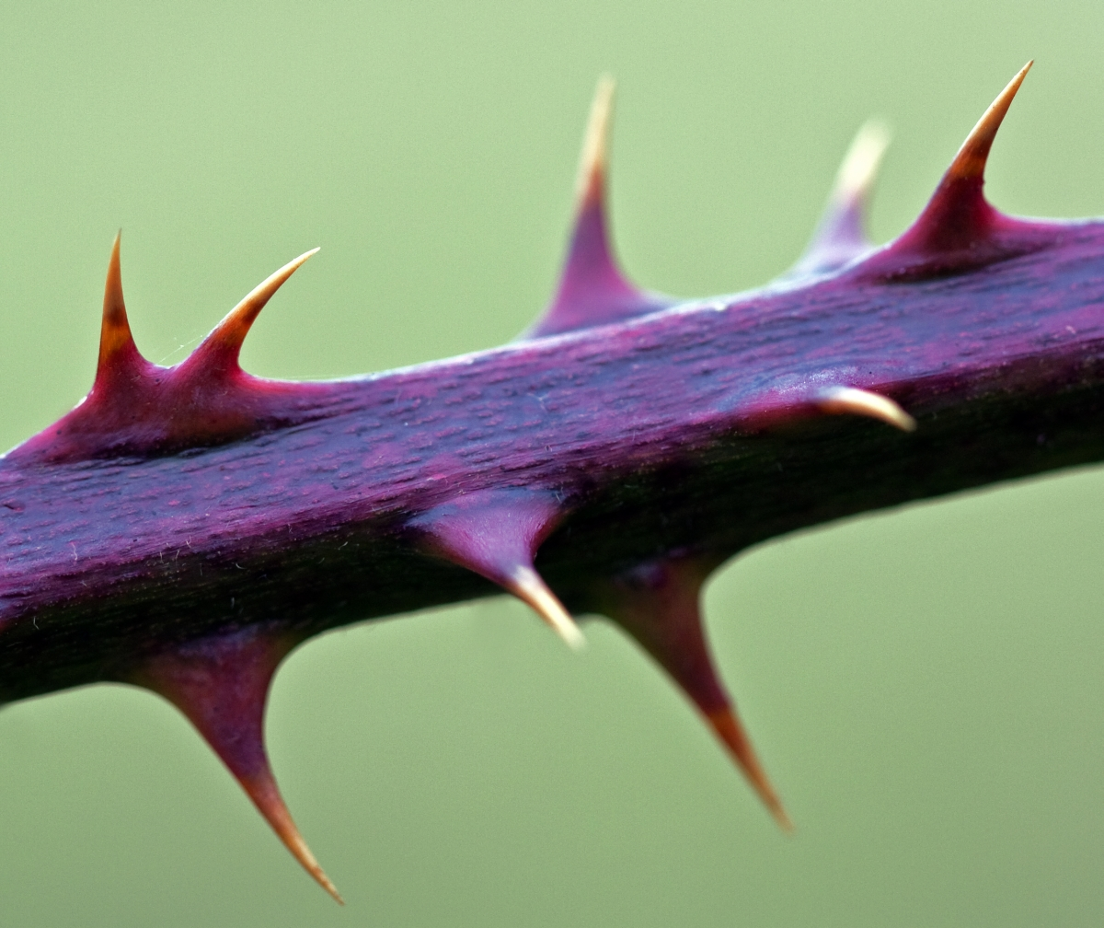

Slide 22
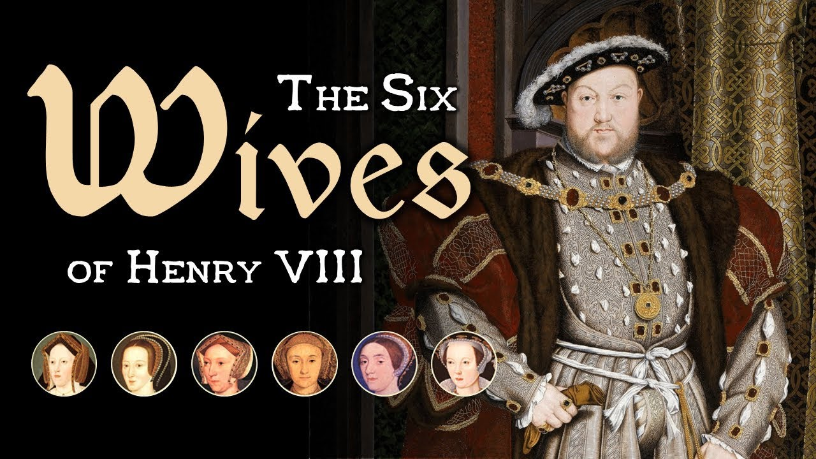

Slide 23
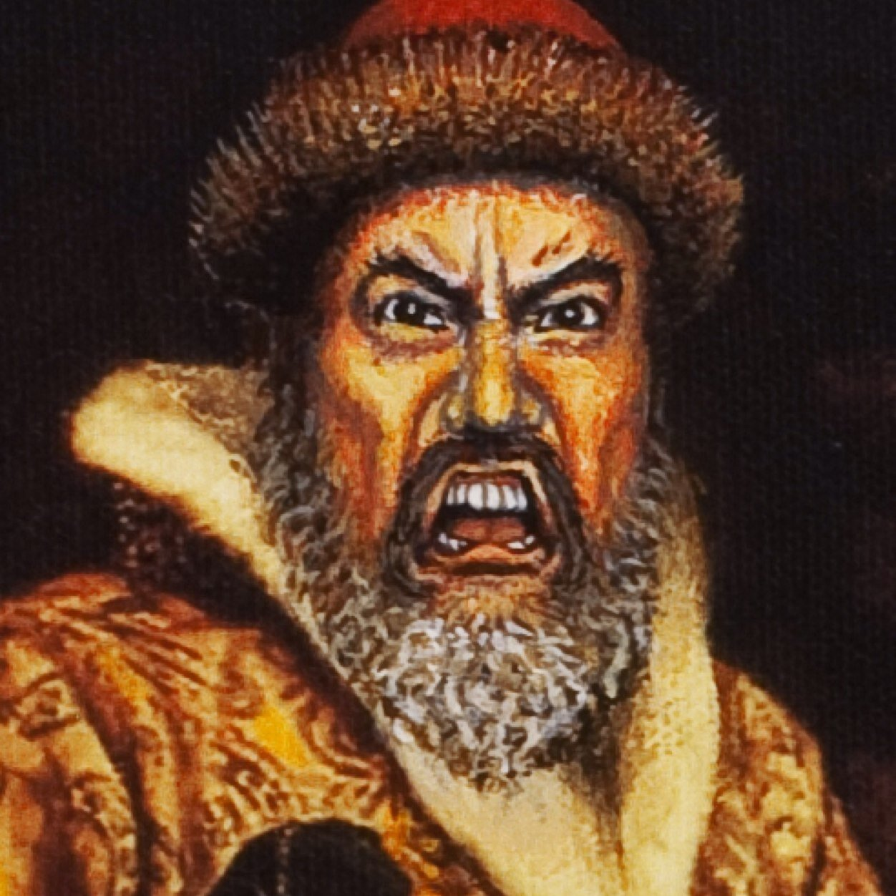

Slide 24
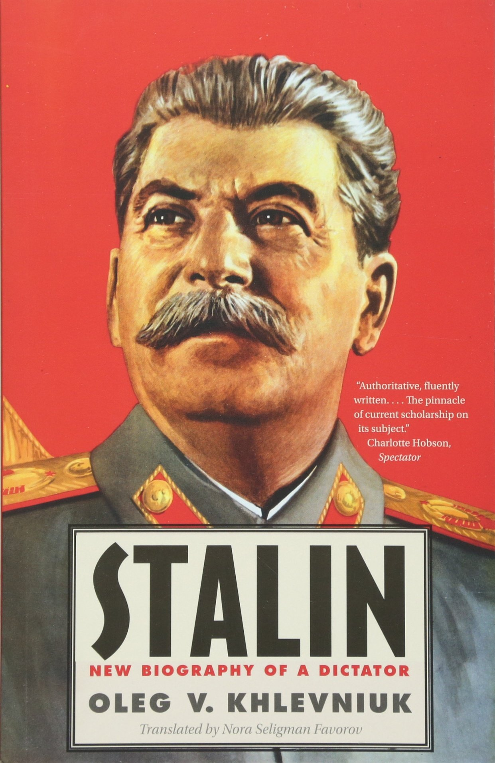

Slide 25
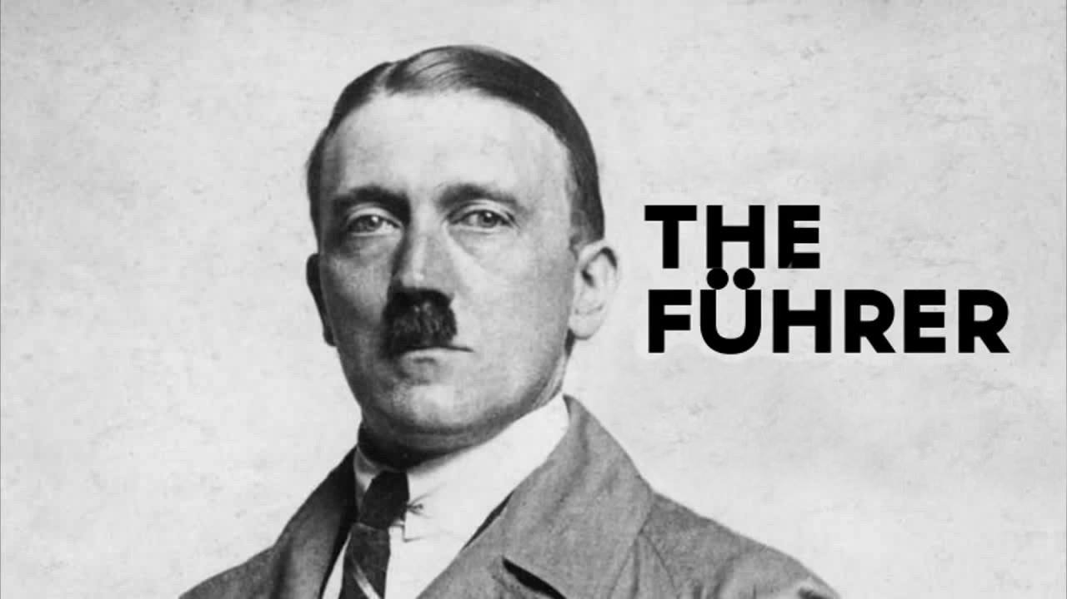

Slide 27
Matthew 5:13
“You are the salt of the earth”

