Slide 2
JUDGES 4-5
Deborah
&
Barak

Slide 3
“Learn from the mistakes of others. You can’t live long enough to make them all yourself.”
- Eleanor Roosevelt

Slide 4
“You have to make mistakes to find out who you aren’t.”
-Anne Lamott

Slide 5
“Mistakes are a fact of life. It is the response to error that counts.”
- Nikki Giovanni

Slide 6
Jdg 4:1 When Ehud was dead, the children of Israel again did evil in the sight of the LORD.

Slide 7
Circle of Death… again
5
1
4
2
3

Slide 8
Jdg 4:3 And the children of Israel cried out to the LORD; for Jabin had nine hundred chariots of iron, and for twenty years he had harshly oppressed the children of Israel.

Slide 9
Judges 1:19
And the LORD was with Judah, and he took possession of the hill country, but he could not drive out the inhabitants of the plain because they had chariots of iron.

Slide 11
Jos 11:1 When Jabin, king of Hazor, heard of this...
1- he sent to Jobab king of Madon,
2- and to the king of Shimron,
3- and to the king of Achshaph,
4- and to the kings who were in the northern hill country,
5- and in the Arabah south of Chinneroth,
6- and in the lowland,
7- and in Naphoth-dor on the west,
8- to the Canaanites in the east
9- and the west,
10- the Amorites,
11- the Hittites,
12- the Perizzites,
13- and the Jebusites in the hill country,
14- and the Hivites under Hermon in the land of Mizpah

Slide 12
Joshua 11- King Jabin
Jos 11:4 And they came out with all their troops, a great horde, in number like the sand that is on the seashore, with very many horses and chariots.
Jos 11:5 And all these kings joined their forces and came and encamped together at the waters of Merom to fight against Israel.

Slide 13
Joshua 11- King Jabin
Jos 11:6 And the LORD said to Joshua, "Do not be afraid of them, for tomorrow at this time I will give over all of them, slain, to Israel. You shall hamstring their horses and burn their chariots with fire."

Slide 15
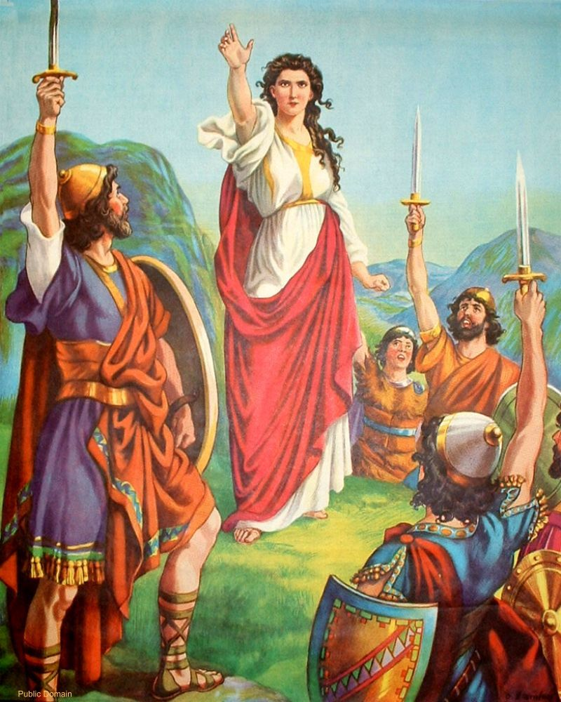

Slide 16
Jdg 4:5 And she would sit under the palm tree of Deborah between Ramah and Bethel in the mountains of Ephraim. And the children of Israel came up to her for judgment.

Slide 17
Deborah’s Prophecy
"Has not the LORD God of Israel commanded, 'Go and deploy troops at Mount Tabor; take with you ten thousand men of the sons of Naphtali and of the sons of Zebulun; and against you I will deploy Sisera, the commander of Jabin's army, with his chariots and his multitude at the River Kishon; and I will deliver him into your hand'?"

Slide 18
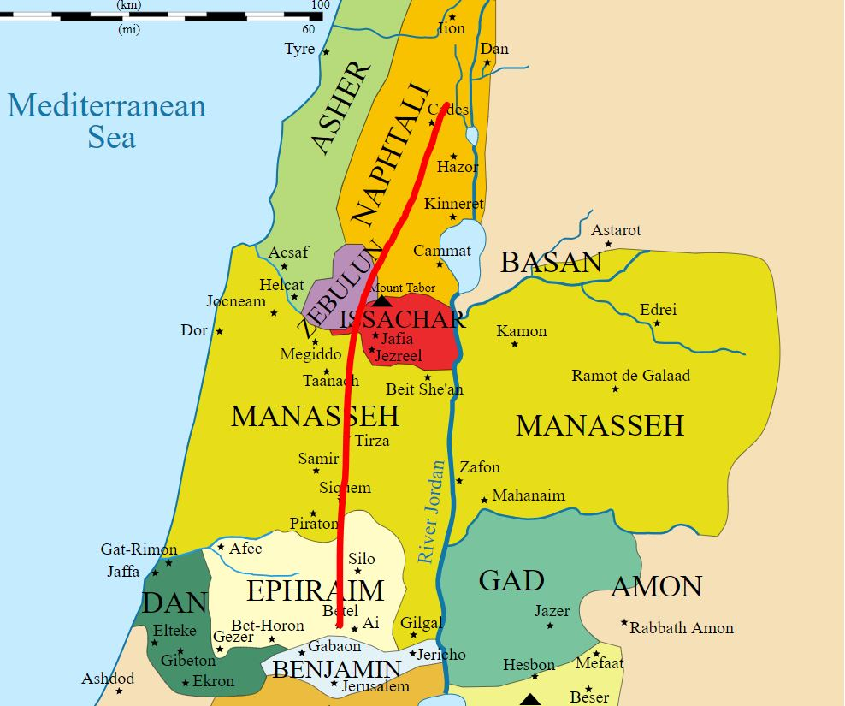

Slide 19
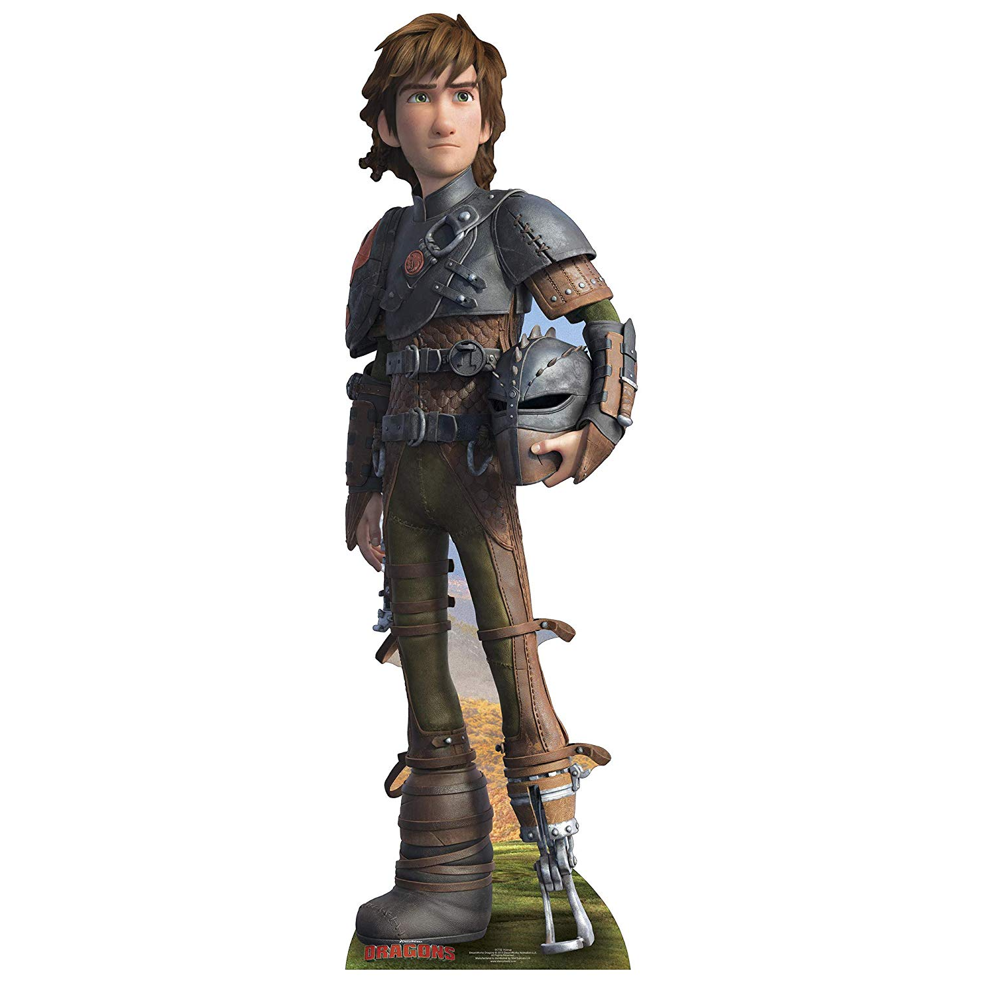

Slide 20
Deborah & Jabin
DEBORAH Judge of Israel | Jabin King of Canaan
BARAK Military Commander | SISERA Military Commander

Slide 21
Ḥeḇer: dirty rat

Slide 22
Then Deborah said to Barak,
“Up!”
“For this is the day in which the LORD has delivered Sisera into your hand.
Has not the LORD gone out before you?"

Slide 23
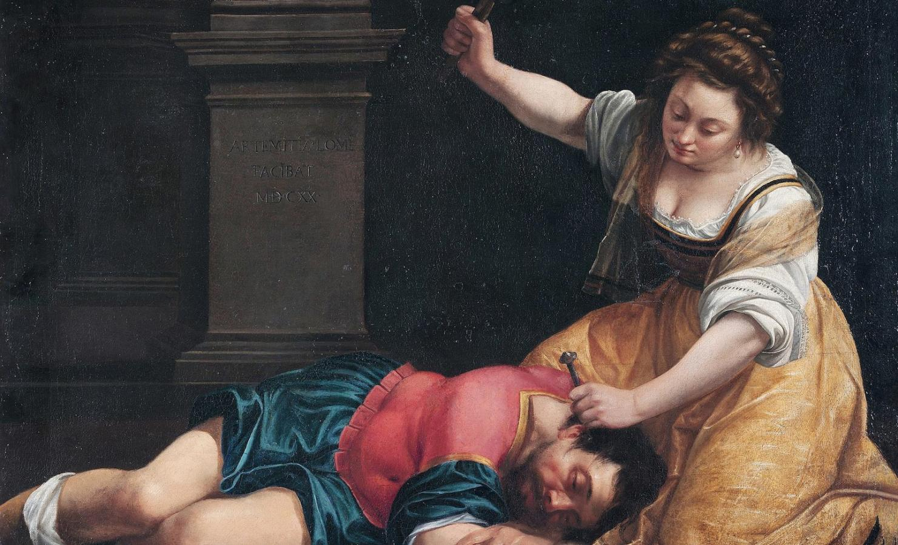

Slide 24
Jdg 4:24 And the hand of the children of Israel grew stronger and stronger against Jabin king of Canaan, until they had destroyed Jabin king of Canaan.

Slide 25
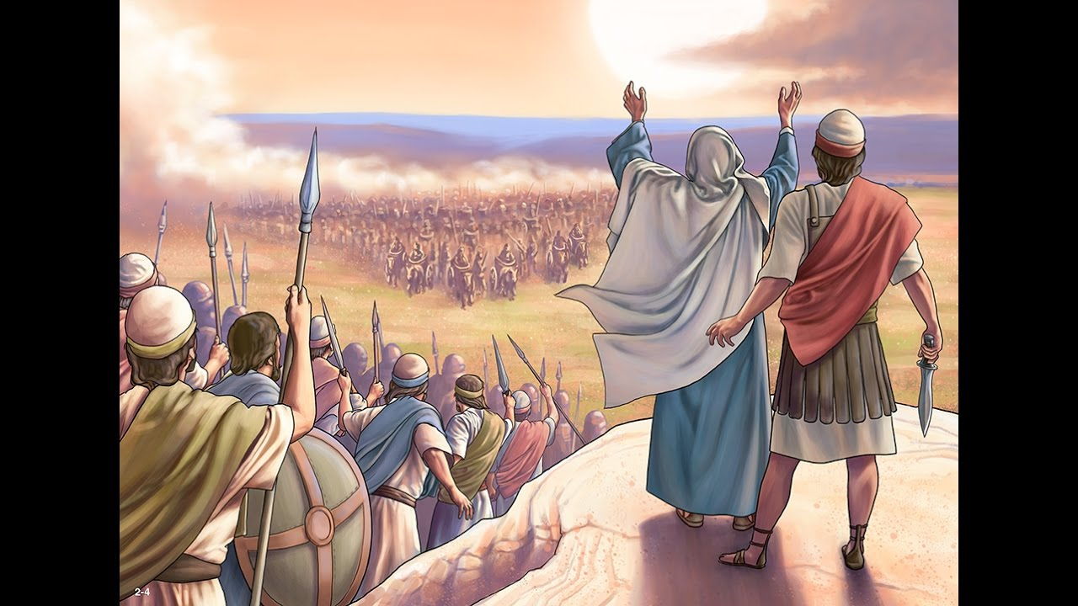

Slide 26
Matthew 21:28-31
A man had two sons, and he came to the first and said, 'Son, go, work today in my vineyard.'
He answered and said, 'I will not,' but afterward he regretted it and went.
Then he came to the second and said likewise. And he answered and said, 'I go, sir,' but he did not go.
Which of the two did the will of his father?"

Slide 27
Hâmam:
to disturb, destroy: - break, consume, crush, trouble

Slide 28
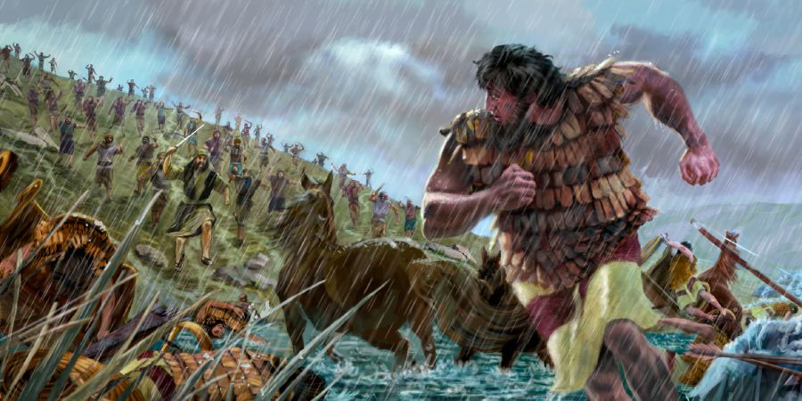

Slide 29
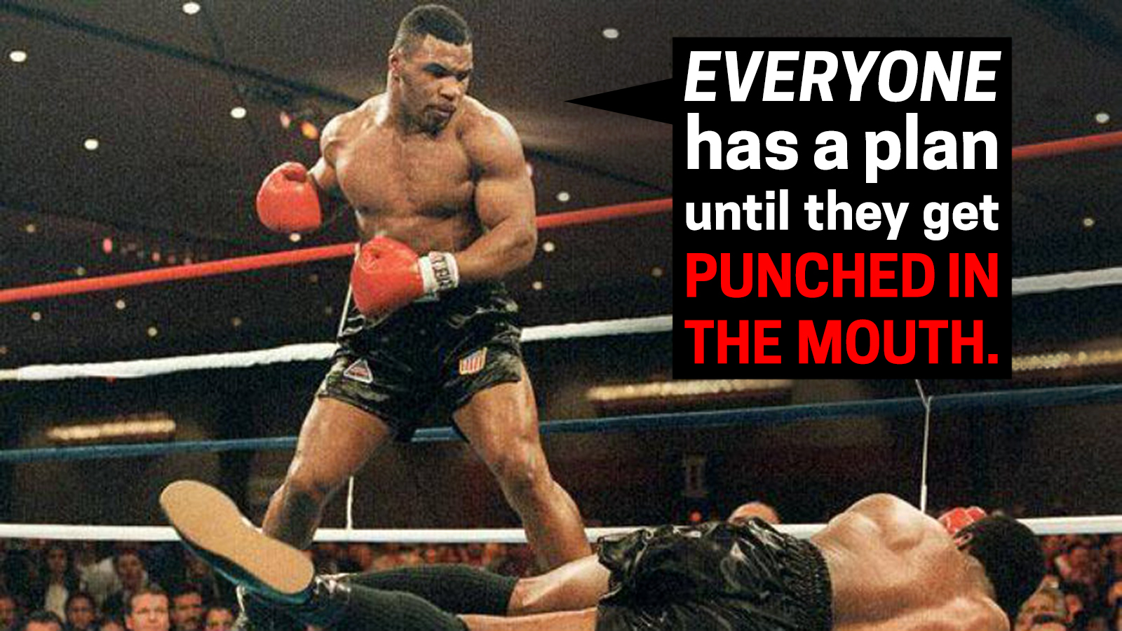

Slide 30
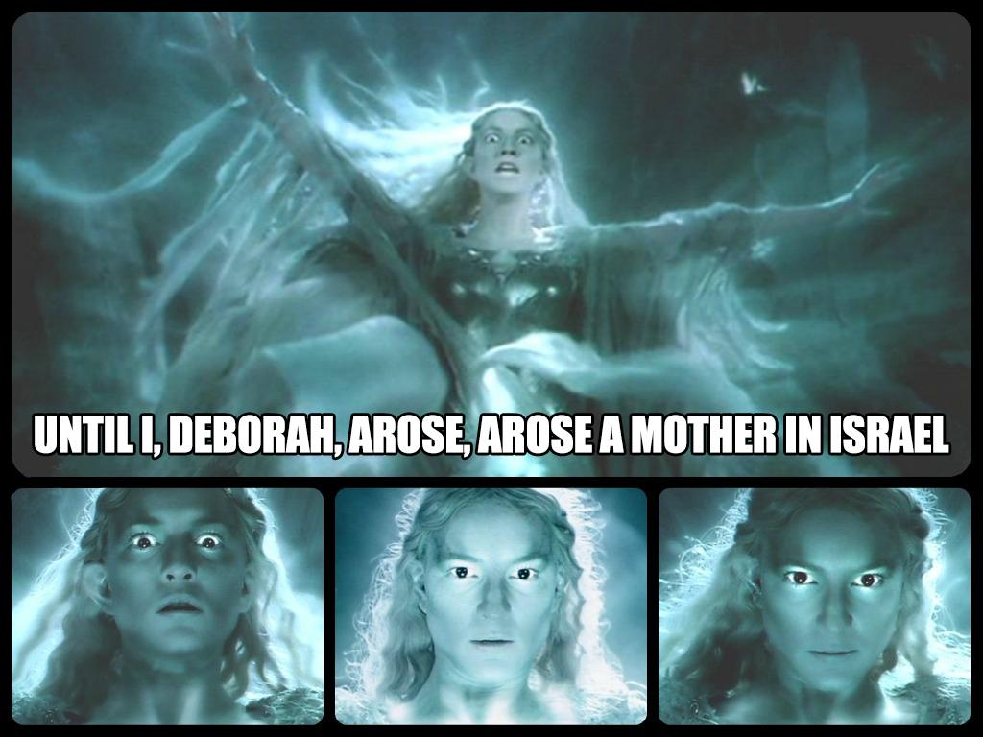

Slide 31
Single Mothers
“Today 1 in 4 children under the age of 18 — a total of about 16.4 million — are being raised without a father.”
“Single motherhood has grown so common in America that today 80 percent of single-parent families are headed by single mothers”

Slide 32
“In a child's eyes, a mother is a goddess. She can be glorious or terrible, benevolent or filled with wrath, but she commands love either way.
I am convinced that this is the greatest power in the universe.”

Slide 33
Judges 5:31
"Thus let all Your enemies perish, O LORD!
But let those who love Him be like the sun When it comes out in full strength."
So the land had rest for forty years.

