Slide 1
JUDGES 3
recap

Slide 2
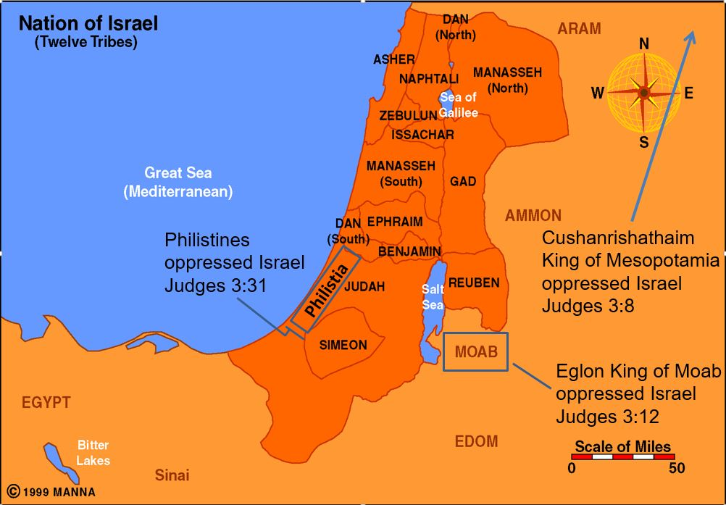

Slide 3
Testing of our Faith
1Pe 1:6 In this you greatly rejoice, though now for a little while, if need be, you have been grieved by various trials,
1Pe 1:7 that the genuineness of your faith, being much more precious than gold that perishes, though it is tested by fire, may be found to praise, honor, and glory at the revelation of Jesus Christ,

Slide 4
Israel is being tested
Jdg 3:4 And they were left, that He might test Israel by them, to know whether they would obey the commandments of the LORD, which He had commanded their fathers by the hand of Moses.

Slide 5
What is our faith producing
Jas 1:2 My brethren, count it all joy when you fall into various trials,
Jas 1:3 knowing that the testing of your faith produces patience.
Jas 1:4 But let patience have its perfect work, that you may be perfect and complete, lacking nothing.

Slide 6
What is our faith producing
Rom 5:3 And not only that, but we also glory in tribulations, knowing that tribulation produces perseverance;
Rom 5:4 and perseverance, character; and character, hope.

Slide 7
Strike 1
Jdg 3:6 And they took their daughters to be their wives, and gave their daughters to their sons; and they served their gods.

Slide 8
Strike 2
Jdg 3:7 So the children of Israel did evil in the sight of the LORD. They forgot the LORD their God, and served the Baals and Asherahs.

Slide 9
"THE LORD WILL JUDGE HIS PEOPLE."
Jdg 3:8 Therefore the anger of the LORD was hot against Israel, and He sold them into the hand of Cushan-Rishathaim king of Mesopotamia; and the children of Israel served them eight years.

Slide 10
Israel’s First Judge: Othniel
Jdg 3:9 When the children of Israel cried out to the LORD, the LORD raised up a deliverer for the children of Israel, who delivered them: Othniel the son of Kenaz, Caleb's younger brother.
Jdg 3:10 The Spirit of the LORD came upon him, and he judged Israel. He went out to war, and the LORD delivered the king of Mesopotamia into his hand; and his hand prevailed.

Slide 11
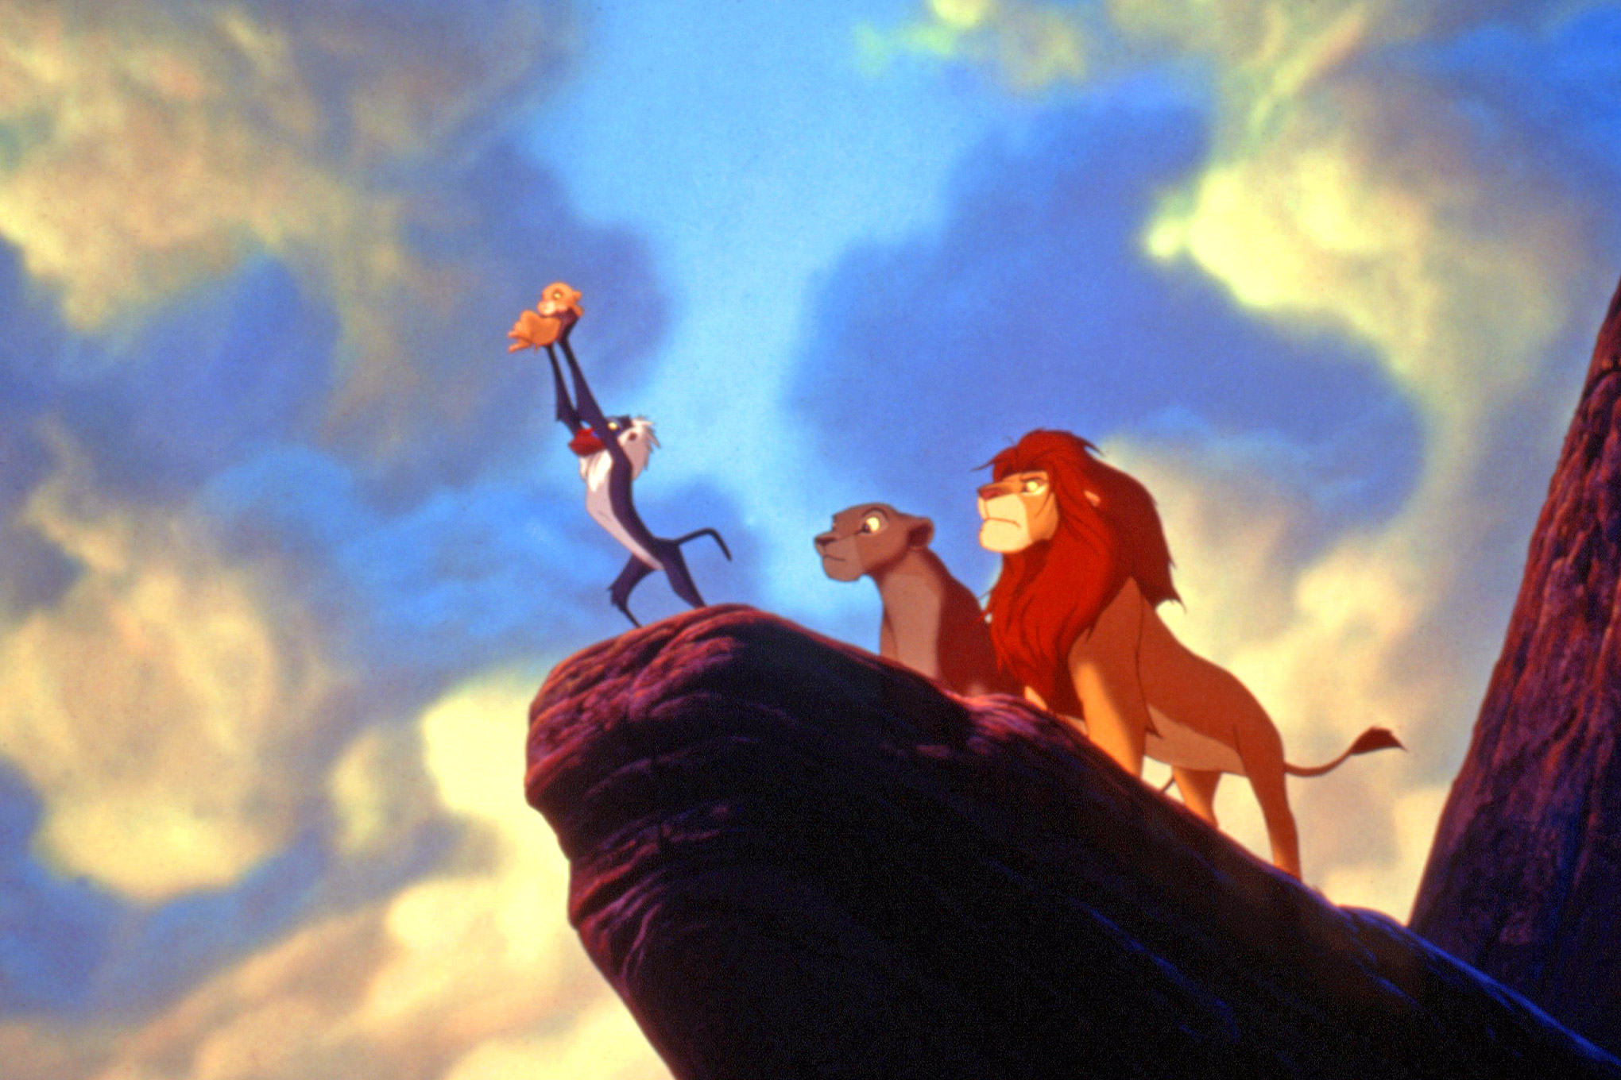
Disney = Circle of Life

Slide 12
Judges = Circle of Death
Jas 1:15 Then, when desire has conceived, it gives birth to sin; and sin, when it is full-grown, brings forth death.
1- Sin: turning from God
2- Oppression: a life conquered by sin
3- Repentance: turning to God
4- Deliverance: God sends a deliverer
5- Peace

Slide 13
Judges = Circle of Death
Jas 1:15 Then, when desire has conceived, it gives birth to sin; and sin, when it is full-grown, brings forth death.
1- Sin: turning from God
2- Oppression: a life conquered by sin
3- Repentance: turning to God
4- Deliverance: God sends a deliverer
5- Peace

Slide 14
Ehud
Jdg 3:15 But when the children of Israel cried out to the LORD, the LORD raised up a deliverer for them: Ehud the son of Gera, the Benjamite, a left-handed man. By him the children of Israel sent tribute to Eglon king of Moab.

Slide 15
Idiom
Cross your fingers - For good luck.
Fell on deaf ears - People wouldn't listen
Get cold feet - to be nervous.
Giving the cold shoulder - Ignore someone.
Have a change of heart - Changed your mind.
I'm all ears - You have my full attention.
It cost an arm and a leg - It was expensive.

Slide 16
Idiom
Cross your fingers - For good luck.
Fell on deaf ears - People wouldn't listen
Get cold feet - to be nervous.
Giving the cold shoulder - Ignore someone.
Have a change of heart - Changed your mind.
I'm all ears - You have my full attention.
It cost an arm and a leg - It was expensive.

Slide 17
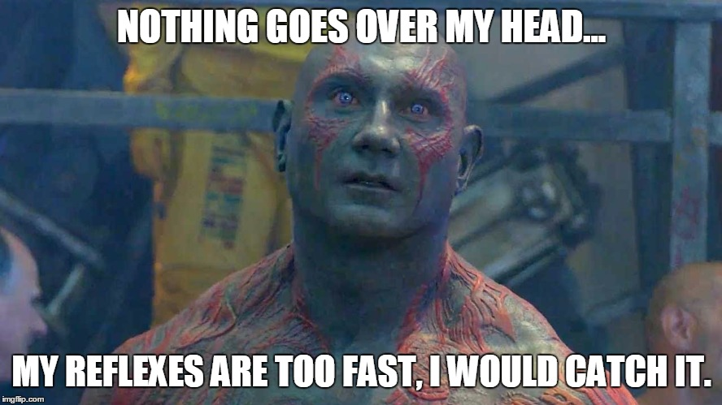
Idiom

Slide 18
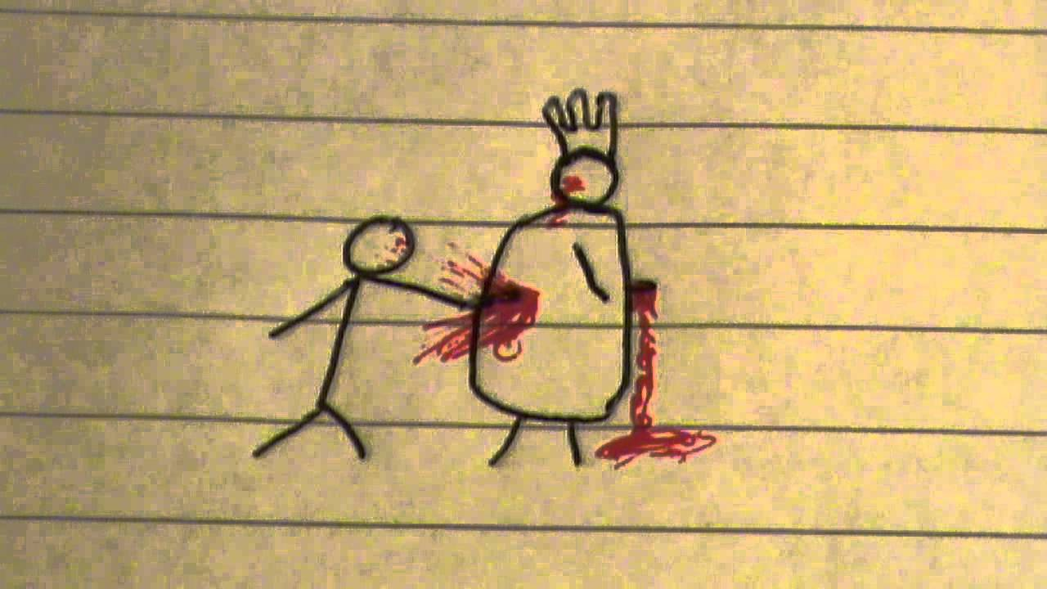
eh-hOOd
Cross your fingers - For good luck.
Fell on deaf ears - People wouldn't listen
Get cold feet - to be nervous.
Giving the cold shoulder - Ignore someone.
Have a change of heart - Changed your mind.
I'm all ears - You have my full attention.
It cost an arm and a leg - It was expensive.

Slide 19
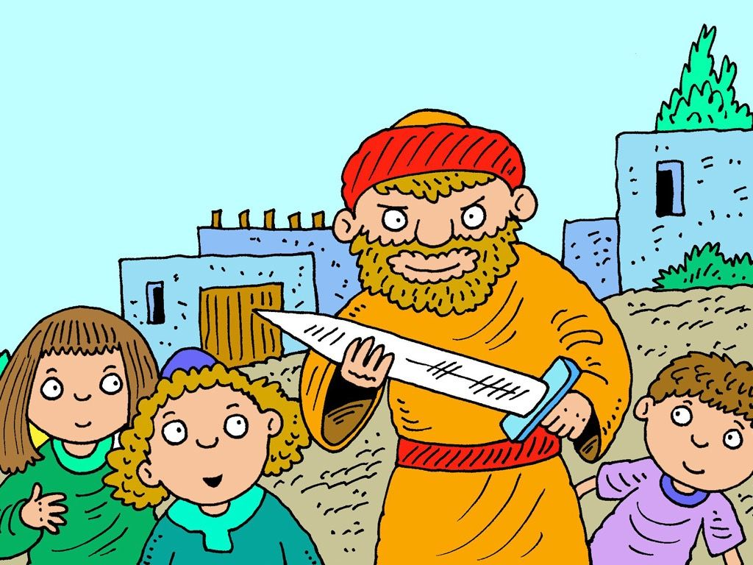
eh-hOOd

Slide 20
eh-hOOd

Slide 21
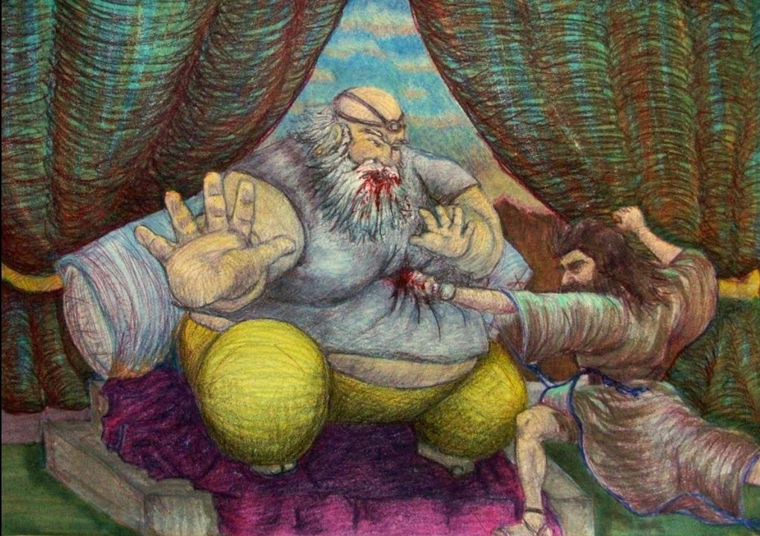
eh-hOOd

Slide 22
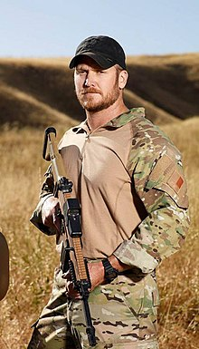
Chris Kyle "Devil of Ramadi "
Insurgents placed an $80,000 bounty for his head
"The Pentagon has officially confirmed more than 150 of Kyle's kills
in 2008, outside Sadr City, he killed an insurgent sniper aiming at other members of the US military with "a straight-up luck shot" from his McMillan TAC-338 sniper rifle from about 2,100 yards

Slide 23
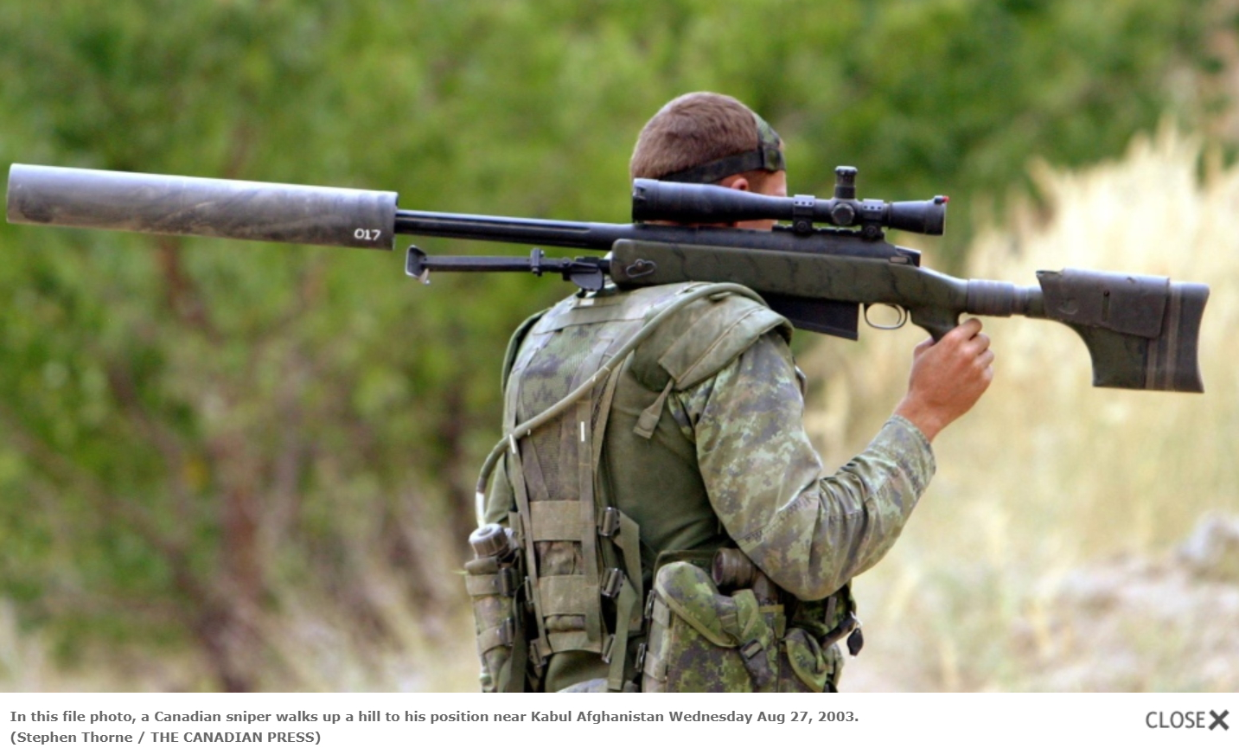
McMillan TAC-50

Slide 24
Shamgar
Jdg 3:31 After him was Shamgar the son of Anath, who killed six hundred men of the Philistines with an ox goad; and he also delivered Israel.

Slide 25
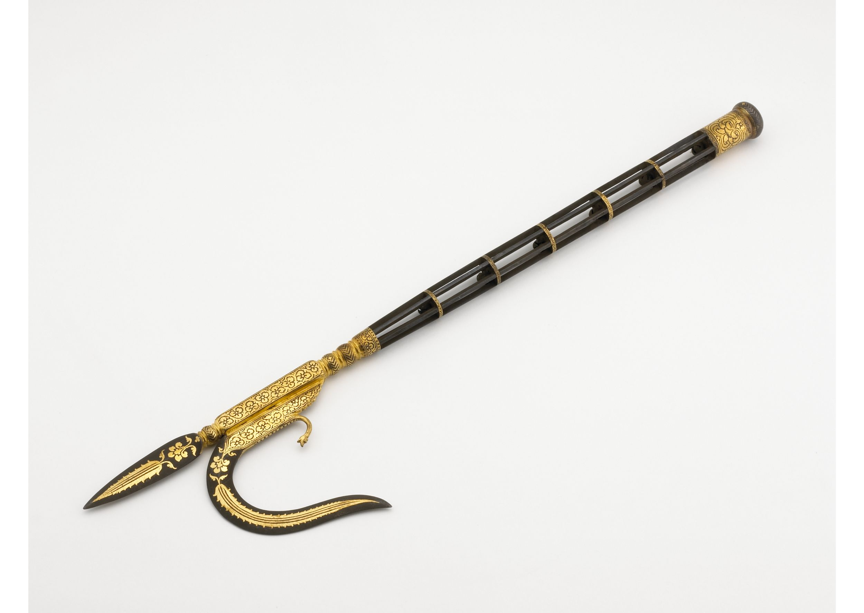
Shamgar

Slide 26
Shamwow
Jdg 3:31 After him was Shamgar the son of Anath, who killed six hundred men of the Philistines with an ox goad; and he also delivered Israel.

Slide 27
