Slide 1
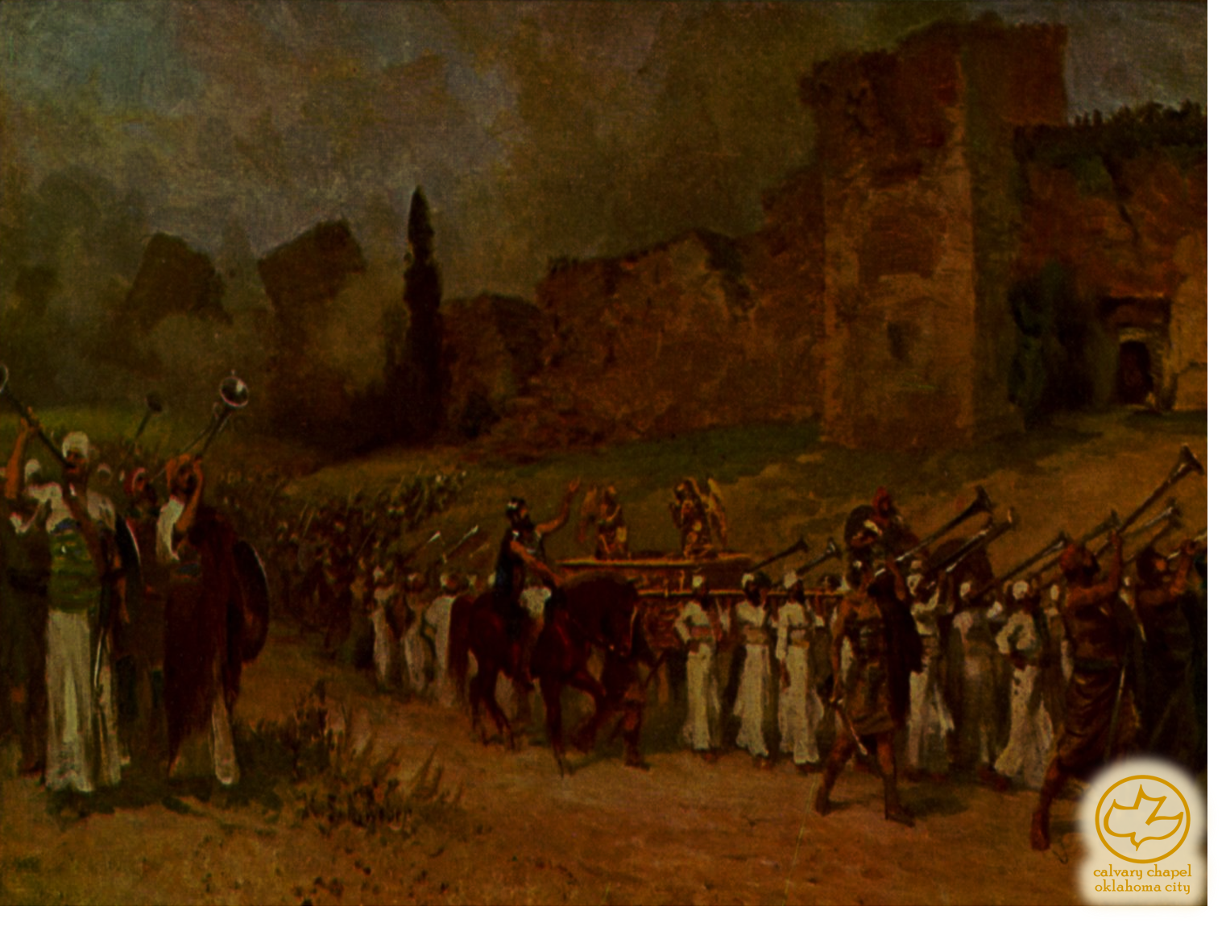

J
oshua 02-03
A CD of this message will be available (free of charge) immediately following the service.
It will also be available for podcast later this week at calvaryokc.com

Slide 2
Joshua 02-03
13.5'
6'

Slide 3
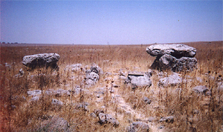
Joshua 02-03
Dolmens
12-15’

Slide 4
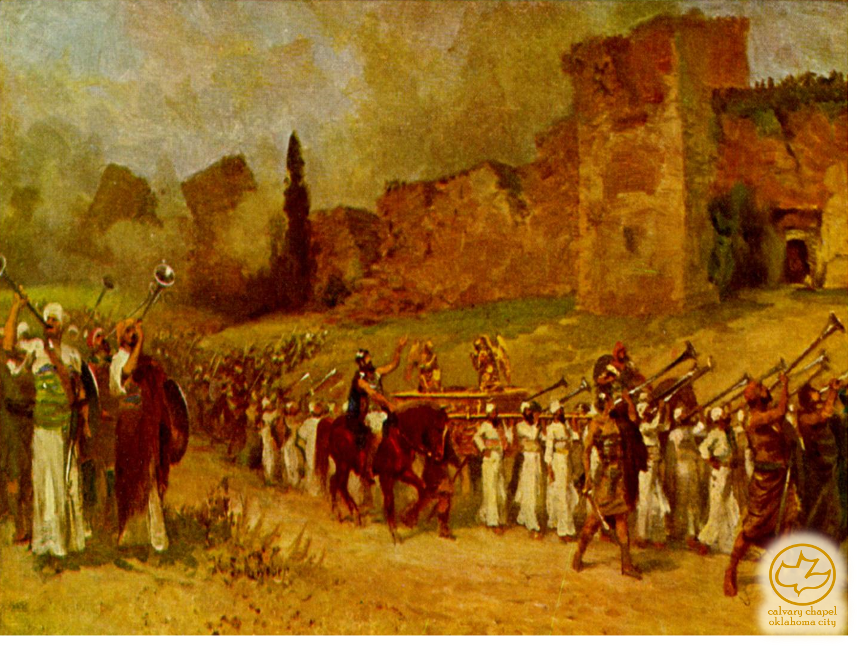
Joshua 02-03

Slide 5
Joshua 02-03
Alan Redpath ~ "Sometimes in the course of human experience it is good to sit down and reflect on what has been conquered by the grace of God."

Slide 6
Joshua 02-03

Slide 7
Joshua 02-03
Advanced ~ KJV, stricken

Slide 8
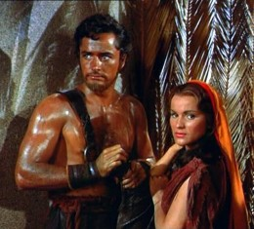
Joshua 02-03

Slide 9
Joshua 02-03

Slide 10
Joshua 02-03
Ex. 23:27-30 ~ ²⁷ I will send My fear before you, I will cause confusion among all the people to whom you come, and will make all your enemies turn their backs to you. ²⁸ And I will send hornets before you, which shall drive out the Hivite, the Canaanite, and the Hittite from before you. ²⁹ I will not drive them out from before you in one year, lest the land become desolate and the beasts of the field become too numerous for you. ³⁰ Little by little I will drive them out from before you, until you have increased, and you inherit
the land.

Slide 11
Joshua 02-03

Slide 12
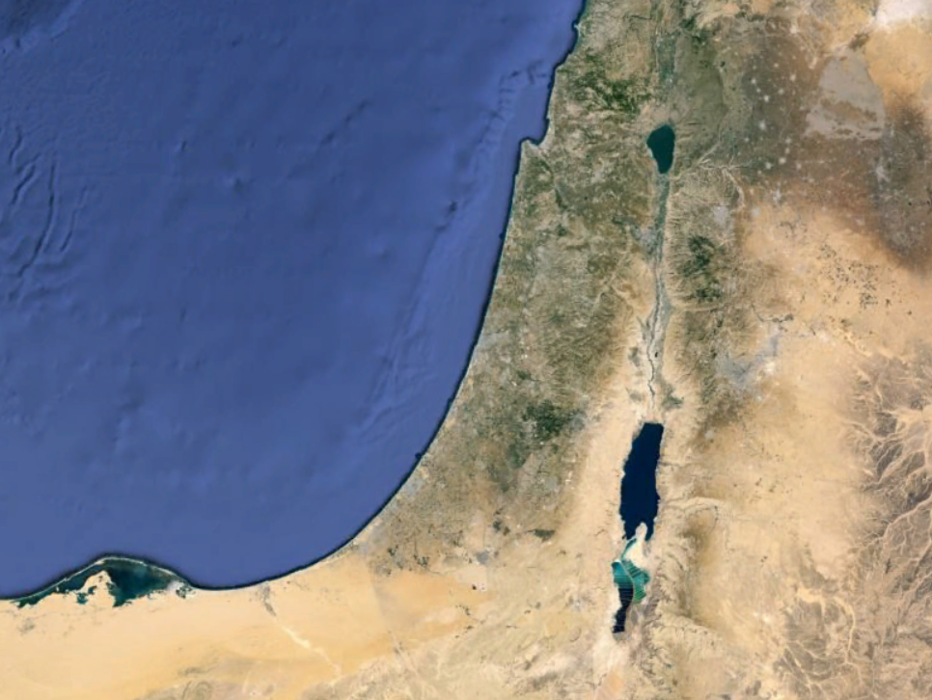
Joshua 02-03
BASHAN
MANASSEH
GILEAD
GAD
AMMON
REUBEN
MOAB
EDOM

Slide 13
Joshua 02-03

Slide 14
Joshua 02-03
Prov. 16:33 ~ The lot is cast into the lap, But its every decision is from the Lord.

Slide 15
Joshua 02-03

Slide 16
Joshua 02-03
MANASSEH
GAD
Hebron
REUBEN

Slide 17
Joshua 02-03

