Slide 1
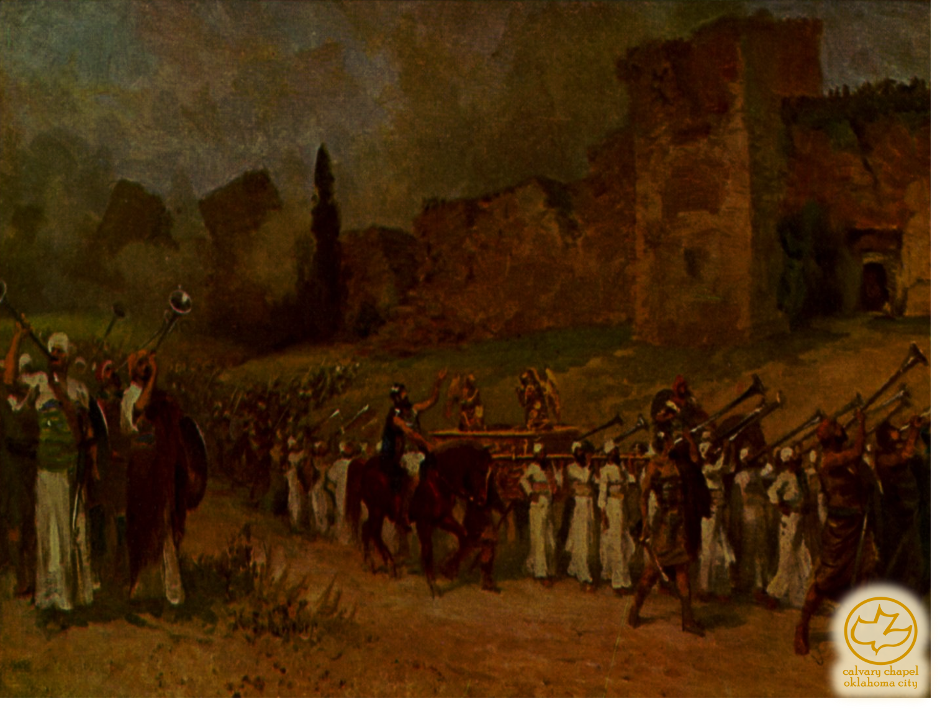

J
oshua 08-09
A CD of this message will be available (free of charge) immediately following the service.
It will also be available for podcast later this week at calvaryokc.com

Slide 2
Joshua 08-09
Point of Sin
Point of Repentance

Slide 3
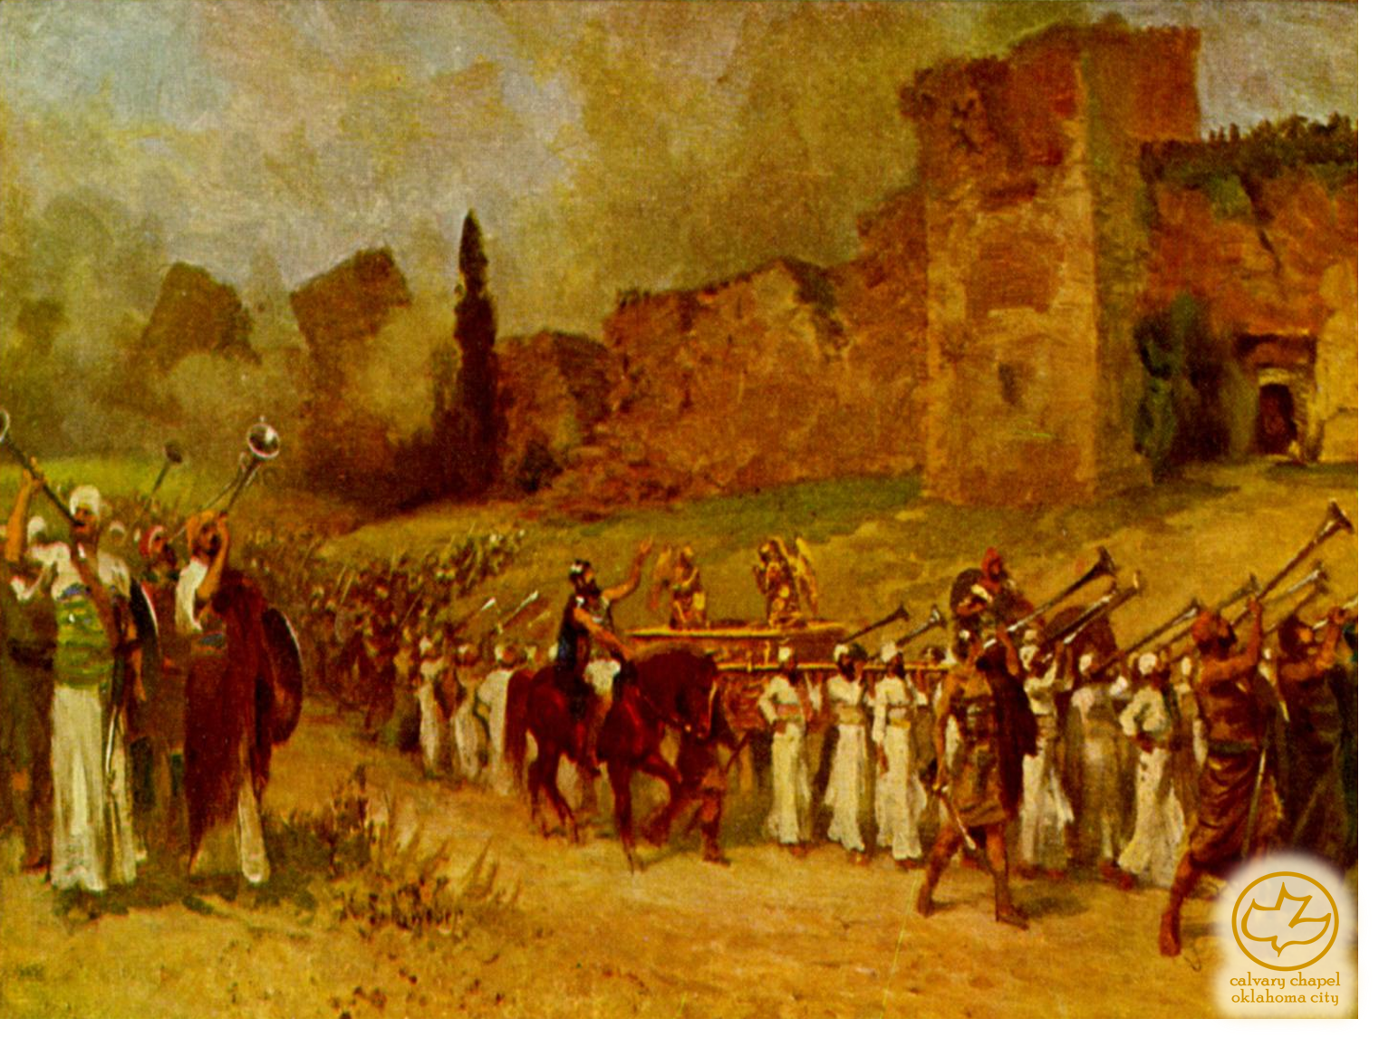
Joshua 08-09

Slide 4
Joshua 08-09
Phil. 3:3 ~ For we are the circumcision, who worship God in the Spirit, rejoice in Christ Jesus, and have no confidence in the flesh,

Slide 5
Joshua 08-09

Slide 6
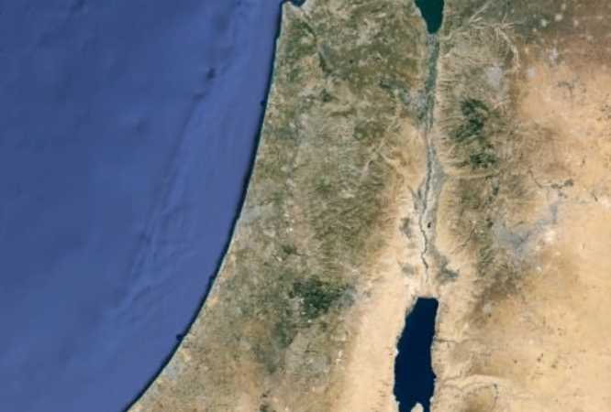
Joshua 08-09
Gerizim
Ebal
Bethel
Gilgal?
Ai
Jericho

Slide 7
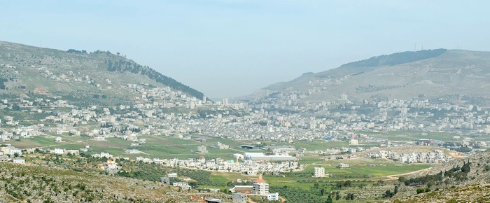
Joshua 08-09
Mt. Gerizim
Mt. Ebal

Slide 8
Joshua 08-09

Slide 9
Joshua 08-09

Slide 10
Joshua 08-09
Oh, what peace we often forfeit
Oh, what needless pain we bear
All because we do not carry
Everything to God in prayer
– Joseph Scriven (1868)

Slide 11
Joshua 08-09

Slide 12
Joshua 08-09
Bethel
Gilgal?
Ai
Gibeon
Jericho

Slide 13
Joshua 08-09

Slide 14
Joshua 08-09
Is. 61:3 ~ To console those who mourn in Zion,To give them beauty for ashes,The oil of joy for mourning,The garment of praise for the spirit of heaviness;

Slide 15
Joshua 08-09

Slide 16
Joshua 08-09
Ps. 84:10 ~ For a day in Your courts is better than a thousand.
I would rather be a doorkeeper in the house of my God
Than dwell in the tents of wickedness.

Slide 17
Joshua 08-09

