Slide 1
5:1-23

Slide 2
5:1-23
Pool of Bethesda
Sheep
Gate
East
Gate
Water
Gate
City of David
Refuse
Gate
Fountain
Gate
Wall in New Testament times
Present Old City Walls
Temple Mount

Slide 3
5:1-23

Slide 4
5:1-23
Bethesda ~ house of mercy

Slide 5
5:1-23

Slide 6
5:1-23
NASB footnote ~ "Early mss do not contain the remainder of v 3, nor v 4"
NIV footnote ~ "Some less important manuscripts paralyzed—and they waited for the moving of the waters. From time to time an angel of the Lord would come down and stir up the waters. The first one into the pool after each such disturbance would be cured of whatever disease he had."

Slide 7
5:1-23

Slide 8
5:1-23
John 3:2-3 ~ ² This man came to Jesus by night and said to Him, "Rabbi, we know that You are a teacher come from God; for no one can do these signs that You do unless God is with him."
³ Jesus answered and said to him, "Most assuredly, I say to you, unless one is born again, he cannot see the kingdom of God."
John 4:15-16 ~ ¹⁵ The woman said to Him, "Sir, give me this water, that I may not thirst, nor come here to draw."
¹⁶ Jesus said to her, "Go, call your husband, and come here."

Slide 9
5:1-23

Slide 10
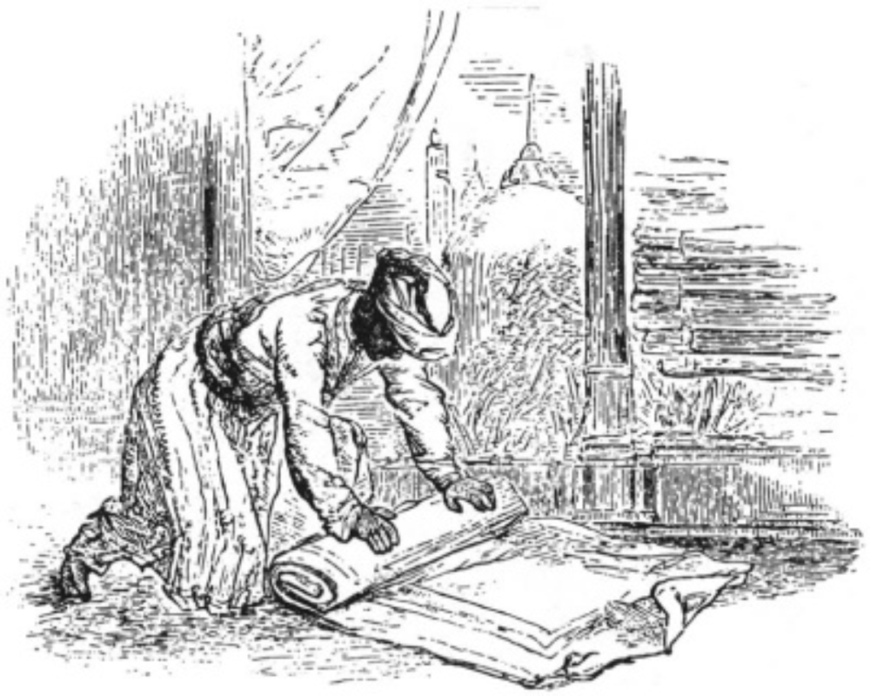
5:1-23

Slide 11
5:1-23

Slide 12
5:1-23
Col. 1:17 ~ And He is before all things, and in Him all things consist.

Slide 13
5:1-23

Slide 14
5:1-23
Not
But
the
My
Father

Slide 15
5:1-23

Slide 16
5:1-23
Most assuredly ~ Amēn, amēn

Slide 17
5:1-23

