Slide 1
4:25-54

Slide 2
4:25-54
I … am He ~ egō eimi
Literally “I am is speaking to you”

Slide 3
4:25-54

Slide 4
4:25-54
Psalm 40:8 ~ I delight to do Your will, O my God,
And Your law is within my heart.

Slide 5
4:25-54

Slide 6
4:25-54
Nobleman ~ basilikos – literally a king's man, or royal official

Slide 7
4:25-54

Slide 8
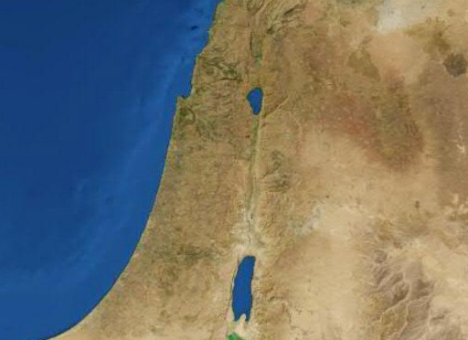
4:25-54
Capernaum
Cana
Jerusalem

Slide 9
4:25-54

Slide 10
4:25-54
Implored ~ imperfect tense – kept on asking

Slide 11
4:25-54

Slide 12
4:25-54
John 20:28 ~ And Thomas answered and said to Him, “My Lord and my God!”
John 20:29 ~ Jesus said to him, “Thomas, because you have seen Me, you have believed. Blessed are those who have not seen and yet have believed.”

Slide 13
4:25-54

