Slide 1
3:22-36

Slide 2
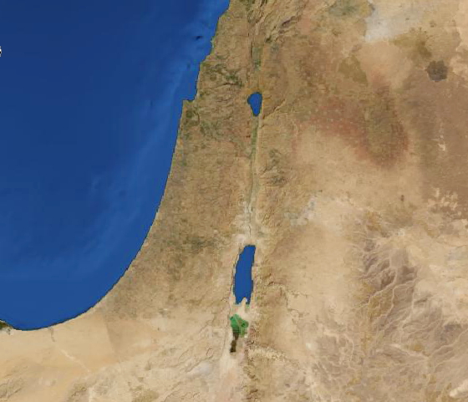
3:22-36
Aenon
Salim
Jerusalem

Slide 3
3:22-36

Slide 4
3:22-36
Dispute ~ zētēsis – KJV, a question
Jews ~ NIV, a certain Jew

Slide 5
3:22-36

Slide 6
3:22-36
Dei ~ it is necessary (3x in chapter 3)
(v. 7) You must be born again
(v. 14) Even so must the Son of Man be lifted up

Slide 7
3:22-36

Slide 8
3:22-36
The Water Song
Hear the summons night and day
Calling us to come away.
From the heights we leap and flow
Always answering to the call,
To the lowest place of all
Sweetest urge and sweetest pain,
To go low and rise again.
Come, oh come! Let us away –
Lower, lower every day,
Oh, what joy it is to race
Down to find the lowest place.
This is the dearest law we know –
"It is happy to go low."
Sweetest urge and sweetest will,
"Let us go down lower still."

Slide 9
3:22-36

