Slide 1
2:12-3:25

Slide 2
2:12-3:25
Noph and Tahpanhes ~ Egypt

Slide 3
2:12-3:25

Slide 4
2:12-3:25
Sihor ~ Nile
River ~ Euphrates

Slide 5
2:12-3:25

Slide 6
2:12-3:25
backsliding(s) ~ 8x in 2:12-3:35
Prov. 1:7 ~ The fear of the Lord is the beginning of knowledge,
Prov. 8:13 ~ The fear of the LORD is to hate evil,
Prov. 8:13 ~ The fear of the LORD the beginning of wisdom,

Slide 7
2:12-3:25

Slide 8
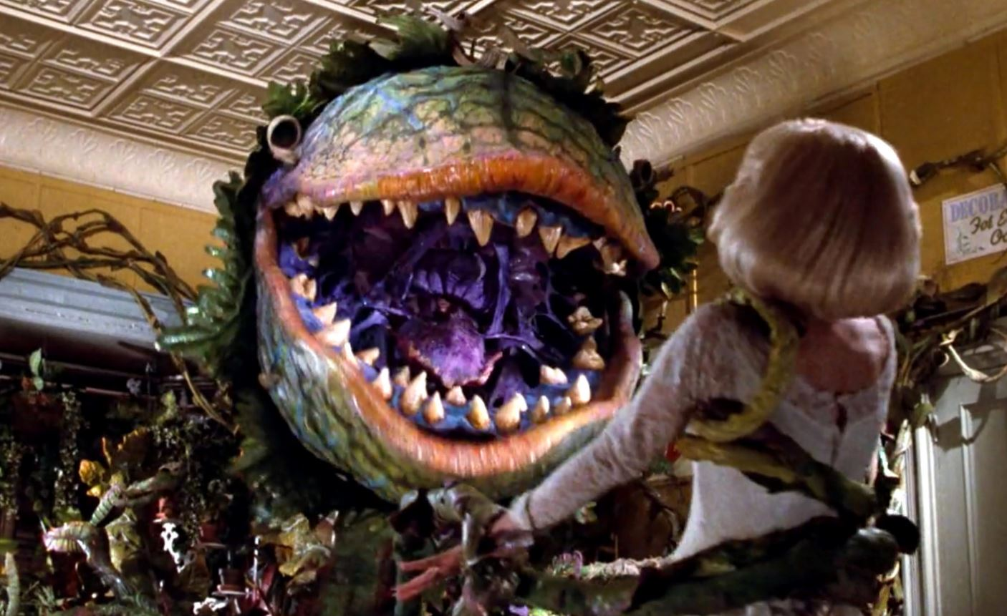
2:12-3:25
NIV, NLT ~ corrupt, wild vine
NASB ~ foreign vine
Audrey II

Slide 9
2:12-3:25

Slide 10
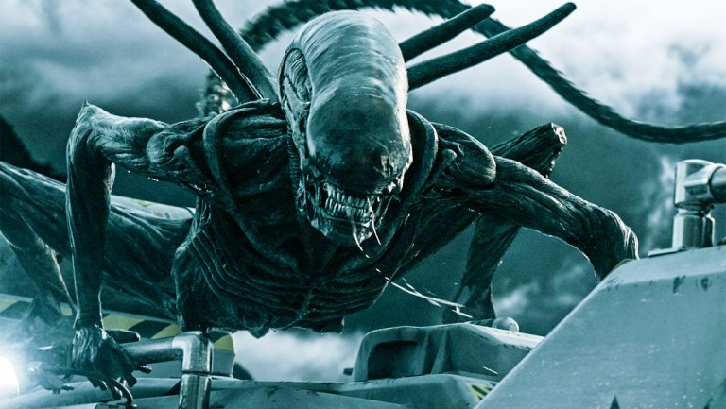
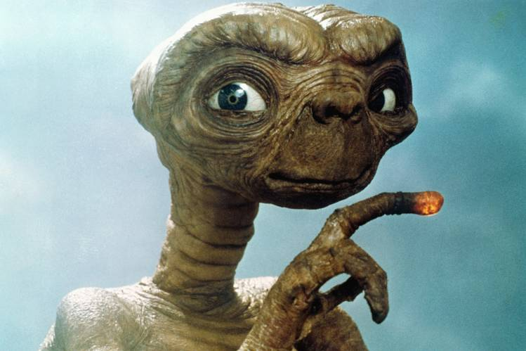
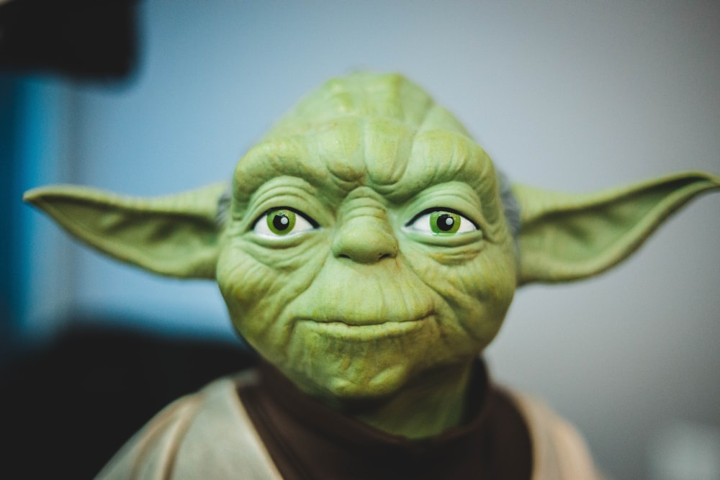
2:12-3:25

Slide 11
2:12-3:25
NLT ~ But you say, ‘Save your breath. I’m in love with these foreign gods, and I can’t stop loving them now!’

Slide 12
2:12-3:25

Slide 13
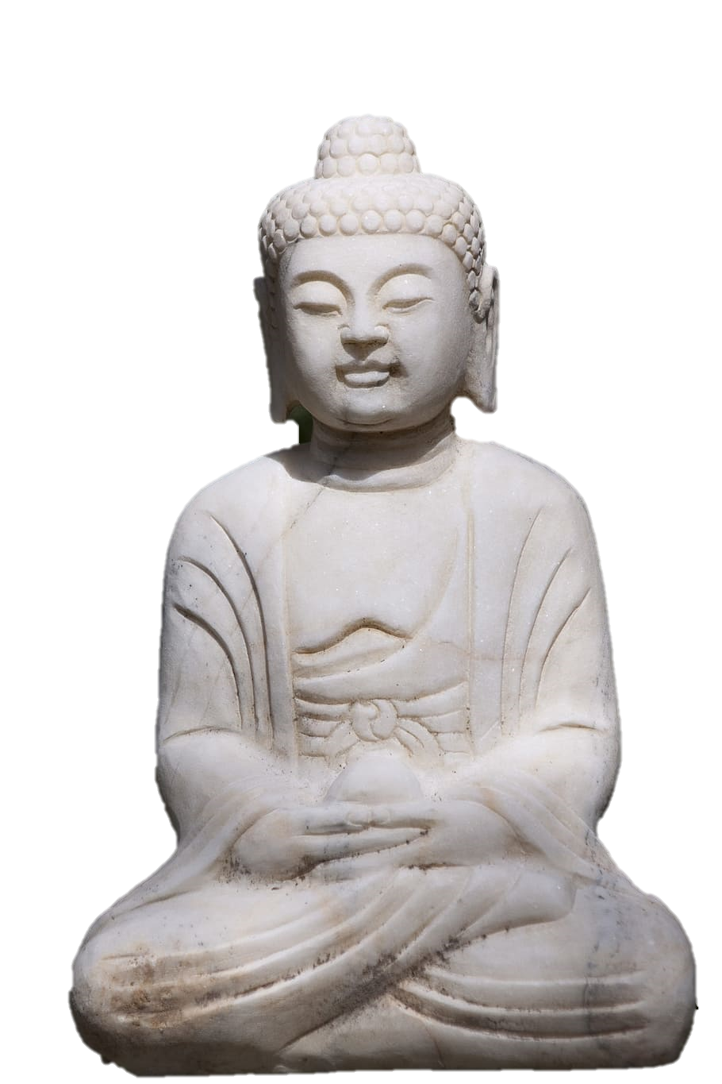
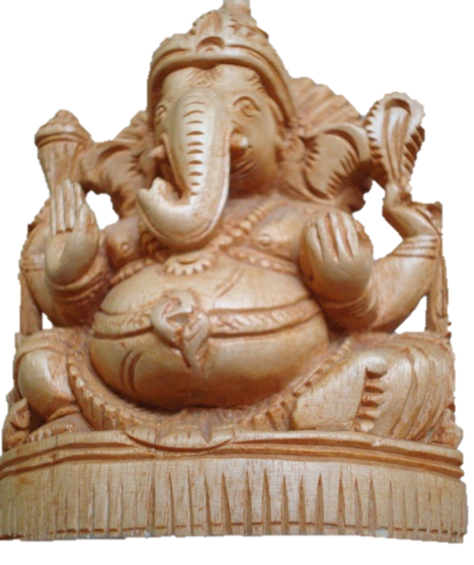
2:12-3:25

Slide 14
2:12-3:25

Slide 15
2:12-3:25
Deut. 24:1-4 ~ ¹ When a man takes a wife and marries her, and it happens that she finds no favor in his eyes because he has found some uncleanness in her, and he writes her a certificate of divorce, puts it in her hand, and sends her out of his house, ² when she has departed from his house, and goes and becomes another man’s wife, ³ if the latter husband detests her and writes her a certificate of divorce, puts it in her hand, and sends her out of his house, or if the latter husband dies who took her as his wife, ⁴ then her former husband who divorced her must not take her back to be his wife after she has been defiled; for that is an abomination before the LORD, and you shall not bring sin on the land which the LORD your God is giving you as an inheritance.

Slide 16
2:12-3:25
NIV ~ would you now return to Me?

Slide 17
2:12-3:25

Slide 18
2:12-3:25
Assyrians
722 BC
Israel
Judah

Slide 19
2:12-3:25

Slide 20
2:12-3:25
1 John 1:9 ~ If we confess our sins, He is faithful and just to forgive us our sins and to cleanse us from all unrighteousness.

Slide 21
2:12-3:25

Slide 22
2:12-3:25
shepherds ~ ra`ah – same as 2:8

Slide 23
2:12-3:25

Slide 24
2:12-3:25
Zech. 12:10 ~ “And I will pour on the house of David and on the inhabitants of Jerusalem the Spirit of grace and supplication; then they will look on Me whom they pierced. Yes, they will mourn for Him as one mourns for his only son, and grieve for Him as one grieves for a firstborn.”

Slide 25
2:12-3:25

Slide 26
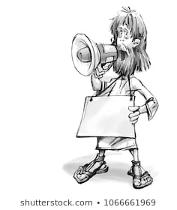
2:12-3:25
Repent!
For the
end is near!

Slide 27
2:12-3:25

