Slide 1
44:1 – 46:13

Slide 2
Jeshurun – upright one
44:1 – 46:13

Slide 3
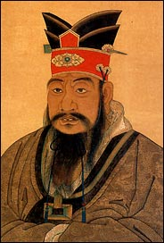
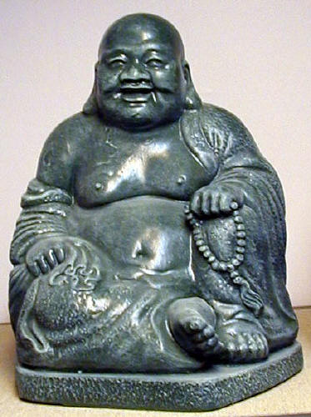
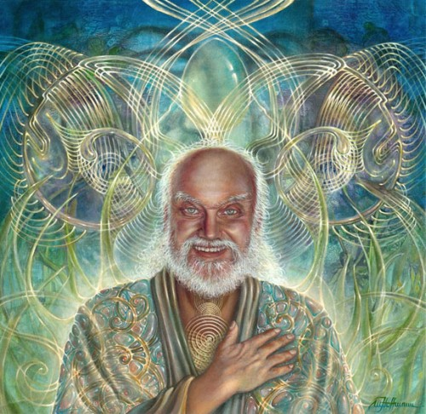
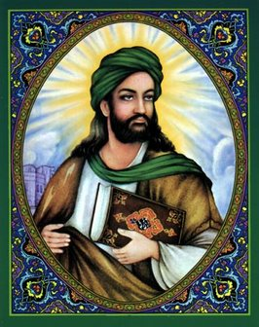
Confucius
Buddha
Baba Ram Dass
Muhammad
44:1 – 46:13

Slide 4
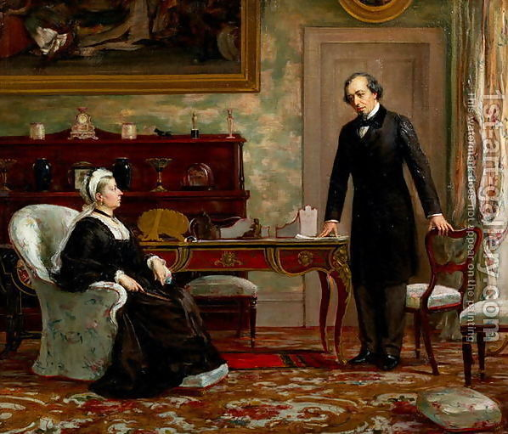
The Jew,
your Majesty
44:1 – 46:13

Slide 5
Armor – (also NIV) loins, NASB, KJV
44:1 – 46:13

Slide 6
Calamity – ra; KJV, evil (bad translation)
44:1 – 46:13

Slide 7
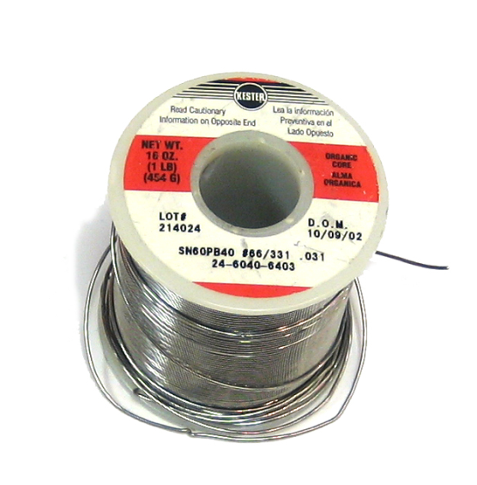
44:1 – 46:13

Slide 8
Heb. 12:2 – looking unto Jesus, the author and finisher of our faith, who for the joy that was set before Him endured the cross, despising the shame, and has sat down at the right hand of the throne of God.
Tit. 2:13-14 – ¹³ looking for the blessed hope and glorious appearing of our great God and Savior Jesus Christ, ¹⁴ who gave Himself for us, that He might redeem us from every lawless deed and purify for Himself His own special people, zealous for good works.
44:1 – 46:13

Slide 9
Bel – Babylonian version of Baal – meaning Lord
44:1 – 46:13

Slide 10
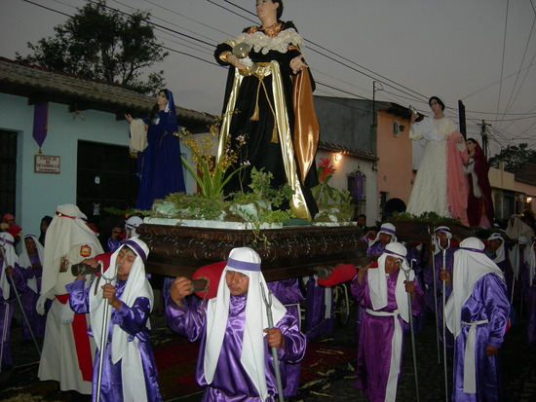
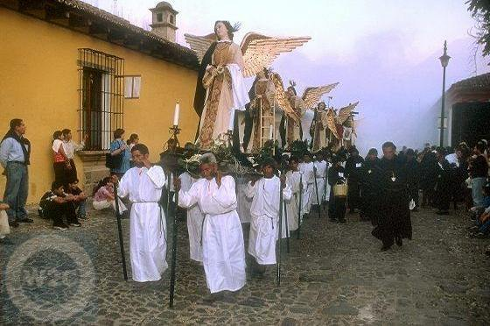
Semana Santa (Holy Week)
Guatemala
44:1 – 46:13

Slide 11
Isaiah's prophecy
c. 700 BC
Restoration of Jerusalem
444 – 395 BC
750 BC
700 BC
650 BC
600 BC
550 BC
500 BC
450 BC
400 BC
350 BC
300 BC
670 BC
Assyrian Empire
745 – 609 BC
Babylonian Empire
612 – 539 BC
Persian Empire
550 – 330 BC
44:1 – 46:13

