Slide 1
35:1 – 37:38

Slide 2
Parched ground – shawrab, from unused root meaning to glare, quivering glow (mirage)
35:1 – 37:38

Slide 3
Fool – maybe better, novice or inexperienced
35:1 – 37:38

Slide 4
“Engineering has done much to tunnel mountains, and bridge abysses; but the greatest triumph of engineering is that which made a way from sin to holiness, from death to life, from condemnation to perfection. Who could make a road over the mountains of our iniquities but Almighty God? None but the Lord of love would have wished it; none but the God of wisdom could have devised it; none but the God of power could have carried it out.” – Spurgeon
35:1 – 37:38

Slide 5
Events of the Millennium
Judgment of the Gentiles (Matt. 25)
Satan will be bound
Will be subjects with the Tribulation Jews
Will have sin natures
Will be limited death
Will produce offspring
We will have our glorified bodies
35:1 – 37:38

Slide 6
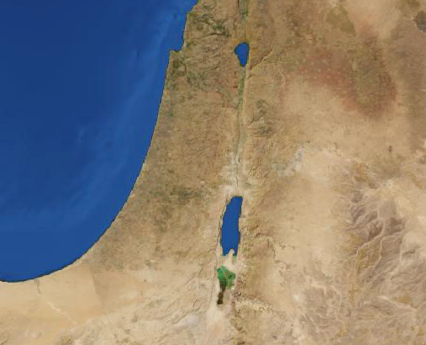
Jerusalem
Lachish
35:1 – 37:38

Slide 7
World's criticism of Christianity
The Bible is full of contradictions
The Bible is unscientific
The Bible is chauvinistic
35:1 – 37:38

