Slide 1
19:1 – 23:18

Slide 2
Fulfilled in 671 BC by Esarhaddon of Assyria
19:1 – 23:18

Slide 3
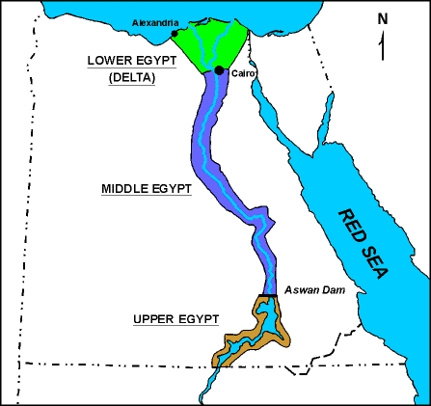
19:1 – 23:18

Slide 4
In that day – used of Isaiah for "the Day of the Lord" or "the Millennium"
19:1 – 23:18

Slide 5
Heb. 12:5-6 – ⁵ And you have forgotten the exhortation which speaks to you as to sons: "My son, do not despise the chastening of the LORD, Nor be discouraged when you are rebuked by Him; ⁶ For whom the LORD loves He chastens, And scourges every son whom He receives."
Chastening/chastens – paideia; discipline
19:1 – 23:18

Slide 6
Tartan – Assyrian word meaning Big Kahuna
Sargon came to power after Sennacherib's assassination
19:1 – 23:18

Slide 7
Is fallen, is fallen – Rev. 14:8
Commercial and Religious Babylon, chapters 17 and 18
19:1 – 23:18

Slide 8
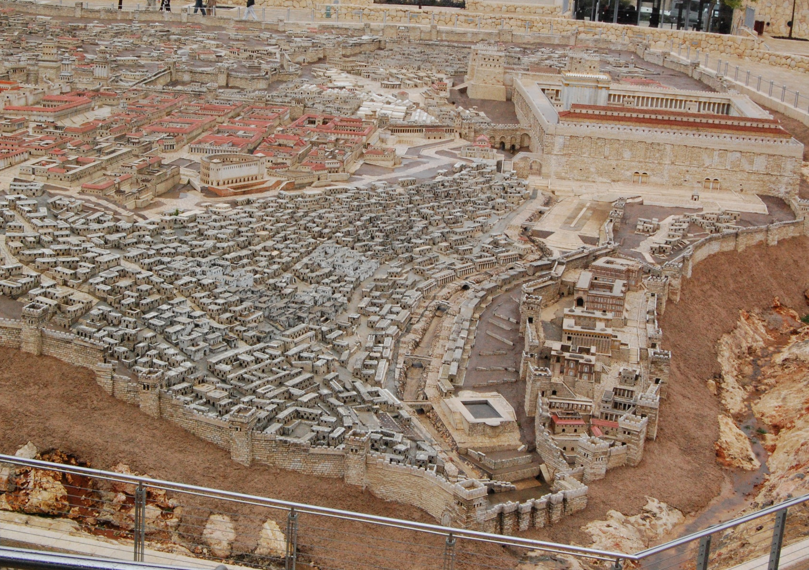
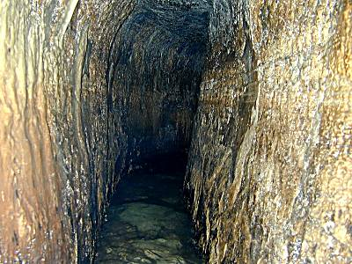
Hezekiah's Tunnel
Gihon Spring
Pool of Siloam
19:1 – 23:18

Slide 9
Eze. 26:4 – And they shall destroy the walls of Tyre and break down her towers; I will also scrape her dust from her, and make her like the top of a rock.
19:1 – 23:18

Slide 10
Prov. 16:18 – Pride; goes before destruction, And a haughty spirit before a fall.
19:1 – 23:18

Slide 11
Ps. 2:1-4 – ¹ Why do the nations rage, And the people plot a vain thing? ² The kings of the earth set themselves, And the rulers take counsel together, Against the LORD and against His Anointed, saying, ³ "Let us break Their bonds in pieces And cast away Their cords from us." ⁴ He who sits in the heavens shall laugh; The Lord shall hold them in derision.
19:1 – 23:18

