Slide 1
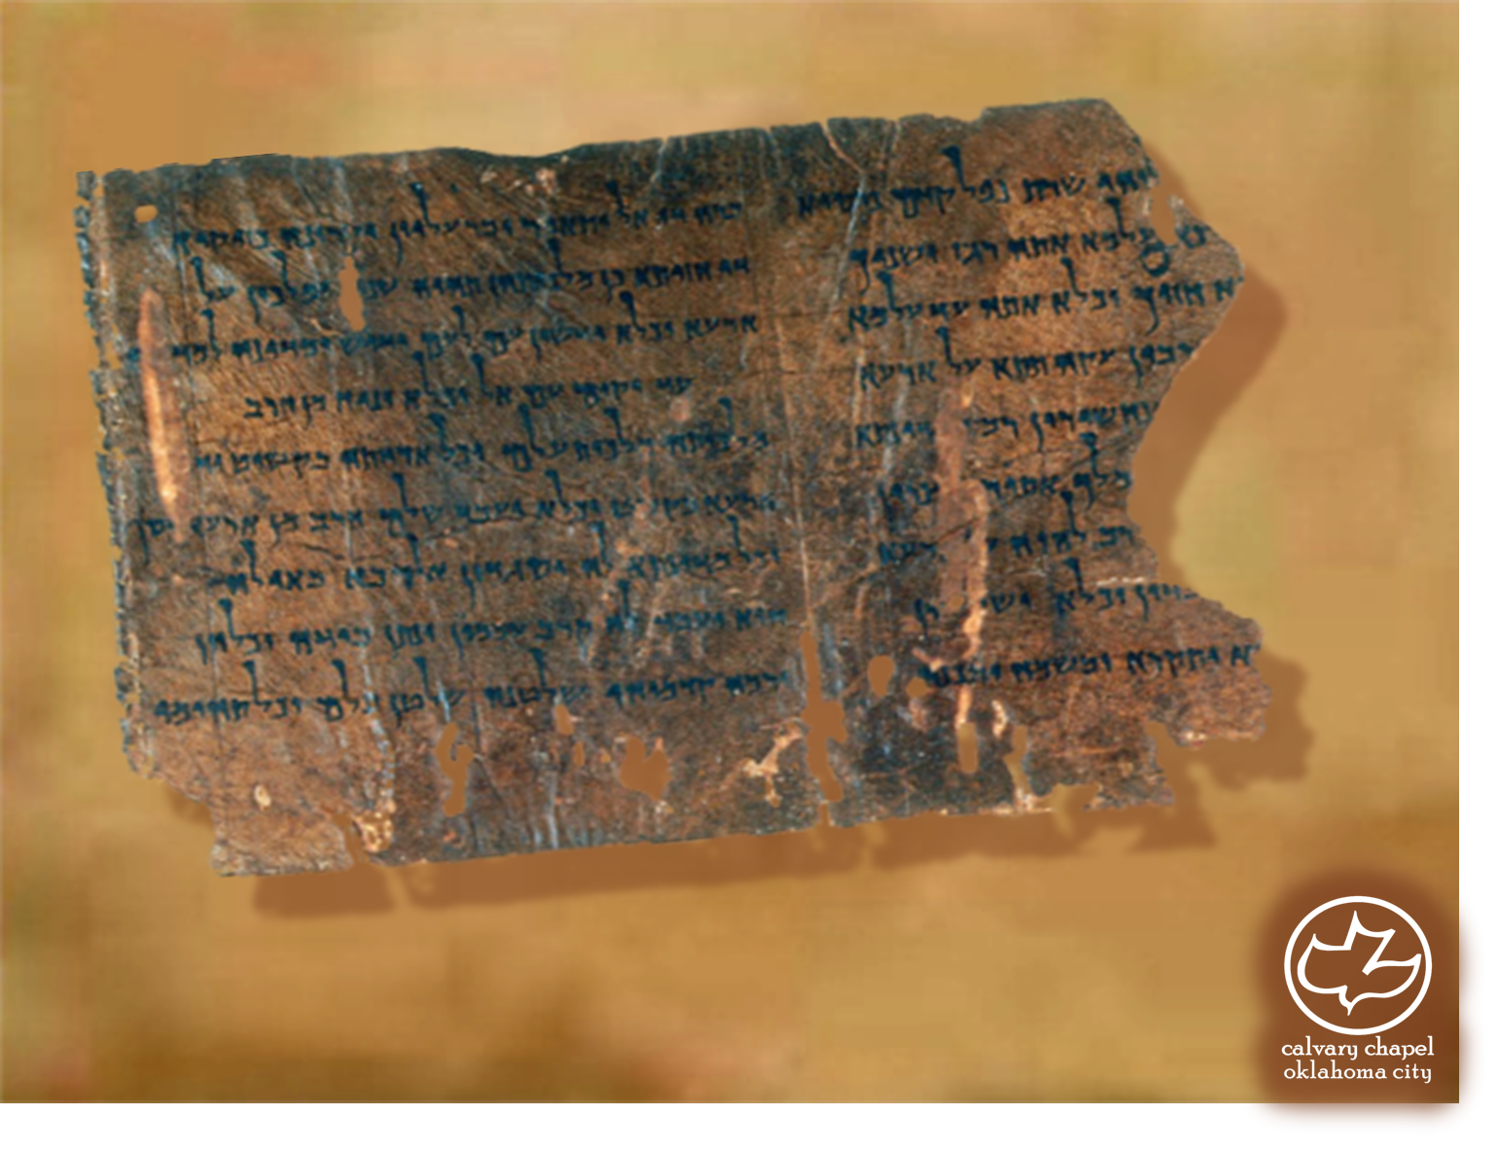

Minor Prophets … Major Message:
Hosea 9:1-11:12
A CD of this message will be available (free of charge) immediately following today's message
This message will be available via podcast later this week at calvaryokc.com

Slide 2
Hosea 9:1-11:12
Made love for hire ~ KJV, gone a-whoring

Slide 3
Hosea 9:1-11:12
Gibeah ~ Judges 19 – the Levite and the concubine
Baal Peor ~ Num. 25 – Balaam, Balak
Ichabod ~ 1 Sam. 4 – Phineas’ wife)

Slide 4
Hosea 9:1-11:12
Beth Aven ~ House of Wickedness (epithet for Bethel)

Slide 5
Hosea 9:1-11:12
Rev. 6:15-17 ~ ¹⁵ And the kings of the earth, the great men, the rich men, the commanders, the mighty men, every slave and every free man, hid themselves in the caves and in the rocks of the mountains, ¹⁶ and said to the mountains and rocks, "Fall on us and hide us from the face of Him who sits on the throne and from the wrath of the Lamb! ¹⁷ "For the great day of His wrath has come, and who is able
to stand?"

Slide 6
Hosea 9:1-11:12
Deut. 25:4 ~ You shall not muzzle an ox while it treads out the grain.

Slide 7
Hosea 9:1-11:12
KJV ~ I drew them with cords of a man, with bands of love (literal)
NIV ~ cords of human kindness
2 Cor. 5:14a ~ For the love of Christ compels us …

Slide 8
Hosea 9:1-11:12
Backsliding ~ meshubah – a turning away

Slide 9
Hosea 9:1-11:12
Prov 14:14 ~ The backslider in heart will be filled with his own ways, but a good man will be satisfied from above.
Is. 29:13 ~ … these people draw near with their mouths and honor Me with their lips, but have removed their hearts far from Me,

Slide 10
Hosea 9:1-11:12
Walks with God ~ literally, walks aimlessly
NASB, better ~ Judah is also unruly against God

