Slide 1
13:7-25

Slide 2
13:7-25
There was a young poet in Japan Whose poetry no one could scan. When told it was so, He replied, “Yes, I know,
But I try to get as many words in the last line as I can.”

Slide 3
13:7-25

Slide 4
13:7-25
Hebrews 13:7-25 ~ ⁷ Remember those who rule over you, who have spoken the word of God to you, whose faith follow, considering the outcome of their conduct. ⁸ Jesus Christ is the same yesterday, today, and forever. ⁹ Do not be carried about with various and strange doctrines. For it is good that the heart be established by grace, not with foods which have not profited those who have been occupied with them.
¹⁰ We have an altar from which those who serve the tabernacle have no right to eat. ¹¹ For the bodies of those animals, whose blood is brought into the

Slide 5
13:7-25
Hebrews 13:7-25 ~ sanctuary by the high priest for sin, are burned outside the camp. ¹² Therefore Jesus also, that He might sanctify the people with His own blood, suffered outside the gate. ¹³ Therefore let us go forth to Him, outside the camp, bearing His reproach. ¹⁴ For here we have no continuing city, but we seek the one to come. ¹⁵ Therefore by Him let us continually offer the sacrifice of praise to God, that is, the fruit of our lips, giving thanks to His name. ¹⁶ But do not forget to do good and to share, for with such sacrifices God is well pleased.

Slide 6
13:7-25
Hebrews 13:7-25 ~ ¹⁷ Obey those who rule over you, and be submissive, for they watch out for your souls, as those who must give account. Let them do so with joy and not with grief, for that would be unprofitable for you.
¹⁸ Pray for us; for we are confident that we have a good conscience, in all things desiring to live honorably. ¹⁹ But I especially urge you to do this, that I may be restored to you the sooner.
²⁰ Now may the God of peace who brought up our Lord Jesus from the dead, that great Shepherd of

Slide 7
13:7-25
Hebrews 13:7-25 ~ the sheep, through the blood of the everlasting covenant, ²¹ make you complete in every good work to do His will, working in you what is well pleasing in His sight, through Jesus Christ, to whom be glory forever and ever. Amen.
²² And I appeal to you, brethren, bear with the word of exhortation, for I have written to you in few words. ²³ Know that our brother Timothy has been set free, with whom I shall see you if he comes shortly.
²⁴ Greet all those who rule over you, and all the saints. Those from Italy greet you.
²⁵ Grace be with you all. Amen.

Slide 8
13:7-25

Slide 9
13:7-25
Dear Pastor, How does God know the good people from the bad people? Do you tell Him or does He read about it in the newspapers?
Sincerely, Marie, Age 9, Lewiston
Dear Pastor, I know God loves everybody but He never met my sister.
Yours sincerely, Arnold, age 8, Nashville
Dear Pastor, Please say in your sermon that Peter Peterson has been a good boy all week. I am Peter Peterson.
Sincerely, Pete, age 9, Phoenix

Slide 10
13:7-25
Dear Pastor, Are there any devils on earth? I think there may be one in my class.
Carla, age 10, Salina
Dear Pastor, My father should be a preacher. Every day he gives us a sermon about something.
Robert, age 11, Anderson
Dear Pastor, I would like to go to heaven someday because I know my brother won’t be there.
Stephen, age 8, Chicago
Dear Pastor, I think a lot more people would come to your church if you moved it to Disneyland.
Loreen, age 9, Tacoma

Slide 11
13:7-25
Dear Pastor, Please say a prayer for our Little League team. We need God’s help or a new pitcher.
Thank you. Alexander, age 10, Raleigh
Dear Pastor, I liked your sermon on Sunday. Especially when it was finished.
Ralph, age 11, Akron
Dear Pastor, I’m sorry I can’t leave more money in the plate, but my father didn’t give me a raise in my allowance. Could you have a sermon about a raise in my allowance?
Love, Patty, age 10, New Haven

Slide 12
13:7-25
Dear Pastor, My mother is very religious. She goes to goes to church to play bingo every week even if she has a cold.
Yours truly, Annette. Age 9, Albany

Slide 13
13:7-25

Slide 14
13:7-25
those who rule over you ~ used 3x in passage (vv. 7, 17, 24)
rule ~ hegeomai (also, vv. 17, 24)
leaders ~ most other modern English translations
hegemony ~ the rise of one group within a greater group, to rule over all,
think “guide”

Slide 15
13:7-25

Slide 16
13:7-25
1 Pet. 5:2-4 ~ ² Shepherd the flock of God which is among you, serving as overseers, not by compulsion but willingly, not for dishonest gain but eagerly; ³ nor as being lords over those entrusted to you, but being examples to the flock ⁴ and when the Chief Shepherd appears, you will receive the crown of glory that does not fade away.

Slide 17
13:7-25
Spiritual
Abuse
Spiritual
Flippancy
Spiritual
Balance

Slide 18
13:7-25

Slide 19
13:7-25
Heraclitus (c. 535-475 BC) ~ “The only thing that never changes is the fact that everything changes.”
yesterday ~ the Atonement
today ~ His Intercession
tomorrow ~ our Blessed Hope

Slide 20
13:7-25

Slide 21
13:7-25
M. R. DeHaan, Hebrews, ~ “There is no period in the history of God’s people when there has been as much deception and false doctrine abroad as today. The past few years have seen the multiplication of sects and cults and religions of every conceivable sort. They arise overnight, and come with some of the most fantastic, fanatical, unearthly doctrines and teachings, manifestations and delusions. Never before has there been such confusion of tongues, so many strange voices saying, ‘Here is truth!’ They quote Scripture, claim supernatural powers, prattle about faith, promise healing, health and wealth, while leaving behind a

Slide 22
13:7-25
M. R. DeHaan, Hebrews, ~ veritable stream of disillusioned, disappointed, frustrated souls. And no matter how wild the fire, if it is only accompanied by a little Scripture, these cults do not lack for followers … We ask, ‘Why are Christians so gullible? Why are they so easily fooled?’ We come right back to the case of the people in the Book of Hebrews. They were weaklings, babes, undernourished infants. The only antidote against the deceptions of this day is the Word, the solid meat of the Word. Unless we saturate ourselves in the Word, and become mature through the strong meat of Scripture, we shall not be able to stand.”
© 1959

Slide 23
13:7-25
Scientology
Latter Day Rain Movement
est
the Way International
rise in astrology
the Children of God
Heaven’s Gate
the Moonies
Concerned Christians (Denver)
Alamo Foundation
holy laughter, barking, growling,
Jim Jones
wiggling, jerking, punching, kicking
David Koresh
Baba Ram Das
New Age Cults
Grave sucking
Word/Faith Movement
Rama dama ding dong
School of the Prophets/
Apostles Movement

Slide 24
13:7-25

Slide 25
13:7-25
2 Tim. 4:1-4 ~ ¹ I charge you therefore before God and the Lord Jesus Christ, who will judge the living and the dead at His appearing and His kingdom: ² Preach the word! Be ready in season and out of season. Convince, rebuke, exhort, with all longsuffering and teaching. ³ For the time will come when they will not endure sound doctrine, but according to their own desires, because they have itching ears, they will heap up for themselves teachers; ⁴ and they will turn their ears away from the truth, and be turned aside to fables.

Slide 26
13:7-25

Slide 27
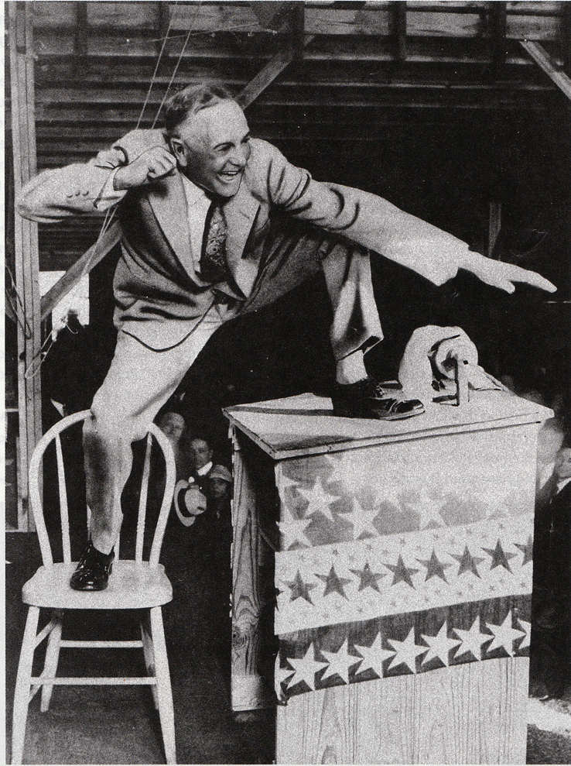
13:7-25
Billy Sunday (1862-1935) ~
“I am an old-fashioned
preacher of the old-time
religion, that has warmed
this cold world’s heart for
two thousand years.”

Slide 28
13:7-25

Slide 29
13:7-25
Obey ~ Literally, make yourself obey…

Slide 30
13:7-25

Slide 31
13:7-25
5 ways to get rid of your pastor:
1. Sit up front, smile and say “amen” every time he says something good.
2. Pat him on the back and tell him what a good job he’s doing in the church and community.
3. Tell him you feel the Lord is leading you to teach in Sunday School and help lead young souls to Jesus.
4. Increase your offering to the church.
5. Get the whole church to band together
and pray for him.

Slide 32
13:7-25

Slide 33
13:7-25
watch out ~ agrupneō – a (negative particle) + hupnos – sleep
3 John 1:4 ~ I have no greater joy than to hear that my children walk in truth.

Slide 34
13:7-25

Slide 35
13:7-25
complete ~ kathartizō
Matt. 4: 21 ~ James and John mending their nets
Rom. 9:22 ~ the vessels of wrath being prepared for destruction
Gal. 6:1 ~ restoring one who is overtaken in a trespass
Heb. 11:3 ~ The worlds were framed by the word of God
Ships were outfitted, armies were equipped, broken bones were set

Slide 36
13:7-25

