Slide 1
2:1-9

Slide 2
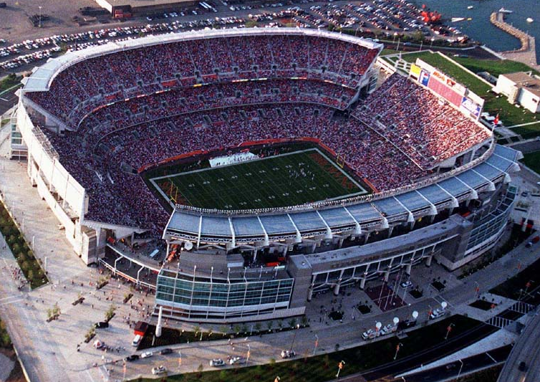
2:1-9

Slide 3
2:1-9

Slide 4
2:1-9
Chapter 1 ~ Jesus’ superiority as Son of God
Chapter 2 ~ Jesus’ superiority as Son of Man

Slide 5
2:1-9

Slide 6
2:1-9
Hebrews 2:1-9 ~ ¹ Therefore we must give the more earnest heed to the things we have heard, lest we drift away. ² For if the word spoken through angels proved steadfast, and every transgression and disobedience received a just reward, ³ how shall we escape if we neglect so great a salvation, which at the first began to be spoken by the Lord, and was confirmed to us by those who heard Him, ⁴ God also bearing witness both with signs and wonders, with various miracles, and gifts of the Holy Spirit, according to His own will? ⁵ For He has not put the world to come,

Slide 7
2:1-9
Hebrews 2:1-9 ~ of which we speak, in subjection to angels. ⁶ But one testified in a certain place, saying:
“What is man that You are mindful of him,
Or the son of man that You take care of him?
⁷ You have made him a little lower than the angels;
You have crowned him with glory and honor,
And set him over the works of Your hands.
⁸ You have put all things in subjection under his feet.”
For in that He put all in subjection under him, He left nothing that is not put under him. But now we do not yet see all things put under him.

Slide 8
2:1-9
Hebrews 2:1-9 ~ ⁹ But we see Jesus, who was made a little lower than the angels, for the suffering of death crowned with glory and honor, that He, by the grace of God, might taste death for everyone.

Slide 9
2:1-9

Slide 10
2:1-9
William Barclay ~ “Otherwise, we may well be like a ship which drifts past the harbor to shipwreck.”

Slide 11
2:1-9
Five Warnings Passages in Hebrews:
1. Heb. 2:1-4
~ do not drift
2. Heb. 3:7-4:1
3. Heb. 5:11-6:20
4. Heb. 10:26-39
5. Heb. 12:14-29

Slide 12
2:1-9

Slide 13
2:1-9
Two longest theological terms:
baptismoftheHolySpiritwiththeevidenceofspeakingintongues
oncesavedalwayssaved

Slide 14
2:1-9
Does
“Once saved always saved”
“Eternal security”
=
?
J. Vernon McGee ~ “I believe in the security of the believer
… but I also believe in the insecurity of the unbeliever.”

Slide 15
2:1-9

Slide 16
2:1-9
sin
“Eye candy”
“Lusting”
“White lies”
“Lying”
“Appropriating”
“Stealing”
My standard
God’s standard
sin-o-meter

Slide 17
2:1-9

Slide 18
2:1-9
A “Just Reward”
Nadab and Abihu
Establishment of the priesthood
Picking up sticks on the Sabbath
Establishment of the Sabbath rest
Achan’s sin at Jericho
Entering into the Promised Land
Uzzah and the Ark of the Covenant
Bringing the Ark of the Covenant into Jerusalem

Slide 19
2:1-9

Slide 20
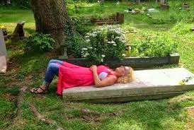
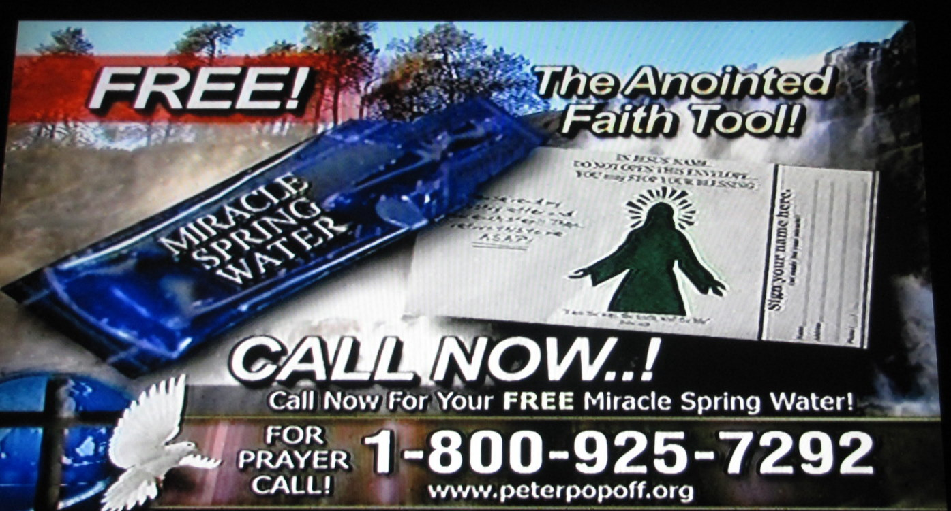
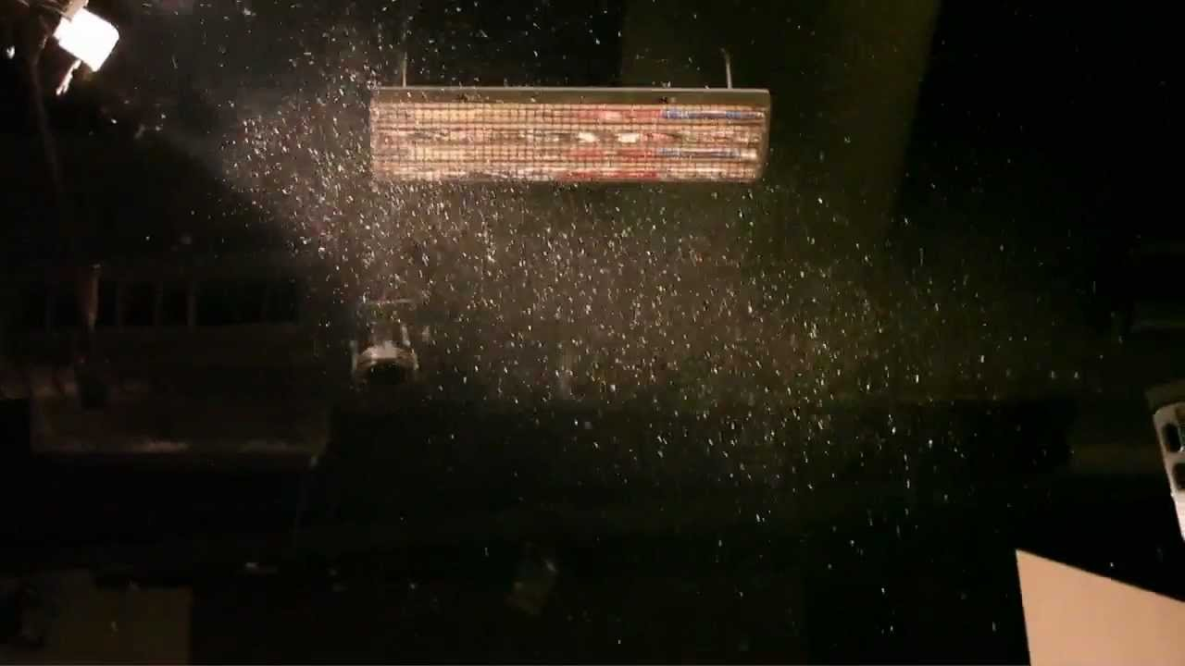
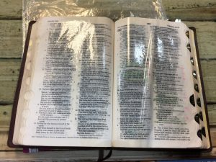
2:1-9
Grave sucking
Miracle Spring Water
“Gold” dust
Oil oozing Bible

Slide 21
2:1-9

Slide 22
2:1-9
1 Thess. 5:21 ~ Test all things; hold fast what is good.

Slide 23
2:1-9

Slide 24
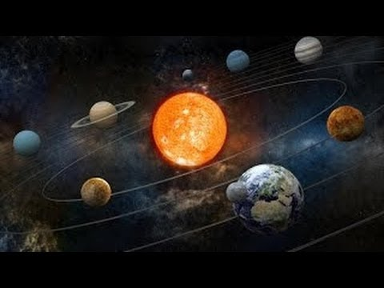
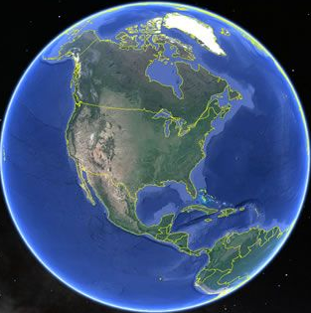
2:1-9
7,500,000,000 mi.
8,000 mi.

Slide 25
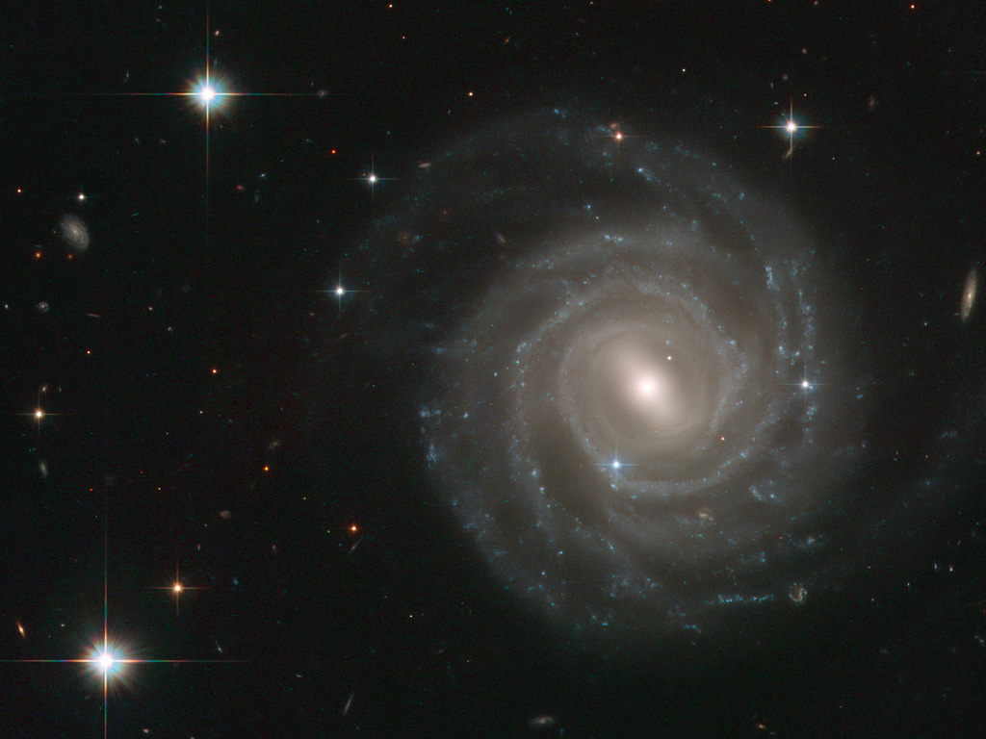
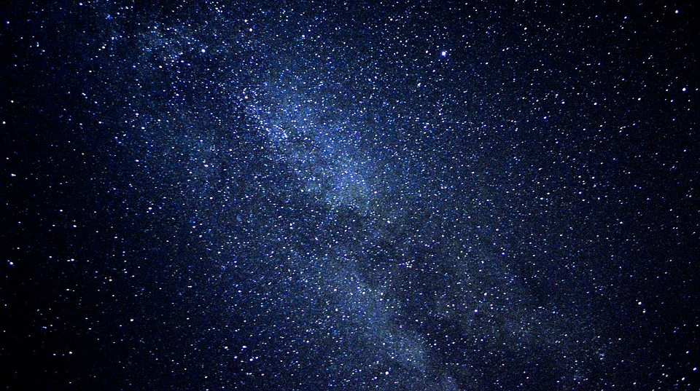
2:1-9
93,000,000 mi. = 1 light year (ly)
You are here
Milky Way
100,000-180,000 ly
91,000,000,000 ly
100-400 billion stars in the Milky Way

Slide 26
2:1-9

Slide 27
2:1-9

Slide 28
2:1-9
NASB ~ a little while lower
•

Slide 29
2:1-9

Slide 30
2:1-9
Eph. 1:18-23 ~ ¹⁸ the eyes of your understanding being enlightened; that you may know what is the hope of His calling, what are the riches of the glory of His inheritance in the saints, ¹⁹ and what is the exceeding greatness of His power toward us who believe, according to the working of His mighty power ²⁰ which He worked in Christ when He raised Him from the dead and seated Him at His right hand in the heavenly places,

Slide 31
2:1-9
Eph. 1:18-23 ~ ²¹ far above all principality and power and might and dominion, and every name that is named, not only in this age but also in that which is to come.
²² And He put all things under His feet, and gave Him to be head over all things to the church, ²³ which is His body, the fullness of Him who fills all in all.

Slide 32
2:1-9

Slide 33
2:1-9
Bishop Hanley Moule (1841-1920) ~ “A Savior not quite God is like a bridge broken at the further end.”
23.83 miles

Slide 34
2:1-9
Job 9:32-33 ~ ³² For He is not a man, as I am,
That I may answer Him,
And that we should go to court together.
³³ Nor is there any mediator between us,
Who may lay his hand on us both.
KJV ~ daysman
NASB ~ umpire
NIV ~ someone to arbitrate

Slide 35
2:1-9

