Slide 1
49-50

Slide 2
49-50
Genesis 01-02 ~ generation
Genesis 03-11 ~ degeneration
Genesis 12-50 ~ regeneration

Slide 3
49-50

Slide 4
49-50
in the last times ~ 1st mention

Slide 5
49-50

Slide 6
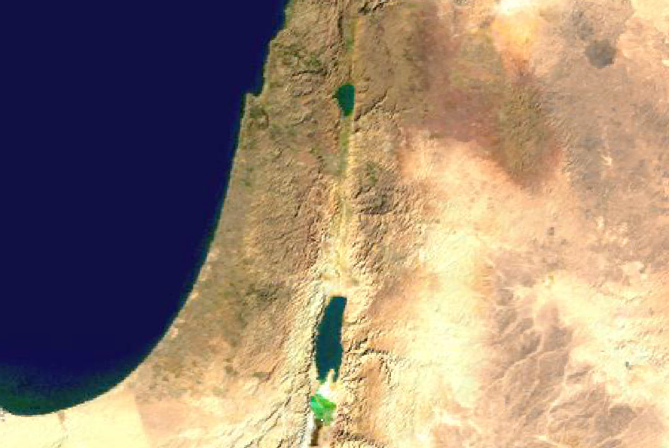
49-50
Ammon
Reuben
Moab

Slide 7
49-50

Slide 8
49-50
KJV ~ and in their self-will they digged down a wall.

Slide 9
49-50

Slide 10
49-50
Judah
Simeon

Slide 11
49-50

Slide 12
49-50
Shiloh ~ Messianic phrase derived from Shalom
Talmud ~ “Woe unto us for the scepter has departed from Judah and the Messiah has not come”
Jesus in the Temple (Luke 2:49)
12 years
6 BC
5 BC
4 BC
3 BC
2 BC
1 BC
AD 1
AD 2
AD 3
AD 4
AD 5
AD 6
AD 7
Jesus’ birth c. 6 BC
Capital punishment removed c. AD 7

Slide 13
49-50
Gen. 3:16 ~ Seed of a Woman
Abraham
No other descendants of Adam
Not Ishmael
Isaac
Jacob
Not Esau
Not the other 11
Judah

Slide 14
49-50

Slide 15
49-50
Is. 63:1-4 ~ ¹ With dyed garments from Bozrah,
This One who is glorious in His apparel,
Traveling in the greatness of His strength?—
“I who speak in righteousness, mighty to save.”
² Why is Your apparel red,
And Your garments like one who treads in the winepress?
³ “I have trodden the winepress alone,
And from the peoples no one was with Me.
For I have trodden them in My anger,

Slide 16
49-50
Is. 63:1-4 ~ And trampled them in My fury;
Their blood is sprinkled upon My garments,
And I have stained all My robes.
⁴ For the day of vengeance is in My heart,
And the year of My redeemed has come.”

Slide 17
49-50
Rev. 20:7-10 ~ ⁷ Now when the thousand years have expired, Satan will be released from his prison ⁸ and will go out to deceive the nations which are in the four corners of the earth, Gog and Magog, to gather them together to battle, whose number is as the sand of the sea. ⁹ They went up on the breadth of the earth and surrounded the camp of the saints and the beloved city. And fire came down from God out of heaven and devoured them.

Slide 18
49-50
Rev. 20:7-10 ~ ¹⁰ The devil, who deceived them, was cast into the lake of fire and brimstone where the beast and the false prophet are. And they will be tormented day and night forever and ever.

Slide 19
49-50

Slide 20
49-50
Assyrian
Conquest
Zebulun
Issachar

Slide 21
49-50

Slide 22
49-50
Dan

Slide 23
49-50

Slide 24
49-50
salvation ~ yeshua – 1st mention

Slide 25
49-50

Slide 26
49-50
troop, tramp and triumph are all from word “Gad”
Gad

Slide 27
49-50

Slide 28
49-50
Naphtali

Slide 29
49-50

Slide 30
49-50
Ephraim
Manasseh
Joshua
Samuel
Gideon
Jephthah
separate ~ nazir – where we get the word “Nazarite”

Slide 31
49-50

Slide 32
49-50
Abel Mizraim ~ i.e. “mourning of Egypt”

Slide 33
49-50

Slide 34
49-50
Jer. 29:11-13 ~ ¹¹ For I know the thoughts that I think toward you, says the Lord, thoughts of peace and not of evil, to give you a future and a hope. ¹² Then you will call upon Me and go and pray to Me, and I will listen to you. ¹³ And you will seek Me and find Me, when you search for Me with all your heart.

Slide 35
49-50

Slide 36
49-50
Human history

Slide 37
49-50

