Slide 1
37-38

Slide 2
37-38
Genesis
25%
Joseph

Slide 3
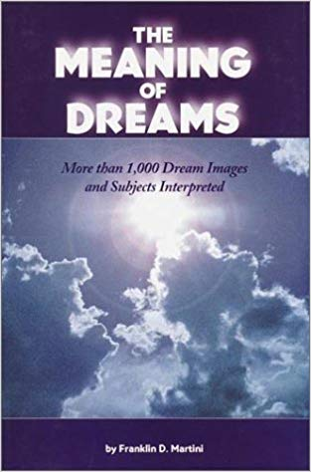
37-38
by Ima Nutt

Slide 4
37-38

Slide 5
37-38
Robert Baker ~ “As I grow older, I care less what people think about me and more what God thinks of me. I expect to be with him much longer than with you.”

Slide 6
37-38

Slide 7
37-38
many colors ~ better, coat with sleeves
ketōnet passim – from a root meaning of the palm of the hand or of the sole of the foot

Slide 8
37-38

Slide 9
37-38
Sandy Adams ~ “For 14 chapters we’re going to embark on a journey with Joseph. We’re going to follow him from the ‘pit,’ to ‘Potiphar’s,’ to ‘prison’ and finally to the ‘palace’ - and Joseph’s life is a showcase for another ‘P’ and that’s ‘providence,’ for God is sovereign over all situations.”

Slide 10
37-38

Slide 11
37-38
Hebron ~ From Hebrew word meaning association or community

Slide 12
37-38

Slide 13
37-38
field ~ Matt. 13:38 – the field is the world

Slide 14
37-38

Slide 15
37-38
Dothan ~ two cisterns
Jer. 2:13 ~ For My people have committed two evils: They have forsaken Me, the fountain of living waters (left Hebron),
And hewn themselves cisterns – broken cisterns that can hold no water.

Slide 16
37-38

Slide 17
37-38
dreamer ~ ba`al chalom – master (or lord) of dreams

Slide 18
37-38

Slide 19
37-38
Ishmaelites (v. 25, 27) (Abraham’s descendants through Hagar) or Midianites (v. 28) (Abraham’s descendants through Kethurah)?
Ishmaelites ~ generic term for Arab people

Slide 20
37-38

Slide 21
37-38
officer ~ saris – eunuch

Slide 22
37-38

Slide 23
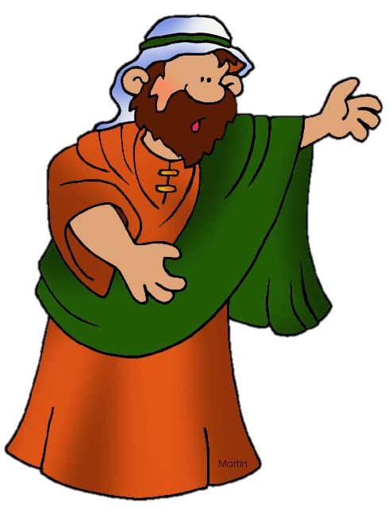
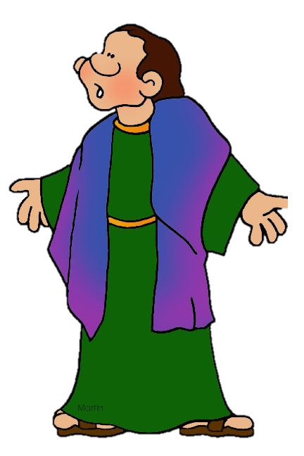
37-38
What are you gonna name him?
OK
Er ….

Slide 24
37-38

Slide 25
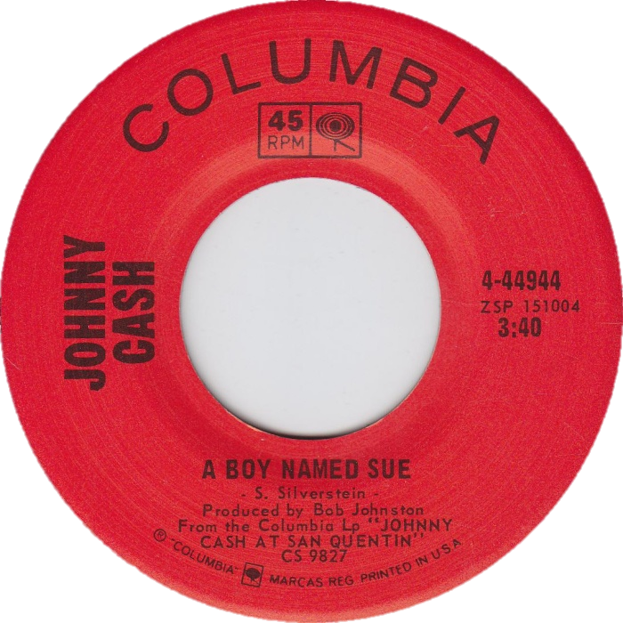
37-38
A BOY NAMED SHELAH

Slide 26
37-38

Slide 27
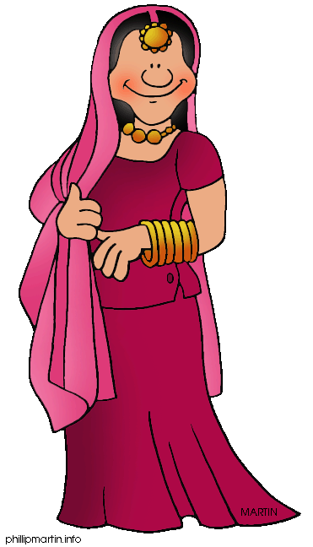
37-38
We accept VISA with two forms of ID
Hey, Baby.
Ya lookin’ for a date?

Slide 28
37-38

Slide 29
37-38
burned ~ or branded (Matthew Henry)

Slide 30
37-38

Slide 31
37-38
Four women given in Jesus’ genealogy:
Tamar
Rahab
Ruth
Mary

Slide 32
37-38
Deut. 23:2 ~ One of illegitimate birth shall not enter the assembly of the Lord; even to the tenth generation none of his descendants shall enter the assembly of the Lord.
illegitimate birth ~ NIV, born of a forbidden marriage
mamzer ~ obscure word only used 2x
Zech. 9:6 ~ A mixed race shall settle in Ashdod

Slide 33
37-38
Ruth 4:18-22 ~ ¹⁸ Now this is the genealogy of Perez: Perez begot Hezron; ¹⁹ Hezron begot Ram, and Ram begot Amminadab; ²⁰ Amminadab begot Nahshon, and Nahshon begot Salmon; ²¹ Salmon begot Boaz, and Boaz begot Obed; ²² Obed begot Jesse, and Jesse begot David.
Perez was the illegitimate son of Tamar and Judah
David was the 10th generation from Perez

Slide 34
37-38

