Slide 1
24-25

Slide 2
24-25
Abraham = God, the Father
Sarah = Israel (wife of God)
Isaac = God, the Son
Rebekah = the Church
(bride of Christ)
Eliezer = God, the Holy Spirit

Slide 3
24-25

Slide 4
24-25
oldest servant ~ more than likely Eliezer (God is my Help)
2 Cor. 6:14-15 ~ ¹⁴ Do not be unequally yoked together with unbelievers. For what fellowship has righteousness with lawlessness? And what communion has light with darkness? ¹⁵ And what accord has Christ with Belial? Or what part has a believer with an unbeliever?

Slide 5
24-25

Slide 6
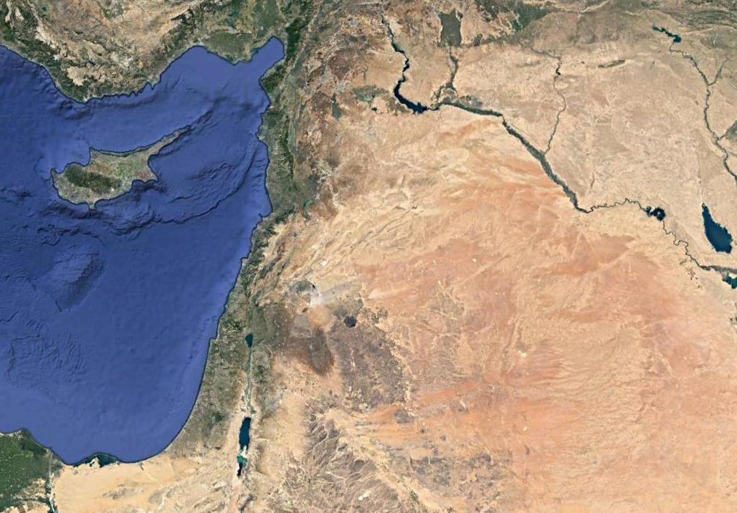
24-25
Padan-aram
450 mi.
Hebron

Slide 7
24-25

Slide 8
24-25
nose ring ~ KJV, earring

Slide 9
24-25

Slide 10
24-25
Beer Lahai Roi ~ “well of the Living One seeing me”

Slide 11
24-25

Slide 12
24-25
Rebekah!
Isaac!

Slide 13
24-25

Slide 14
24-25
dismounted ~ naphal – to fall
The word that Nephilim comes from (Gen. 6:4)

Slide 15
24-25

Slide 16
24-25
died ~ naphal – to fall (same as Gen. 24:64)

Slide 17
24-25

Slide 18
24-25
struggled ~ ra`tsats – to crush or grievously oppress

Slide 19
24-25

Slide 20
24-25
Esau ~ hairy
Jacob ~ heel catcher

Slide 21
24-25

Slide 22
24-25
mild man ~ KJV, plain – better, cultured or well rounded

Slide 23
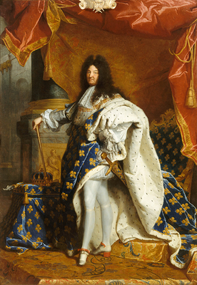
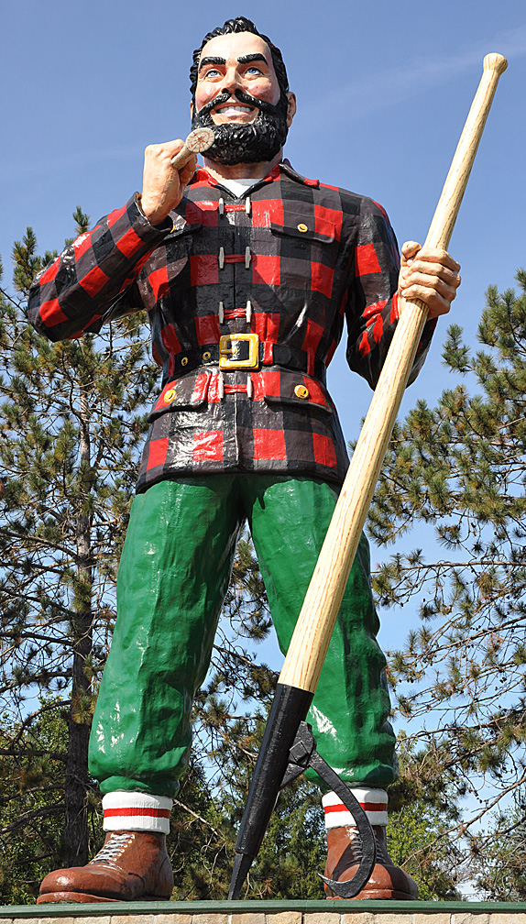
24-25

Slide 24
24-25
FIXER UPPER

Slide 25
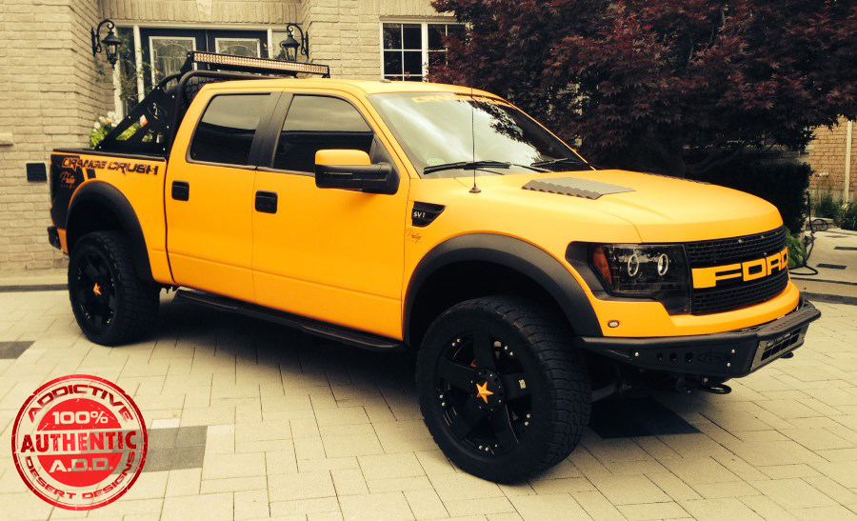
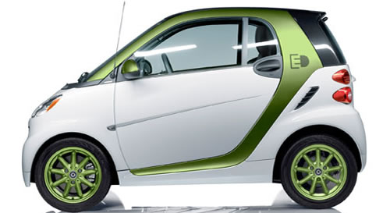
24-25

Slide 26
24-25

Slide 27
24-25
cooked a stew ~ KJV, sod pottage

Slide 28
24-25

Slide 29
24-25
same red stew ~ literally
adom edom
red red
Strong’s #
h0122
h0123

Slide 30
24-25

Slide 31
24-25
Heb. 12:14-17 ~ ¹⁴ Pursue peace with all people, and holiness, without which no one will see the Lord: ¹⁵ looking carefully lest anyone fall short of the grace of God; lest any root of bitterness springing up cause trouble, and by this many become defiled; ¹⁶ lest there be any fornicator or profane person like Esau, who for one morsel of food sold his birthright. ¹⁷ For you know that afterward, when he wanted to inherit the blessing, he was rejected, for he found no place for repentance, though he sought it diligently with tears.
profane : To treat (something sacred) with abuse, irreverence, or contempt

Slide 32
24-25

