Slide 1
20-21

Slide 2
20-21
Heb. 5:14 ~ But solid food belongs to those who are of full age, that is, those who by reason of use have their senses exercised to discern both good and evil.

Slide 3
20-21

Slide 4
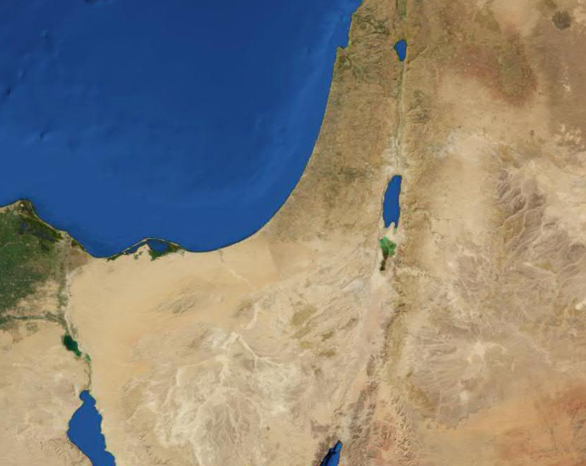
20-21
Hebron
Gerar
Negev (South)
Wilderness of Shur
Kadesh

Slide 5
20-21

Slide 6
20-21
man’s wife ~ literally, ba`al’s ba`al
Strong’s #
1167
1166
ba`al ~ is equivalent to “lord” or “sir”
She is a noble man’s noble wife

Slide 7
20-21

Slide 8
20-21
Lord (v.4) ~ not YHWH, but Adonai

Slide 9
20-21

Slide 10
20-21
Prov. 29:25 ~ The fear of man brings a snare, but whoever trusts in the Lord shall be safe.
F. B. Meyer ~ “The best of men are men at best.”

Slide 11
20-21

Slide 12
20-21
Num. 14:18 ~ The Lord is longsuffering and abundant in mercy, forgiving iniquity and transgression; but He by no means clears the guilty, visiting the iniquity of the fathers on the children to the third and fourth generation.
James Strahan (Hebrew Ideals © 1982) ~ “A bad man’s example has little influence over good men, but the bad example of a good man, eminent in station and established in reputation, has an enormous power for evil.”

Slide 13
20-21

Slide 14
20-21
Lev. 20:10 ~ The man who commits adultery with another man's wife, he who commits adultery with his neighbor's wife, the adulterer and the adulteress, shall surely be put to death.
John 8:11-12 ~ ¹¹ She said, “No one, Lord.” And Jesus said to her, “Neither do I condemn you; go and sin no more.”
¹² Then Jesus spoke to them again, saying, “I am the light of the world. He who follows Me shall not walk in darkness, but have the light of life.”

Slide 15
20-21
John Ashcroft ~ “Through the ups and downs of failure and success, we become better people, and as better people, God can call us to bigger jobs.”

Slide 16
20-21

Slide 17
20-21
NIV ~ This is to cover the offense against you before all who are with you; you are completely vindicated.

Slide 18
20-21

Slide 19
20-21
Application for Employment
Handmaid
Position desired:
Hagar
The
Egyptian
(first name) (middle name) (last name)
Previous Employer:
Abraham the Nomad

Slide 20
20-21

Slide 21
20-21
Gen. 16:7-14 ~ the Angel of the LORD ~ malakh YHWH – a Theophany
Gen. 21:17 ~ the angel of God ~ malakh Elohim

Slide 22
20-21

Slide 23
20-21
Sarah
Abraham
Hagar
Isaac
Ishmael
Israelites
Arabs

Slide 24
20-21

Slide 25
20-21
Abimelech ~ my father is king

Slide 26
20-21

Slide 27
20-21
Beersheba ~ well of the seven-fold oath
oath comes from Hebrew word for seven

Slide 28
20-21

Slide 29
20-21
Everlasting God ~ El Olam

Slide 30
20-21

