Slide 1
18-19

Slide 2
18-19
Mamre ~ strength or fatness

Slide 3
18-19

Slide 4
18-19
bowed ~ shachaw – usually translated worship

Slide 5
18-19

Slide 6
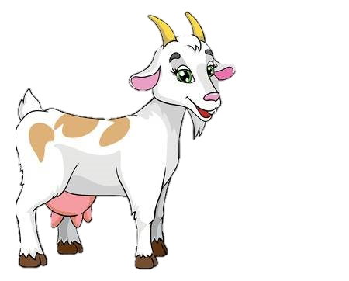
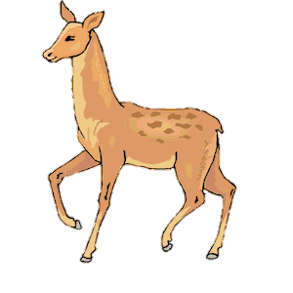
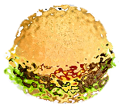
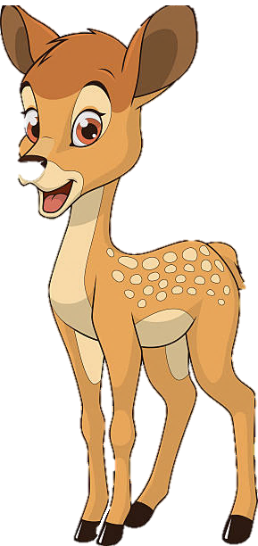
18-19
Ex. 23:19 ~ The first of the firstfruits of your land you shall bring into the house of the Lord your God. You shall not boil a young goat in its mother’s milk.

Slide 7
18-19

Slide 8
18-19
KJV ~ … were old and well stricken in age; and it ceased to be with Sarah after the manner of women.

Slide 9
18-19

Slide 10
18-19
45 righteous?
40 righteous?
50 righteous?
30 righteous?
20 righteous?
10 righteous?
Lot and his wife (Gen. 19:15) = 2
At least 2 married daughters (Gen. 19:14) = 2
At least 2 sons-in-law (Gen. 19:14) = 2
Possibly 2 sons (Gen. 19:12) = 2
At least 2 unmarried daughters (Gen. 19:8) = 2
10
4

Slide 11
18-19

Slide 12
18-19
Lot had gone from pitching his tent toward Sodom (Gen. 13:12), to living in Sodom (Gen. 14:12) to sitting in the gate of Sodom (Gen. 19:1)

Slide 13
18-19

Slide 14
18-19
NIV, NLT ~ “Bring them out to us so that we can have sex with them.”

Slide 15
18-19

Slide 16
18-19
Ezek. 16:49 ~ Look, this was the iniquity of your sister Sodom: She and her daughter had pride, fullness of food, and abundance of idleness; neither did she strengthen the hand of the poor and needy.
Ezek. 16:50 ~ And they were haughty and committed abomination before Me; therefore I took them away as I saw fit.

Slide 17
18-19
Jude 1:7 ~ as Sodom and Gomorrah, and the cities around them in a similar manner to these, having given themselves over to sexual immorality and gone after strange flesh, are set forth as an example, suffering the vengeance of eternal fire.

Slide 18
18-19
Lev. 18:22; 20:13;
Deut. 23:17;
1 Kings 14:24; 15:21; 22:46;
2 Kings 23:7;
Rom. 1:24, 26, 27;
1 Cor. 6:9;
1 Tim. 1:10

Slide 19
18-19
Gen. 1:27 ~ So God created man in His own image; in the image of God He created him; male and female He created them.
man ~ adam – man or mankind
male ~ zakar – male
female ~ n^{e}qeba – female

Slide 20
18-19
Rom. 1:26-27 ~ ²⁶ For this reason God gave them up to vile passions. For even their women exchanged the natural use for what is against nature. ²⁷ Likewise also the men, leaving the natural use of the woman, burned in their lust for one another, men with men committing what is shameful, and receiving in themselves the penalty of their error which was due.

Slide 21
18-19
Rom. 1:26-27 (Phillips) ~ ²⁶ God therefore handed them over to disgraceful passions. Their women exchanged the normal practices of sexual intercourse for something which is abnormal and unnatural. ²⁷ Similarly the men, turning from natural intercourse with women, were swept into lustful passions for one another. Men with men performed these shameful horrors, receiving, of course, in their own personalities the consequences of sexual perversity.

Slide 22
18-19

Slide 23
18-19
Luke 17:26-30 ~ ²⁶ And as it was in the days of Noah, so it will be also in the days of the Son of Man: ²⁷ They ate, they drank, they married wives, they were given in marriage, until the day that Noah entered the ark, and the flood came and destroyed them all. ²⁸ Likewise as it was also in the days of Lot: They ate, they drank, they bought, they sold, they planted, they built; ²⁹ but on the day that Lot went out of Sodom it rained fire and brimstone from heaven and destroyed them all. ³⁰ Even so will it be in the day when the Son of Man is revealed.

Slide 24
18-19

Slide 25
18-19
Zoar means insignificance

Slide 26
18-19

Slide 27
18-19
Literally, looked back and kept considering
“Lot’s wife”

Slide 28
18-19
Luke 17:31-32 ~ ³¹ In that day, he who is on the housetop, and his goods are in the house, let him not come down to take them away. And likewise the one who is in the field, let him not turn back.
³²
Remember Lot’s wife.

Slide 29
18-19

Slide 30
18-19
Moab ~ of his father
Ammon ~ son of my people

Slide 31
18-19
Ammon
Moab

Slide 32
18-19

