Slide 1
Ezekiel 28-29

Slide 2
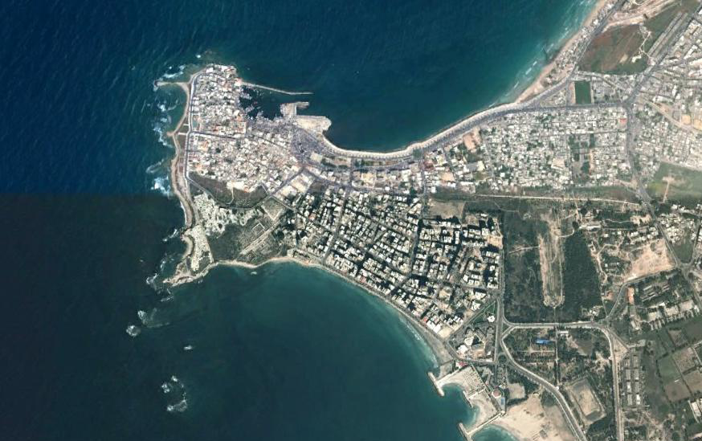
Ezekiel 28-29

Slide 3
Ezekiel 28-29

Slide 4
Ezekiel 28-29
Dan. 4:30-31 ~ ³⁰ The king spoke, saying, "Is not this great Babylon, that I have built for a royal dwelling by my mighty power and for the honor of my majesty?" ³¹ While the word was still in the king 's mouth, a voice fell from heaven:" King Nebuchadnezzar, to you it is spoken: the kingdom has departed from you!

Slide 5
Ezekiel 28-29
Rev. 3:17-18 ~ ¹⁷ Because you say, "I am rich, have become wealthy, and have need of nothing '— and do not know that you are wretched, miserable, poor, blind, and naked — ¹⁸ I counsel you to buy from Me gold refined in the fire, that you may be rich; and white garments, that you may be clothed, that the shame of your nakedness may not be revealed; and anoint your eyes with eye salve, that
you may see.

Slide 6
Ezekiel 28-29

Slide 7
Ezekiel 28-29
Pit ~ not the same as 26:20 (bor) or Sheol, but basically the same meaning

Slide 8
Ezekiel 28-29

Slide 9
Ezekiel 28-29
King ~ melek; prince (v. 2) ~ nagid

Slide 10
Ezekiel 28-29

Slide 11
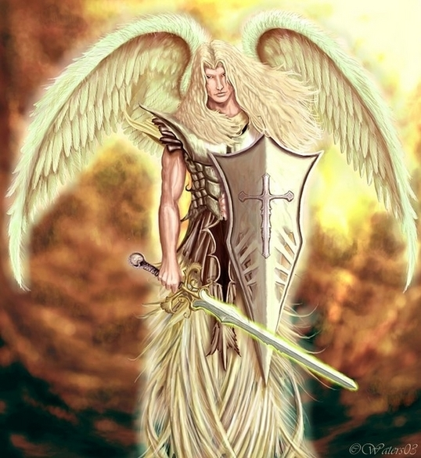
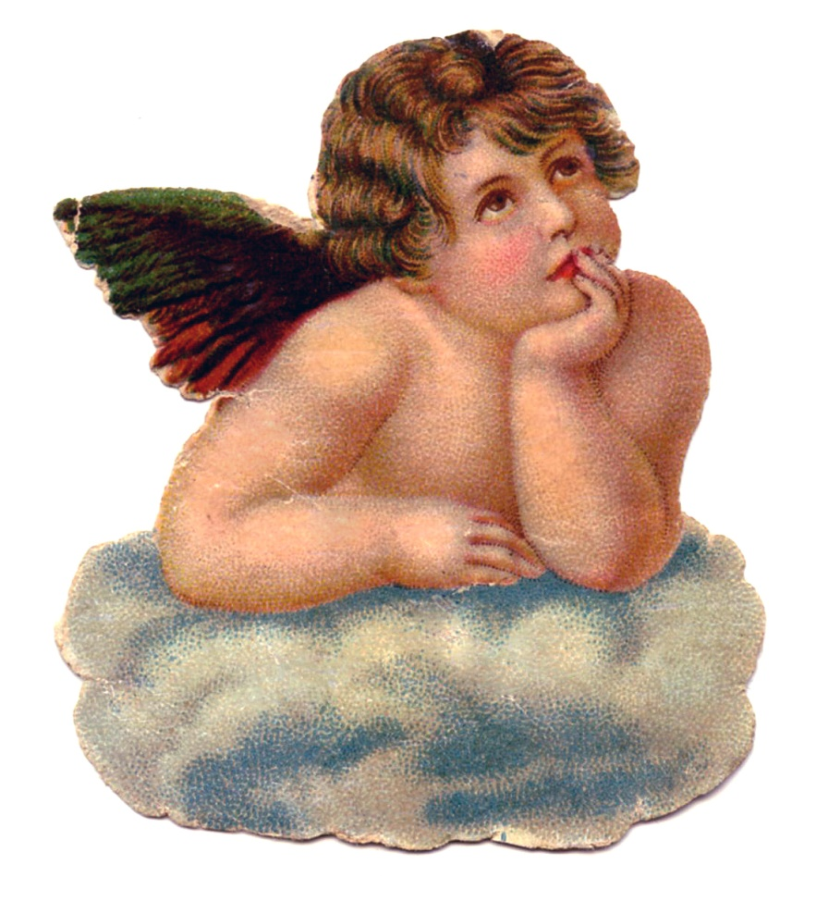
Ezekiel 28-29
Covers ~ sakak – to cover protectively

Slide 12
Ezekiel 28-29

Slide 13
Ezekiel 28-29
Lucifer ~ heylel – literally, shining one

Slide 14
Ezekiel 28-29

Slide 15
Ezekiel 28-29
212º
32º
459.65º

Slide 16
Ezekiel 28-29

Slide 17
Ezekiel 28-29
Jan. 7, 587 BC ~ midst of the siege

Slide 18
Ezekiel 28-29

Slide 19
Ezekiel 28-29
Monster ~ KJV, dragon – tannin

Slide 20
Ezekiel 28-29

Slide 21
Ezekiel 28-29
4,258 mi.

Slide 22
Ezekiel 28-29

Slide 23
Ezekiel 28-29
April, 571 BC ~ the latest dated prophecy in Ezekiel

Slide 24
Ezekiel 28-29

