Slide 1
Ezekiel 25-27

Slide 2
Ezekiel 25-27
1 Pet. 4:17 ~ For the time has come for judgment to begin at the house of God; and if it begins with us first, what will be the end of those who do not obey the gospel of God?

Slide 3
Ezekiel 25-27

Slide 4
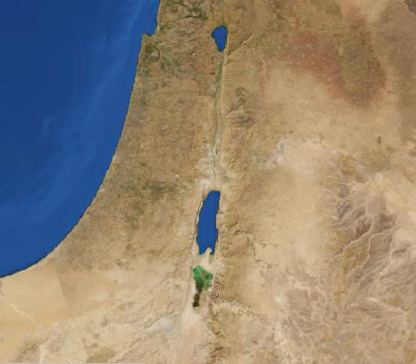
Ezekiel 25-27
Ammon
Philistia
Judah
Moab
Edom

Slide 5
Ezekiel 25-27

Slide 6
Ezekiel 25-27
J. Vernon Magee ~ "If you can rebuild Tyre, you can contradict God’s word, but I advise you to invest your money somewhere else."

Slide 7
Ezekiel 25-27

Slide 8
Ezekiel 25-27
Pit ~ bor, not Sheol but synonymous with it

Slide 9
Ezekiel 25-27

Slide 10
Ezekiel 25-27
Borders ~ NIV – better, domain

Slide 11
Ezekiel 25-27

Slide 12
Ezekiel 25-27
Dedan ~ possibly Redan (Rhodes, as in the NIV, LXX)

Slide 13
Ezekiel 25-27

