Slide 1
Ezekiel 14-16

Slide 2
Ezekiel 14-16
Induced (v. 9) ~ KJV, deceived – from a root meaning gullible
John MacArthur ~ "God will deceive (entice) a false prophet only in a qualified sense. When one willfully rejects His Word, He places a resulting cloud of darkness, or permits it to continue, hiding the truth so that the person is deceived by his own
obstinate self-will."

Slide 3
Ezekiel 14-16

Slide 4
Ezekiel 14-16
1st deportation ~ 605 BC (Daniel was probably around 15 y/o)
605BC
595BC
585BC
Ezekiel's prophecy ~ 592 BC (Daniel was probably in mid-20s)

Slide 5
Ezekiel 14-16

Slide 6
Ezekiel 14-16
Wild ~ KJV – noisome

Slide 7
Ezekiel 14-16

Slide 8
Ezekiel 14-16
Prov. 14:12 ~ There is a way that seems right to a man, But its end is the way of death.

Slide 9
Ezekiel 14-16

Slide 10
Ezekiel 14-16
Badger ~ probably porpoise (as in NASB)

Slide 11
Ezekiel 14-16

Slide 12
Ezekiel 14-16
Ezek. 12:15 ~ You were perfect in your ways from the day you were created,
Till iniquity was found in you.

Slide 13
Ezekiel 14-16

Slide 14
Ezekiel 14-16
Nakedness ~ synonym = exile

Slide 15
Ezekiel 14-16

Slide 16
Ezekiel 14-16
Luke 12:48 ~ But he who did not know, yet committed things deserving of stripes, shall be beaten with few. For everyone to whom much is given, from him much will be required; and to whom much has been committed, of him they will ask the more.

Slide 17
Ezekiel 14-16

Slide 18
Ezekiel 14-16
Ezek. 47:8-9 ~ ⁸ Then he said to me: "This water flows toward the eastern region, goes down into the valley, and enters the sea. When it reaches the sea, its waters are healed. ⁹ And it shall be that every living thing that moves, wherever the rivers go, will live. There will be a very great multitude of fish, because these waters go there; for they will be healed, and everything will
live wherever the river goes."

Slide 19
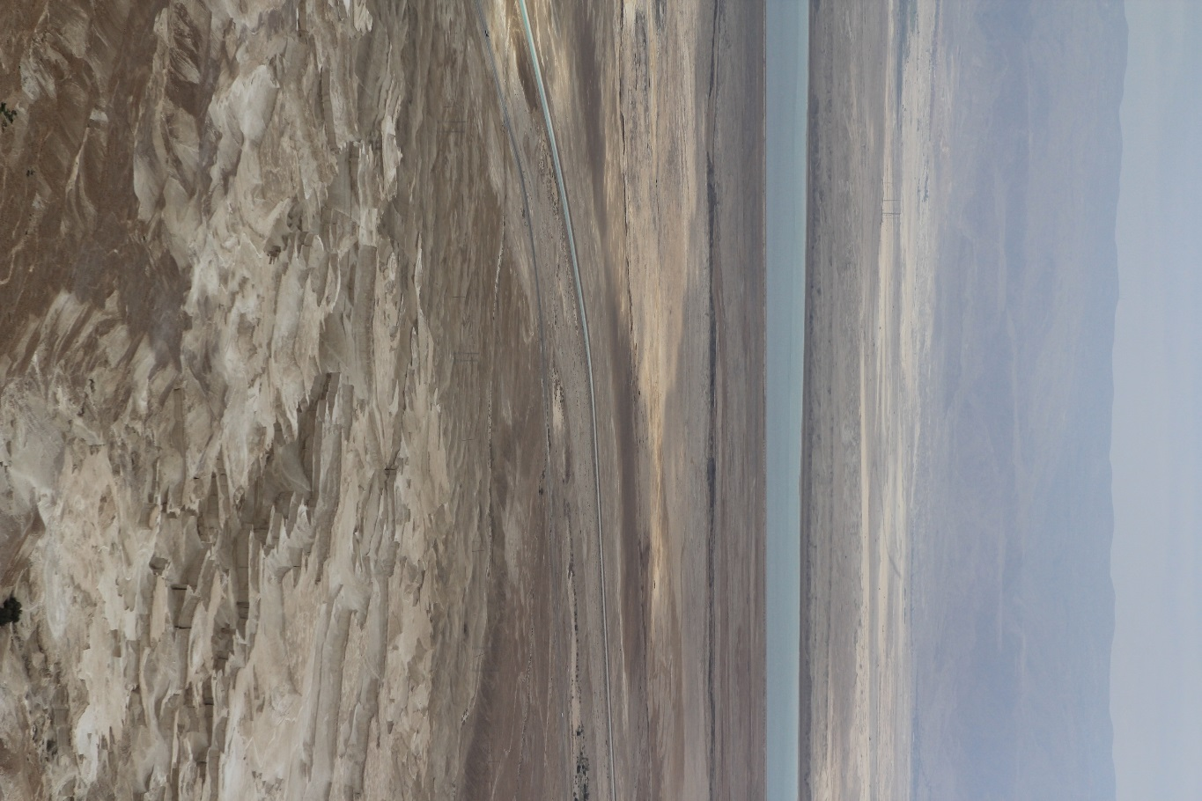
Ezekiel 14-16
Kidron Valley
Jerusalem

Slide 20
Ezekiel 14-16

Slide 21
Ezekiel 14-16
KJV ~ but not by thy covenant.
NLT ~ even though they are not part of our covenant.

Slide 22
Ezekiel 14-16

