Slide 1

Ephesians 5:25-33

Slide 2
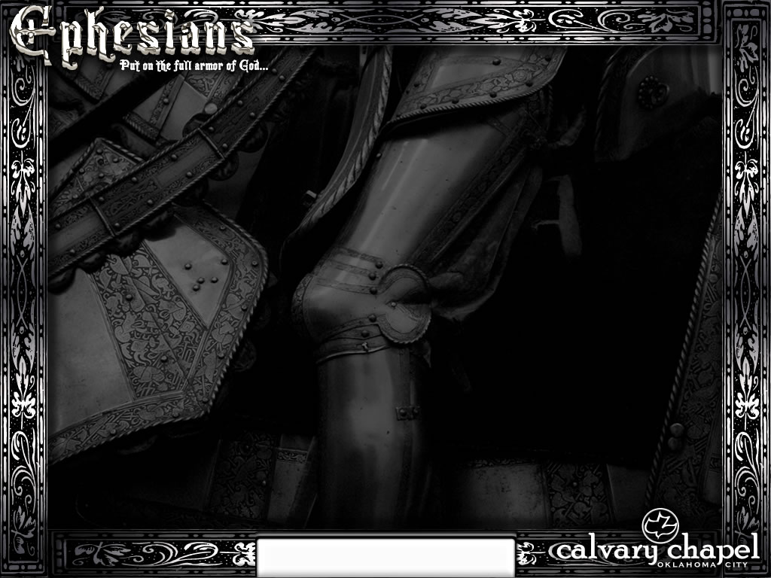
Eph. 5:25 ~ Husbands, love your wives, just as Christ also loved the church and gave Himself for her …
Ephesians 5:25-33

Slide 3
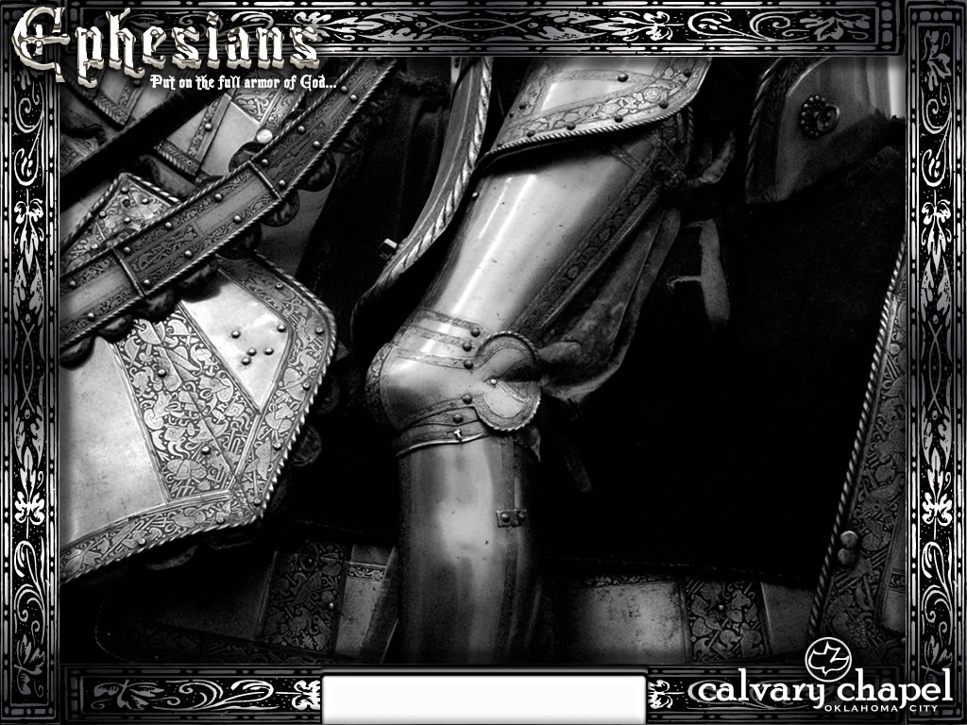
Ephesians 5:25-33

Slide 4
10 Reasons why it's great to be a guy
(OK, 12)
1. You can open all your own jars.
2. When clicking through the tv channels, you don’t have to stall on every shot of someone crying.
3. You don’t have to lug a useful bag of stuff with you everywhere you go.
4. You can go to the bathroom without a support group.
5. You get extra credit for the slightest act of thoughtfulness.
6. Wedding plans take care of themselves.
7. Three pairs of shoes are more than enough.
Ephesians 5:25-33

Slide 5
10 Reasons why it's great to be a guy
(OK, 12)
8. You don’t have to clean your apartment if the meter reader is coming by.
9. You can watch a game in silence with your buddy for hours without even thinking, “He must be mad at me.”
10. You never have to drive to another gas station because this one’s “just too yucky.”
11. You can drop by to see a friend without bringing a little gift.
12. If you don’t call your buddy when you say you will, he won’t tell your friends you’ve changed.
Ephesians 5:25-33

Slide 6
Ephesians 5:25-33

Slide 7
Guys' rules:
1. Learn to work the toilet seat.
1. Sunday = sports.
1. Shopping is NOT a sport.
1. Crying is blackmail.
1. Ask for what you want.
1. We don't remember dates.
1. Most guys own three pairs of shoes – tops.
1. "Yes" and "No" are perfectly acceptable answers to almost every question.
1. Come to us with a problem only if you want help solving it.
Ephesians 5:25-33

Slide 8
Guys' rules:
1. Check your oil! Please.
1. Anything we said 6 months ago is inadmissible in an argument.
1. Do not, under any circumstances, ever … ever ask us if this dress makes you look fat.
1. If something we said can be interpreted two ways, and one of the ways makes you sad or angry, we meant the other one.
1. Christopher Columbus did not need directions, and neither do we.
1. We are not mind readers and we never will be.
1. ALL men see in only 16 colors.
Ephesians 5:25-33

Slide 9
Guys' rules:
1. If we ask what is wrong and you say "nothing," we will act like nothing's wrong.
1. When we have to go somewhere, absolutely anything you wear is fine.
1. Don't ask us what we're thinking about unless you are prepared to discuss such topics as navel lint, the shotgun formation, or monster trucks.
1. You have enough clothes.
1. You have too many shoes.
1. Peanuts are as exciting for us as handbags are for you
1. I'm in shape. ROUND is a shape.
Ephesians 5:25-33

Slide 10
Ephesians 5:25-33

Slide 11
What Guys Really Mean:
"It's a guy thing."
"There is no rational thought pattern connected with it, and you have no chance at all of making it logical."
"Can I help with dinner?"
"Why isn't it already on the table?"
"Uh huh," "Sure, honey," or "Yes, dear."
Absolutely nothing. It's a conditioned response.
"It would take too long to explain."
"I have no idea how it works."
"I'm getting more exercise lately."
"The batteries in the remote are dead."
Ephesians 5:25-33

Slide 12
What Guys Really Mean:
"Take a break, honey, you're working too hard."
"I can't hear the game over the vacuum cleaner."
"Honey, we don't need material things to prove our love."
"I forgot our anniversary again."
"That's women's work."
"It's difficult, dirty, and thankless."
"You know how bad my memory is."
"I remember the theme song to 'F Troop', the address of the first girl I ever kissed and the Vehicle Identification Numbers of every car I've ever owned, but I forgot your birthday."
Ephesians 5:25-33

Slide 13
What Guys Really Mean:
"Oh, don't fuss. I just cut myself, it's no big deal."
"I have severed a limb, but will bleed to death before I admit I'm hurt."
"I do help around the house."
"I once put a dirty towel in the laundry basket."
"I can't find it."
"It didn't fall into my outstretched hands, so I'm completely clueless."
"I heard you."
"I have no idea what you just said, and am hoping desperately that I can fake it well enough so that you don't spend the next 3 days yelling at me."
Ephesians 5:25-33

Slide 14
What Guys Really Mean:
"You look terrific."
"Oh, please don't try on one more outfit. I'm starving."
"I really missed you."
"I can't find my sock drawer, the kids are hungry and we are out of toilet paper."
"I'm not lost. I know exactly where we are."
"I'm lost. I have no idea where we are, and no one will ever see us alive again."
Ephesians 5:25-33

Slide 15
Ephesians 5:25-33

Slide 16
Word ~ rhēma – spoken word
Ephesians 5:25-33

Slide 17
Ephesians 5:25-33

Slide 18

Ephesians 5:25-33

Slide 19
Ephesians 5:25-33

