Slide 1
Ephesians 2:11-22

Slide 2
Luke 7:47 ~ "Therefore I say to you, her sins, which are many, are forgiven, for she loved much. But to whom little is forgiven, the same loves little."
Ephesians 2:11-22

Slide 3
Ephesians 2:11-22

Slide 4
2 Cor. 5:21 … He made Him who knew no sin to be sin for us, that we might become the righteousness of God in Him.
Ephesians 2:11-22

Slide 5
Ephesians 2:11-22

Slide 6
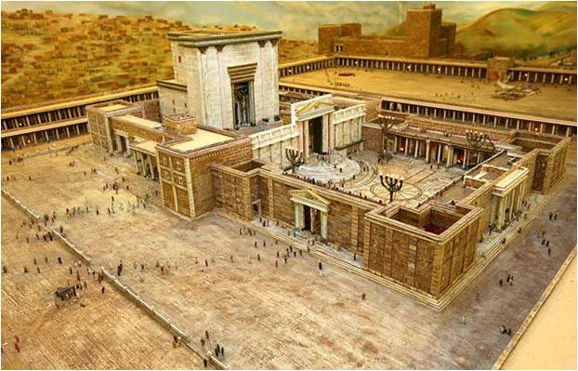
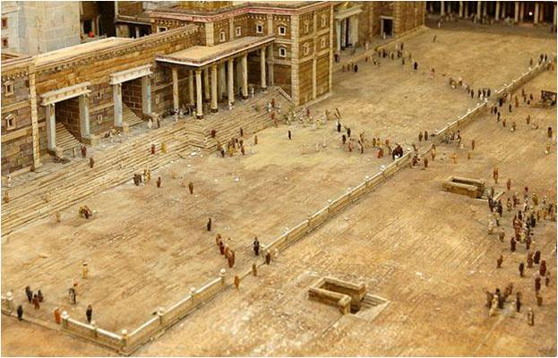
"No man of another race is to proceed within the partition and enclosing wall about the sanctuary. Any one arrested there will have himself to blame for the penalty of death which will be imposed as a consequence."
Ephesians 2:11-22

Slide 7
Ephesians 2:11-22

Slide 8
Luke 18:14 ~ "I tell you, this man went down to his house justified rather than the other; for everyone who exalts himself will be humbled, and he who humbles himself will be exalted."
Ephesians 2:11-22

Slide 9
Ephesians 2:11-22

Slide 10
1 Cor. 4:7 ~ For who makes you differ from another? And what do you have that you did not receive? Now if you did indeed receive it, why do you boast as if you had not received it?
Ephesians 2:11-22

Slide 11
Ephesians 2:11-22

Slide 12
“Alfred Nobel, the inventor of dynamite, who died yesterday, devised a way for more people to be killed in a war than ever before, and he died a very rich man.“ – Alfred Nobel’s epitaph
“Every man ought to have the chance to correct his epitaph in midstream and write a new one.“ – Alfred Nobel
Ephesians 2:11-22

Slide 13
Ephesians 2:11-22

