Slide 1
Ephesians 1:1-10

Slide 2
Outline:
Sit ~ 1:1 – 3:21
Walk ~ 4:1 – 6:9
Stand ~ 6:1 – 6:24
Ephesians 1:1-10

Slide 3
Ephesians 1:1-10

Slide 4
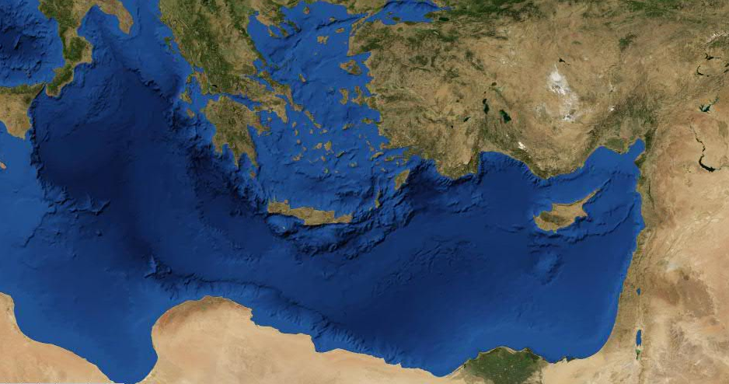
"Prison Epistles"
Ephesians, Philippians, Colossians, Philemon
en Ephesō (1:1)
paulov apostolov ihsou cristou dia yelhmatov yeou toiv agioiv toiv ousin en ōklōma siti kai pistoiv en cristw ihsou cariv umin kai eirhnh apo yeou patrov hmwn kai kuriou ihsou cristou euloghtov o yeov kai pathr tou kuriou hmwn ihsou cristou o euloghsav hmav en pash eulogia pneumatikh en toiv epouranioiv en cristw kaywv exelexato hmav en autw pro katabolhv kosmou einai hmav agiouv kai amwmouv katenwpion autou en agaph proorisav hmav eiv uioyesian dia ihsou cristou eiv auton kata thn eudokian tou yelhmatov autou eiv epainon doxhv thv caritov autou en h ecaritwsen hmav
Oklahoma City
Ephesus
ca. AD 61-62
Ephesians 1:1-10

Slide 5
Ephesians 1:1-10

Slide 6
What is a saint?
"One officially recognized esp. by canonization, as being entitled to public veneration and capable of interceding for people on earth."
"A person who has died and has been declared a saint by canonization; a person of exceptional holiness; model of excellence or perfection of a kind; one having no equal."
Ephesians 1:1-10

Slide 7
Ephesians 1:1-10

Slide 8
Roman Catholic Criteria:
1. Dead
2. Do good deeds
3. At least one verifiable miracle
Christian Criteria:
1. Die to self
2. Created for good works
3. Walking, living, breathing miracles
Ephesians 1:1-10

Slide 9
Ephesians 1:1-10

Slide 10
vv. 3-14
Each are single sentences in Greek
vv. 15-23
Ephesians 1:1-10

Slide 11
Ephesians 1:1-10

Slide 12
Blessed (eulogētos)
Blessed (eulogeō)
To speak well of
Blessing (eulogia)
Ephesians 1:1-10

Slide 13
Ephesians 1:1-10

Slide 14
In Christ (Him, Jesus, etc.) 23x
Ephesians 1:1-10

Slide 15
Ephesians 1:1-10

Slide 16
Calvinism:
TULIP
otal Depravity
nconditional Election
imited Atonement
rresistible Grace
erseverance of the Saints
Ephesians 1:1-10

Slide 17
Ephesians 1:1-10

Slide 18
Rom. 8:29-30 ~ ²⁹ For whom He foreknew, He also predestined to be conformed to the image of His Son, that He might be the firstborn among many brethren. ³⁰ Moreover whom He predestined, these He also called; whom He called, these He also justified; and whom He justified, these He also glorified.
Ephesians 1:1-10

Slide 19
Ephesians 1:1-10

Slide 20
2 Pet. 3:9 ~ The Lord is not slack concerning His promise, as some count slackness, but is longsuffering toward us, not willing that any should perish but that all should come to repentance.
Ephesians 1:1-10

Slide 21
John 6:44 ~ No one can come to Me unless the Father who sent Me draws him; and I will raise him up at the last day.
Ephesians 1:1-10

Slide 22
1 John 4:19 ~ We love Him because He first loved us.
Ephesians 1:1-10

Slide 23
Ephesians 1:1-10

Slide 24
Made us accepted ~ charitoō – aorist, active, indicative
Verb form of charis (grace)
Luke 1:28 ~ And having come in, the angel said to her, "Rejoice, highly favored one, the Lord is with you; blessed are you among women!"
Ephesians 1:1-10

Slide 25
Ephesians 1:1-10

Slide 26
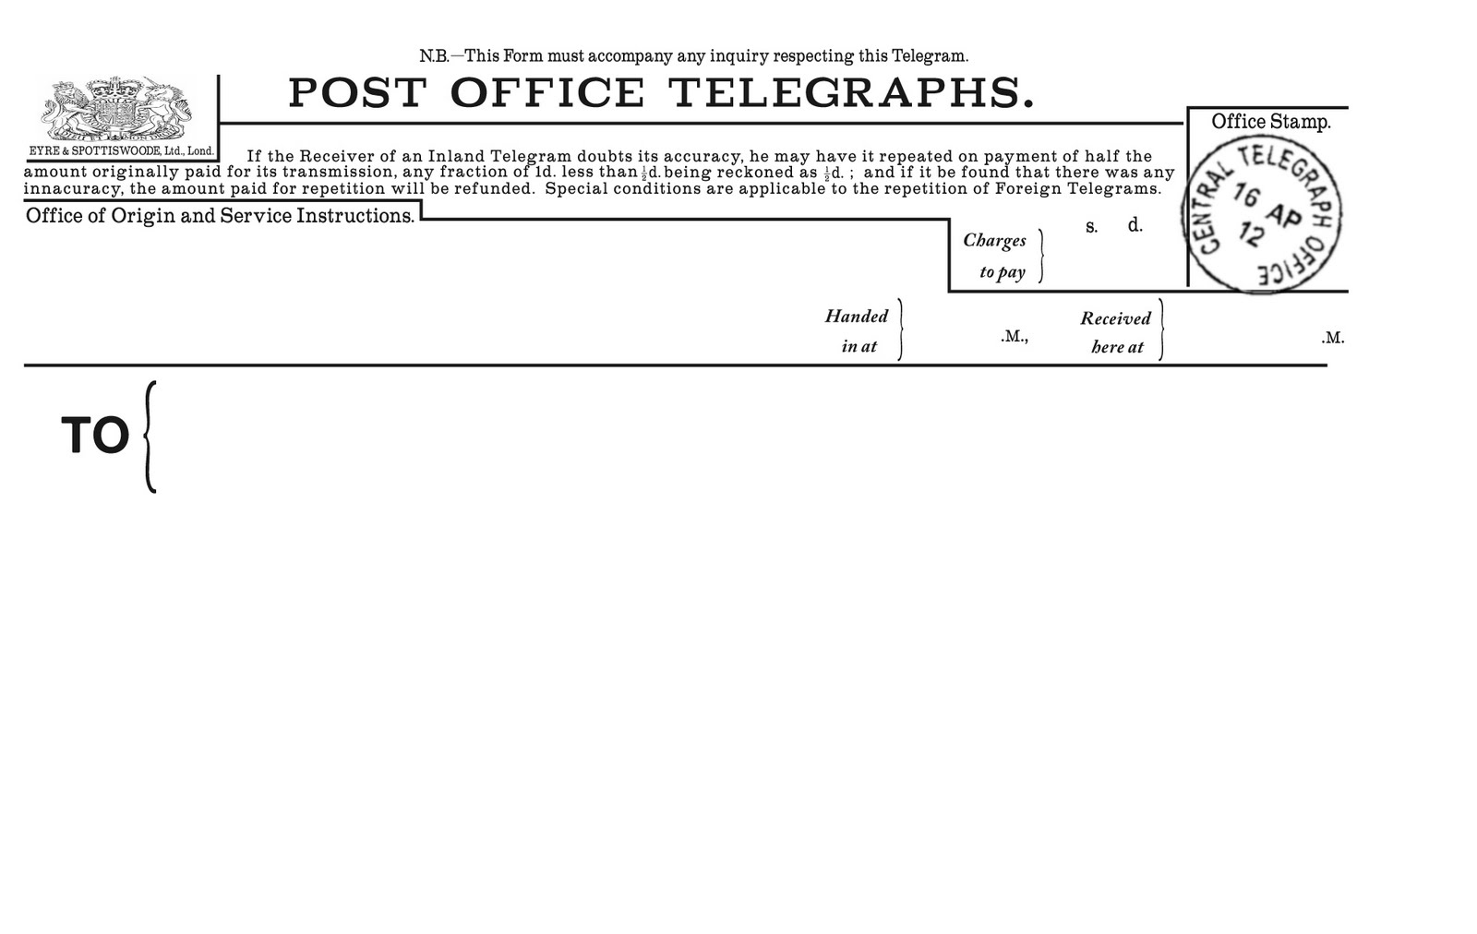
Pastor George Morgan
Campbell Morgan
Rejected.
Rejected on earth. Accepted in heaven.
Campbell
Father
Ephesians 1:1-10

Slide 27
Ephesians 1:1-10

Slide 28
Redemption ~ apolutrōsis – apo (away from) + lutron (ransom)
lutron from luō (to loose)
To ransom away from
Ephesians 1:1-10

Slide 29
Ephesians 1:1-10

