Slide 1
To everything thing there is a season
A time for every purpose under heaven
ECCLESIASTES
03-04
A free CD of this message will be available following the service
IT WILL ALSO be available LATER THIS WEEK
VIA cALVARYOKC.CO

Slide 2
Solomon's doctoral thesis:
Life's a bore ~ 1:4-11, examined in 3-5:9
Emptiness of riches ~ 5:10-6:12
Emptiness of wisdom and certainty of death in 7-10
Ecclesiastes 03-04

Slide 3
Ecclesiastes 03-04

Slide 4
Kill ~ sometimes people die
Heal ~ sometimes they don’t
Cast away ~ clearing the land
Gather ~ to build a wall
Embrace ~ to say “Hello”
Refrain ~ to say “Goodbye”
Keep silence ~ to grieve
Speak ~ to “move on”
Ecclesiastes 03-04

Slide 5
Ecclesiastes 03-04

Slide 6
Henry Martyn ~ “If God has a work for me to do I cannot die.”
Ecclesiastes 03-04

Slide 7
Ecclesiastes 03-04

Slide 8
Rom. 8:28 ~ And we know that all things work together for good to those who love God, to those who are the called according to His purpose.
C. H. Spurgeon ~ “God is too good to be unkind, too wise to be mistaken. And when you cannot trace His hand, you can always trust His heart.”
Ecclesiastes 03-04

Slide 9
Ecclesiastes 03-04

Slide 10
Eternity ~ KJV, also he hath set the world in their heart …
The word occurs over 430x in the Old Testament
Translated variously as perpetual, forever, always, etc.
Literally, “concealed, that is, the vanishing point”
Ecclesiastes 03-04

Slide 11
Ecclesiastes 03-04

Slide 12
Beasts have life cycles … men have histories
Ecclesiastes 03-04

Slide 13
Ecclesiastes 03-04

Slide 14
Isaac Pennington ~ “Thus has the Lord been teaching me to live upon Himself: not upon anything received from Him but upon the Life itself.”
Ecclesiastes 03-04

Slide 15
Ecclesiastes 03-04

Slide 16
Arnold Toynbee ~ “We are the 1st of 21 civilizations daring to build a society without a moral point of reference.”
Ecclesiastes 03-04

Slide 17
Ecclesiastes 03-04

Slide 18
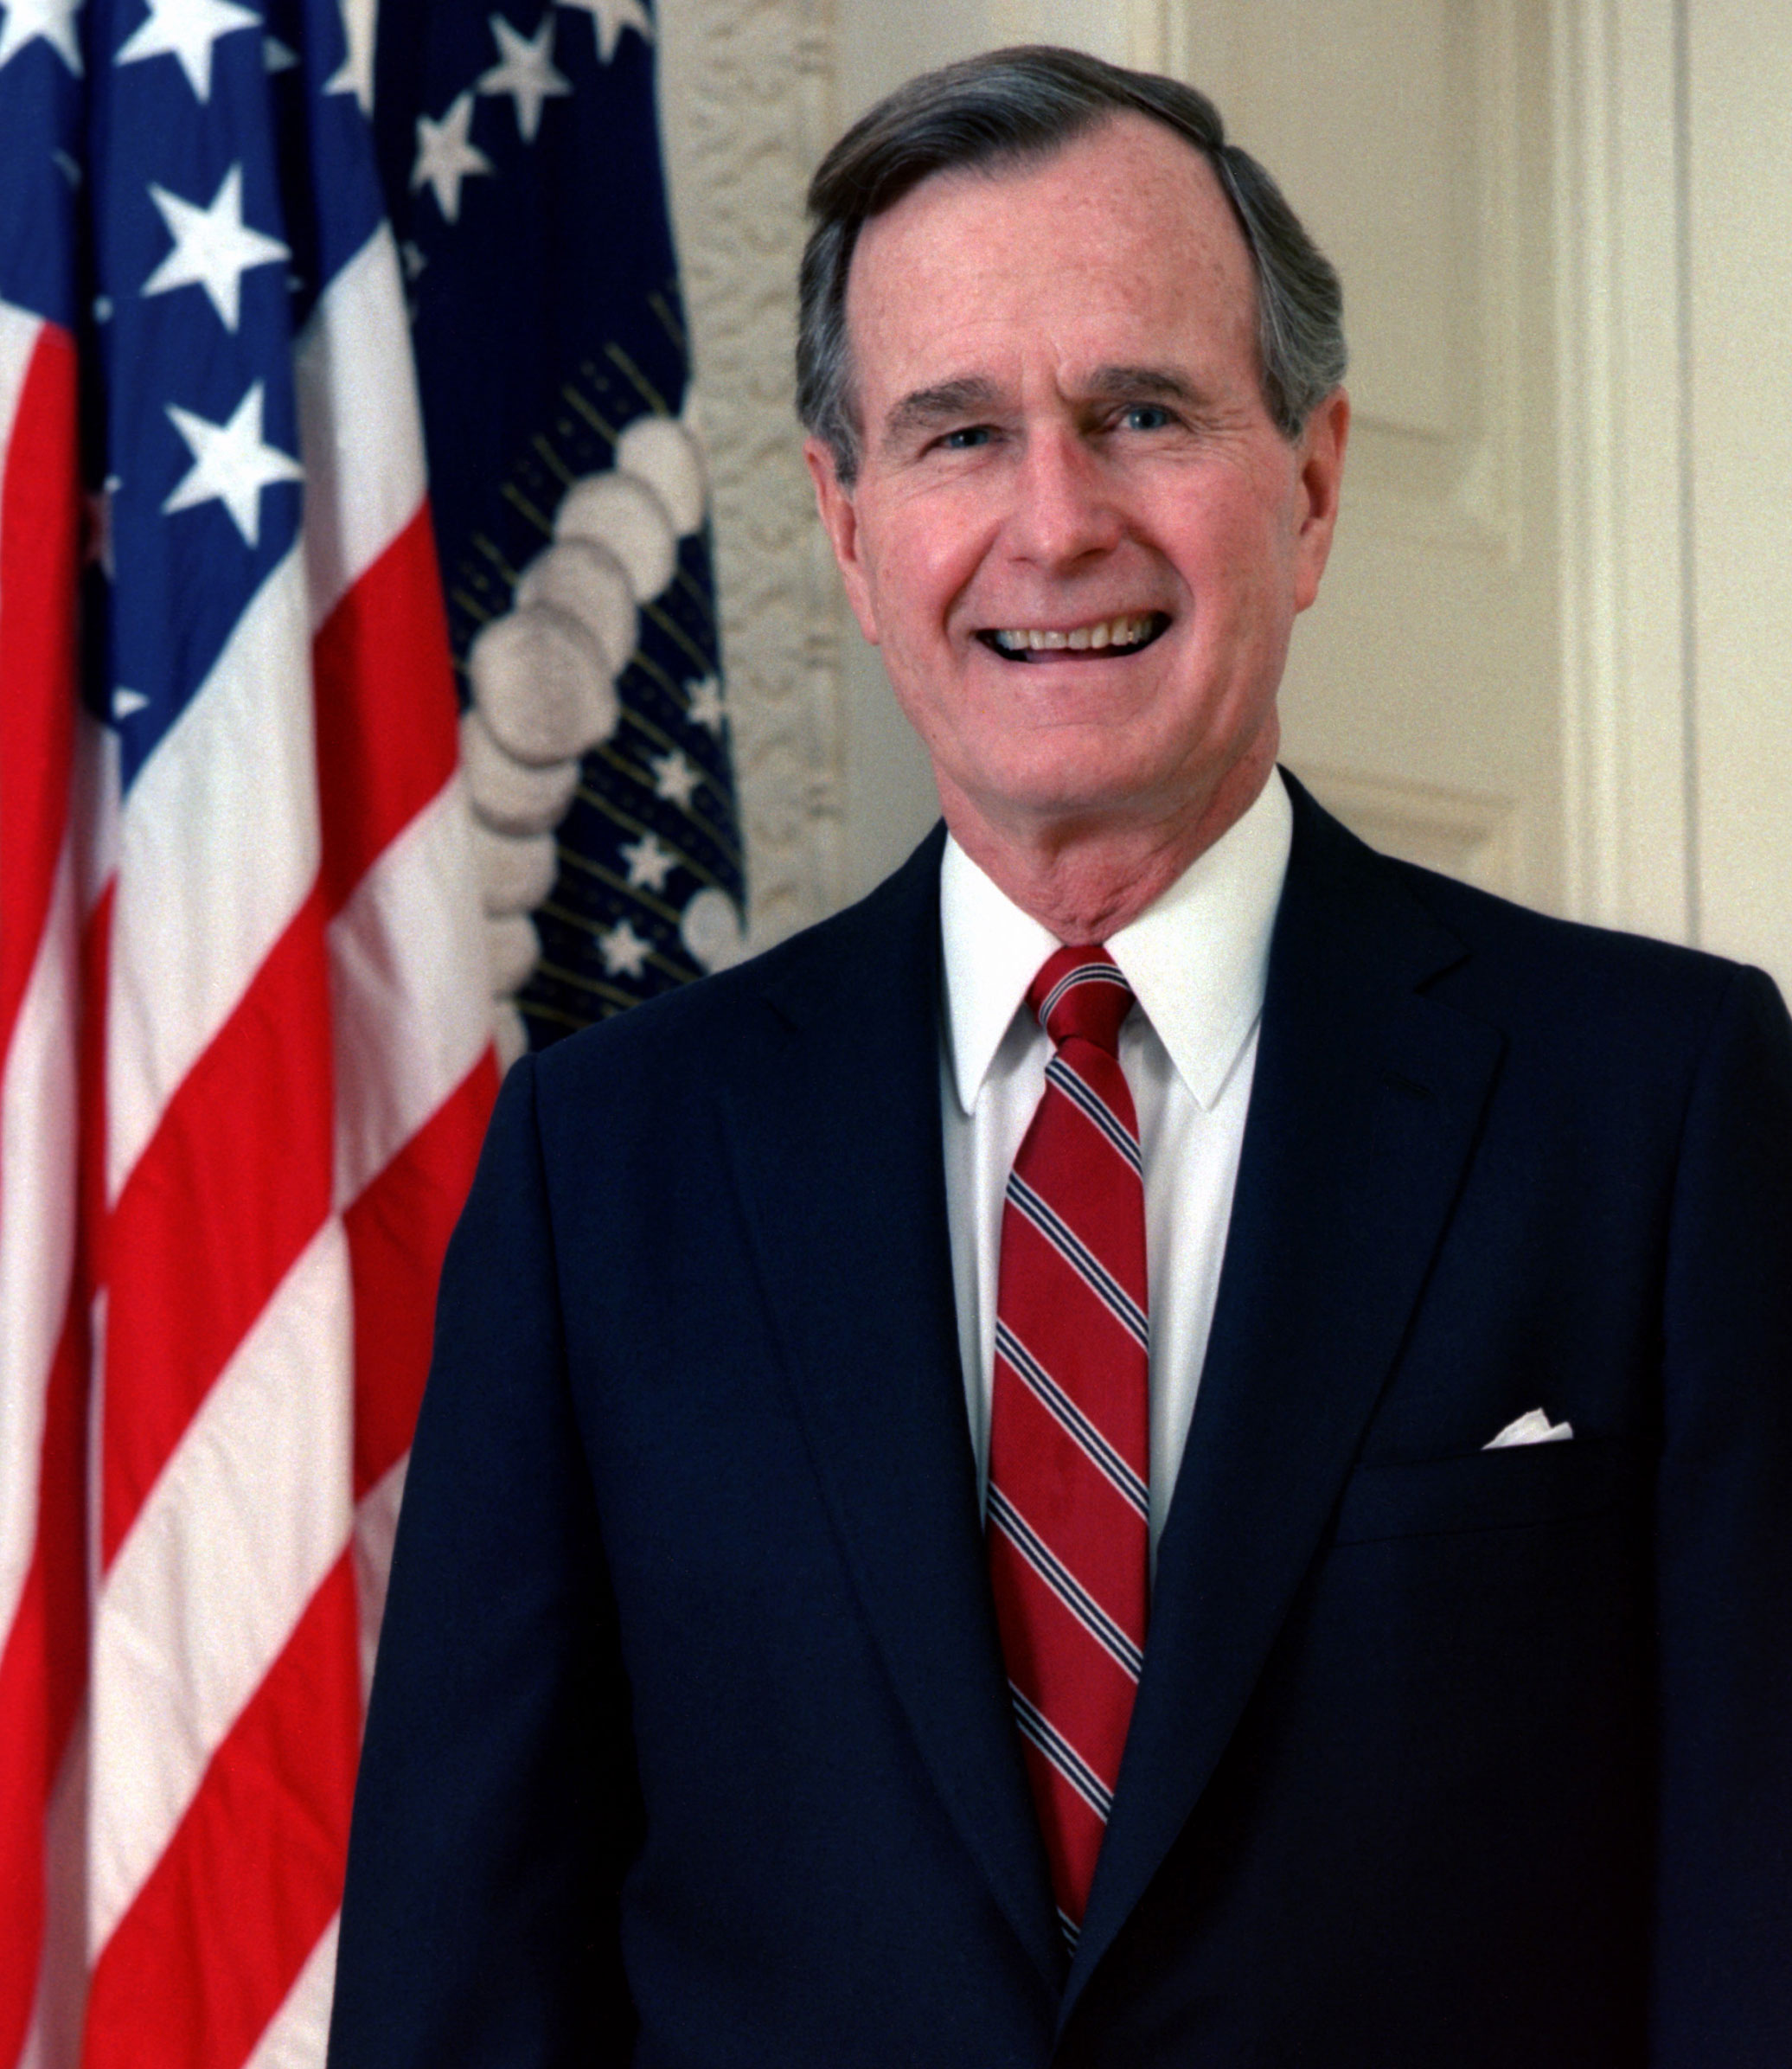
90
80
89%
70
60
50
40
29%
Geo. H. W. Bush
30
Mar
May
Jul
Sep
Nov
Jan
Mar
May
Jul
1991
1992
Ecclesiastes 03-04

Slide 19
Ecclesiastes 03-04

