Slide 1
the Book of
Daniel
11.21 - 12.13
A free CD of the study will be available upon request following the service.
A podcast will be available later in the week at calvaryokc.com.
A videowill be available at facebook.com/CalvaryOKC and our YouTube channel (Calvary Chapel OKC)

Slide 2
Daniel
11.21 - 12.13
Antiochus II Theos
262-246 BC (Dan. 11:6)
Antiochus III The Great
223-187 BC (Dan. 11:10-11, 13, 15-19)
Antiochus I Soter 281-262 BC
Seleucus III Soter
227-223 BC (Dan. 11:10)
Antiochus IV Epiphanes
176-163 BC (Dan. 11:21-35)
Seleucus I Nicator
312-281 BC (Dan. 11:5)
Seleucus II Callinicus
246-227 BC (Dan. 11:7-9)
Seleucus IV Philopator 187-176 BC (Dan. 11:20)
Syria
Syria
300 BC
250 BC
200 BC
150 BC
Egypt
Egypt
Ptolemy I Soter
323-285 BC (Dan. 11:5)
Ptolemy IV Philopator
221-204 BC (Dan. 11:12, 14-15)
Ptolemy VI Philometor
181-145 BC (Dan. 11:25)
Ptolemy II Philadephus
285-246 BC (Dan. 11:6)
Ptolemy V Epiphanes
204-181 BC (Dan. 11:17)
Ptolemy III Euergetes
246-221 BC (Dan. 11:7-8)

Slide 3
Daniel
11.21 - 12.13

Slide 4
Daniel
11.21 - 12.13
Epiphanes
madman
Epimanes
God manifested
Antiochus IV ~
intrigue ~ literally, slippery

Slide 5
Daniel
11.21 - 12.13

Slide 6
Daniel
11.21 - 12.13
prince of the covenant ~ High Priest, Onias III

Slide 7
Daniel
11.21 - 12.13

Slide 8
Daniel
11.21 - 12.13
Cyprus ~ literally, Chittim (KJV)
LXX ~ romaioi – Romans

Slide 9
Daniel
11.21 - 12.13

Slide 10
Daniel
11.21 - 12.13
Dec. 16, 167 BC

Slide 11
Daniel
11.21 - 12.13

Slide 12
Daniel
11.21 - 12.13
135 fulfilled prophecies in Daniel 11:1-35
300 BC
250 BC
200 BC
150 BC
Dan. 11:1-35
(325-145 BC)

Slide 13
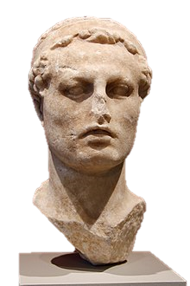
Daniel
11.21 - 12.13
?
Anti
ochus IV
christ

Slide 14
Daniel
11.21 - 12.13
135 fulfilled prophecies in Daniel 11:1-35
300 BC
250 BC
200 BC
150 BC
Dan. 11:1-35
(321-145 BC)
Dan. 11:36-12:13
(7-yr Tribulation)

Slide 15
Daniel
11.21 - 12.13
1 Thess. 4:13-18 ~ the Rapture
Followed by 7-year Tribulation (Rev. 6-18)
Followed by Judgment of the Nations (Matt. 25:31-46)
Followed by Millennium (Rev. 20:1-6)
Followed by final rebellion and Lake of Fire (Rev. 20:7-10)

Slide 16
Daniel
11.21 - 12.13

Slide 17
Daniel
11.21 - 12.13
Isaiah 14:13-14 ~ ¹³ For you have said in your heart:
“I will ascend into heaven,
I will exalt my throne above the stars of God;
I will also sit on the mount of the congregation
On the farthest sides of the north;
¹⁴ I will ascend above the heights of the clouds,
I will be like the Most High.”

Slide 18
Daniel
11.21 - 12.13
2 Thess. 2:3-4 ~ ³ Let no one deceive you by any means; for that Day will not come unless the falling away comes first, and the man of sin is revealed, the son of perdition, ⁴ who opposes and exalts himself above all that is called God or that is worshiped, so that he sits as God in the temple of God, showing himself that he is God.

Slide 19
Daniel
11.21 - 12.13

Slide 20
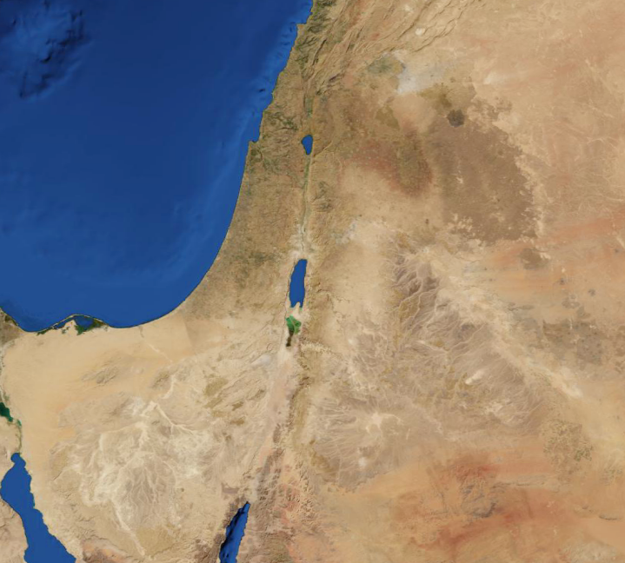
Daniel
11.21 - 12.13
West Bank
Gaza
Israel

Slide 21
Daniel
11.21 - 12.13

Slide 22
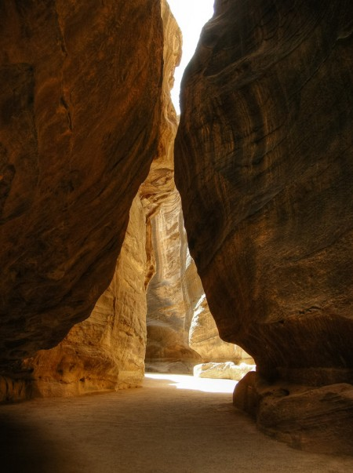
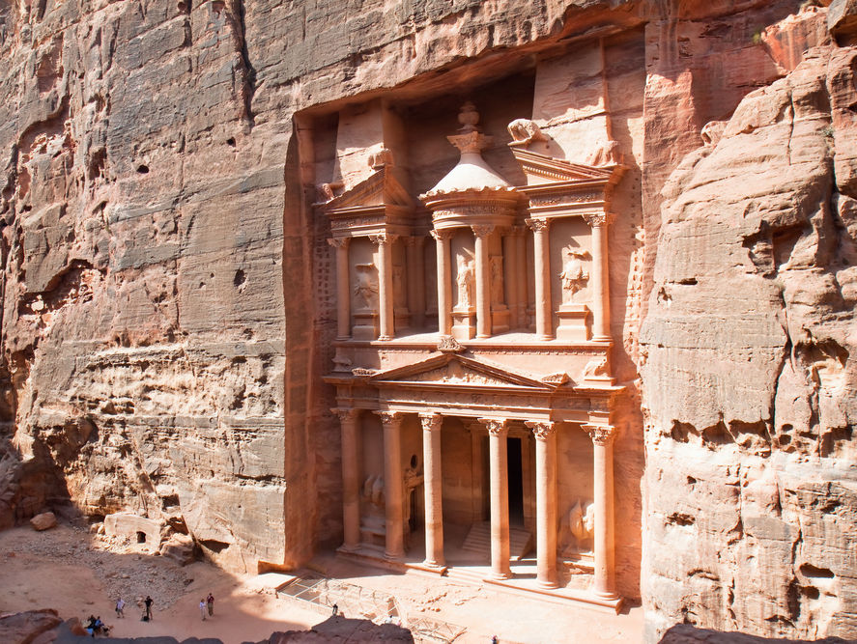
Daniel
11.21 - 12.13
Petra, Jordan ~ Old Testament, Sela

Slide 23
Daniel
11.21 - 12.13

Slide 24
Daniel
11.21 - 12.13
1 Thess. 4:13-18 ~ ¹³ But I do not want you to be ignorant, brethren, concerning those who have fallen asleep, lest you sorrow as others who have no hope. ¹⁴ For if we believe that Jesus died and rose again, even so God will bring with Him those who sleep in Jesus.
¹⁵ For this we say to you by the word of the Lord, that we who are alive and remain until the coming of the Lord will by no means precede those who are asleep. ¹⁶ For the Lord Himself will descend from heaven with a shout, with the voice of an archangel, and with the trumpet of God. And the dead in Christ will rise first. ¹⁷ Then we who are alive and remain shall be caught up together with them in the clouds to meet the Lord in the air. And thus we shall always be with the Lord. ¹⁸ Therefore comfort one another with these words.

Slide 25
Daniel
11.21 - 12.13
Rev. 20:4-5 ~ ⁵ But the rest of the dead did not live again until the thousand years were finished. This is the first resurrection. ⁶ Blessed and holy is he who has part in the first resurrection. Over such the second death has no power, but they shall be priests of God and of Christ, and shall reign with Him a thousand years.

Slide 26
Daniel
11.21 - 12.13

Slide 27
Daniel
11.21 - 12.13
Beginning of time to 1848 ~ 1”
1948-1988 ~ over 650’
1848-1948 ~ 3”

Slide 28
Daniel
11.21 - 12.13

Slide 29
Daniel
Daniel
11.21 - 12.13
11.21 - 12.13
3 ½ years
42 months
1260 days
3 ½ years
42 months
1260 days
1
2
3
4
5
6
7
Abomination of Desolation
Sheep and Goats Judgment
(Matt. 25:21-46)

Slide 30
Daniel
11.21 - 12.13

