Slide 1
the Book of
Daniel
9 . 22 - 27
A free CD of the study will be available upon request following the service.
A podcast will be available later in the week at calvaryokc.com.
A videowill be available at facebook.com/CalvaryOKC and our YouTube channel (Calvary Chapel OKC)

Slide 2
Daniel
9 . 22 - 27
Dan. 9:22-27 ~ ²² And he informed me, and talked with me, and said, “O Daniel, I have now come forth to give you skill to understand. ²³ At the beginning of your supplications the command went out, and I have come to tell you, for you are greatly beloved; therefore consider the matter, and understand the vision:
²⁴ “Seventy weeks are determined
For your people and for your holy city,
To finish the transgression,
To make an end of sins,
To make reconciliation for iniquity,
To bring in everlasting righteousness,

Slide 3
Daniel
9 . 22 - 27
Dan. 9:22-27 ~ To seal up vision and prophecy,
And to anoint the Most Holy.
²⁵ “Know therefore and understand,
That from the going forth of the command
To restore and build Jerusalem
Until Messiah the Prince,
There shall be seven weeks and sixty-two weeks;
The street shall be built again, and the wall,
Even in troublesome times.
²⁶ “And after the sixty-two weeks
Messiah shall be cut off, but not for Himself;
And the people of the prince who is to come
Shall destroy the city and the sanctuary.

Slide 4
Daniel
9 . 22 - 27
Dan. 9:22-27 ~ The end of it shall be with a flood,
And till the end of the war desolations are determined.
²⁷ Then he shall confirm a covenant with many for one week;
But in the middle of the week
He shall bring an end to sacrifice and offering.

Slide 5
Daniel
9 . 22 - 27

Slide 6
Daniel
9 . 22 - 27
weeks ~ shavuwa’ - group of seven
NLT ~ A period of seven sets of seven …
Seventy “weeks” of years
70 x 7 = 490 years
7 weeks = 49 years
62 weeks = 434 years
490 years
1 week = 7 years

Slide 7
Daniel
9 . 22 - 27

Slide 8
Daniel
9 . 22 - 27
Ezra 1:2-4 ~ given by Cyrus to rebuild the Temple (537 BC)
Ezra 6:1-12 ~ given by Darius commanding the Temple work not be hindered (519 BC)
Ezra 7:11-26 ~ given by Artaxerxes concerning practices and service of the Temple (458 BC)
Neh. 2:5-8 ~ given by Artaxerxes to rebuild the city walls (444 BC)

Slide 9
Daniel
9 . 22 - 27

Slide 10
Daniel
9 . 22 - 27
1st Division (7 seven-year periods):
From the command to rebuild the city until its completion
49 years ~ from 444 BC to 395 BC
2nd Division (62 seven-year periods):
From the completion of the city to the coming of the Messiah
434 years

Slide 11
Daniel
9 . 22 - 27
1st div. (49 yr.) + 2nd div. (434 yr.)
49 years (1st Division)
+ 434 years (2nd Division)
483 years
Hebrew lunar year = 360 days
360 days
x 483 years
173,800 days

Slide 12
Daniel
9 . 22 - 27
Convert the Hebrew reckoning to our Gregorian calendar:
173,880 days ÷ 365.25 = 476.06 years
444 BC
Mar. 5 – when the command to rebuild was given
+ 476 years
The length of the 7 weeks and the 62 weeks added together
AD 33
Mar. 30 – the Sunday before Passover or the day of the Triumphal Entry

Slide 13
Daniel
9 . 22 - 27
173, 880 days
7 “weeks”
62 “weeks”
400 BC
300 BC
200 BC
100 BC
BC/AD
Artaxerxes' decree (Mar. 5, 444 BC)
Triumphal Entry (Mar. 30, AD 33)
Jerusalem rebuilt (395 BC)

Slide 14
Daniel
9 . 22 - 27

Slide 15
Daniel
9 . 22 - 27
Rom. 11:25 ~ For I do not desire, brethren, that you should be ignorant of this mystery, lest you should be wise in your own opinion, that blindness in part has happened to Israel until the fullness of the Gentiles has come in.

Slide 16
Daniel
9 . 22 - 27

Slide 17
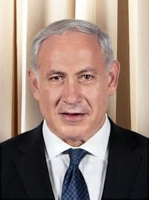
Daniel
9 . 22 - 27
war ~ literally, warring
Benjamin Netanyahu (b. 1949) ~ “If the Arabs put down their weapons today, there would be no more ‎violence. If the Jews put down their weapons ‎today, there would be no﻿ ‎more Israel.‎”

Slide 18
Daniel
9 . 22 - 27

Slide 19
Daniel
9 . 22 - 27
Russia
Ukraine
Kazakhstan
Bulgaria
Georgia
Azerbaijan
Armenia
Romania
Turkey
Iran
Syria
Saudi Arabia
Libya
Libya
Sudan

Slide 20
Daniel
9 . 22 - 27
Rev. 11:1-2a ~ ¹ Then I was given a reed like a measuring rod. And the angel stood, saying, “Rise and measure the temple of God, the altar, and those who worship there. ^{2a} But leave out the court which is outside the temple, and do not measure it, for it has been given to the Gentiles.”

Slide 21
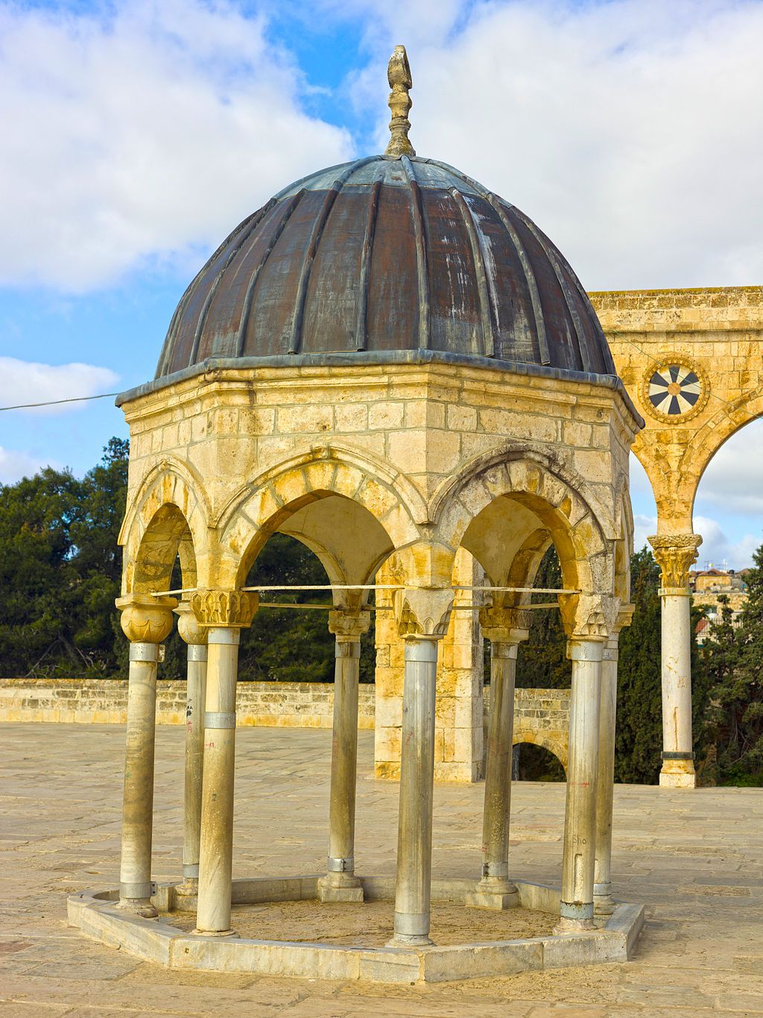
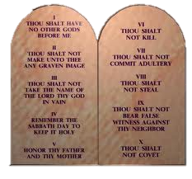
Daniel
9 . 22 - 27
Western Wall
Temple Mount
al-Aqsa Mosque
Dome of the Rock
Dome of the
Spirits
Tablets

Slide 22
Daniel
9 . 22 - 27

Slide 23
Daniel
9 . 22 - 27
1 Thess. 4:17-18 ~ ¹⁷ Then we who are alive and remain shall be caught up together with them in the clouds to meet the Lord in the air. And thus we shall always be with the Lord. ¹⁸ Therefore comfort one another with these words.

Slide 24
Daniel
9 . 22 - 27
Fullness of the Gentiles
70th week
7 “weeks”
62 “weeks”
400 BC
200 BC
BC/AD
AD 200
AD 2000
Artaxerxes' decree (Mar. 5, 444 BC)
Triumphal Entry (Mar. 30, AD 33)
Rapture
Jerusalem rebuilt (395 BC)

Slide 25
Daniel
9 . 22 - 27
Rev. 11:1-2 ~ ¹ Then I was given a reed like a measuring rod. And the angel stood, saying, “Rise and measure the temple of God, the altar, and those who worship there. ² But leave out the court which is outside the temple, and do not measure it, for it has been given to the Gentiles.
And they will tread the holy city underfoot for forty-two months.”

Slide 26
Daniel
9 . 22 - 27

Slide 27
Daniel
9 . 22 - 27
covenant ~ b’rit – 284x in the Old Testament
Always means covenant

Slide 28
Daniel
9 . 22 - 27
Matt. 24:15 ~ Therefore when you see the “abomination of desolation,” spoken of by Daniel the prophet, standing in the holy place (whoever reads, let him understand),
2 Thess. 2:3-4 ~ ³ Let no one deceive you by any means; for that Day will not come unless the falling away comes first, and the man of sin is revealed, the son of perdition, ⁴ who opposes and exalts himself above all that is called God or that is worshiped, so that he sits as God in the temple of God, showing himself that he is God.

Slide 29
Daniel
9 . 22 - 27

