Slide 1
the Book of
Daniel
9 . 1 - 21
A free CD of the study will be available upon request following the service.
A podcast will be available later in the week at calvaryokc.com.
A videowill be available at facebook.com/CalvaryOKC and our YouTube channel (Calvary Chapel OKC)

Slide 2
Daniel
9 . 1 - 21
Lev. 26:34-35 ~ ³⁴ Then the land shall enjoy its sabbaths as long as it lies desolate and you are in your enemies’ land; then the land shall rest and enjoy its sabbaths. ³⁵ As long as it lies desolate it shall rest — for the time it did not rest on your sabbaths when you dwelt in it.

Slide 3
Daniel
9 . 1 - 21
Jer. 25:11 ~ And this whole land shall be a desolation and an astonishment, and these nations shall serve the king of Babylon seventy years.
2 Chr. 36:21 ~ to fulfill the word of the Lord by the mouth of Jeremiah, until the land had enjoyed her Sabbaths. As long as she lay desolate she kept Sabbath, to fulfill seventy years.

Slide 4
Daniel
9 . 1 - 21
Jer. 29:10-12 ~ ¹⁰ For thus says the Lord: After seventy years are completed at Babylon, I will visit you and perform My good word toward you, and cause you to return to this place.
¹¹ For I know the thoughts that I think toward you, says the Lord, thoughts of peace and not of evil, to give you a future and a hope.
¹² Then you will call upon Me and go and pray to Me, and I will listen to you.
¹³ And you will seek Me and find Me, when you search for Me with all your heart.

Slide 5
Daniel
9 . 1 - 21

Slide 6
Daniel
9 . 1 - 21
490 years
3rd Captivity (587/6 BC)
1000 BC
900 BC
800 BC
700 BC
600 BC
Beginning of Saul’s reign
(c. 1050 BC)
1st Captivity (605 BC)

Slide 7
Daniel
9 . 1 - 21
68 years
71/72 years
600 BC
580 BC
560 BC
540 BC
520 BC
1st Captivity
605 BC
3rd Captivity (587/6 BC)
1st Returnees (537 BC)
Completion of the Temple (537 BC)

Slide 8
Daniel
9 . 1 - 21

Slide 9
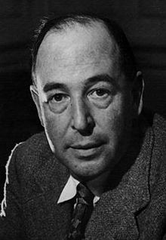
Daniel
9 . 1 - 21
C. S. Lewis (1898-1963), Dangers of National Repentance, 1940 ~ “The first and fatal charm of national repentance is the encouragement it gives us to turn from the bitter task of repenting our own sins to the congenial one of bewailing — but, first, of denouncing — the conduct of others.”

Slide 10
Daniel
9 . 1 - 21

Slide 11
Daniel
9 . 1 - 21
Zech. 7:5 ~ Say to all the people of the land, and to the priests: “When you fasted and mourned in the fifth and seventh months during those seventy years, did you really fast for Me — for Me?”

Slide 12
Daniel
9 . 1 - 21

Slide 13
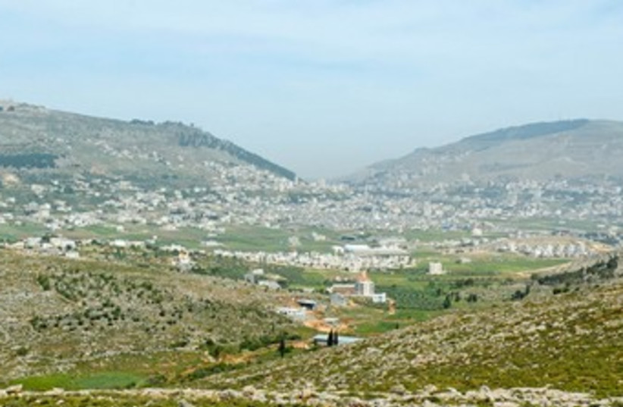
Daniel
9 . 1 - 21
N
vv. 1-14 ~ blessings
vv. 15-54 ~ cursings
Mt. Gerizim
Mt. Ebal

Slide 14
Daniel
9 . 1 - 21

Slide 15
Daniel
9 . 1 - 21
Is. 39.7 ~ And they shall take away some of your sons who will descend from you, whom you will beget; and they shall be eunuchs in the palace of the king of Babylon.

Slide 16
Daniel
9 . 1 - 21

