Slide 1
the Book of
Daniel
4 . 1 - 37
A free CD of the study will be available upon request following the service.
A podcast will be available later in the week at calvaryokc.com.
A videowill be available at facebook.com/CalvaryOKC and our YouTube channel (Calvary Chapel OKC)

Slide 2
Daniel
4 . 1 - 37
Voting for the
wrong party
Reading the
“Message”
Watching
CNN
Pride
sin-o-meter

Slide 3
Daniel
4 . 1 - 37
Nebuchadnezzar’s reign (43 yr.)
Daniel’s ministry (70+ yr.)
595BC
575BC
555BC
535BC
Nebuchadnezzar’s Dream (2)
(603 BC)
Nebuchadnezzar’s humbling (4)
(570 BC?)
Nebuchadnezzar’s
Image (3)
(593 BC?)

Slide 4
Daniel
4 . 1 - 37
Daniel 4
⁵ I saw a dream which made me afraid, and the thoughts on my bed and the visions of my head troubled me. ⁶ Therefore I issued a decree to bring in all the wise men of Babylon before me, that they might make known to me the interpretation of the dream. ⁷ Then the magicians, the astrologers, the Chaldeans, and the soothsayers came in, and I told them the dream;
⁸ But at last Daniel came before me (his name is Belteshazzar, according to the name of my god; in him is the Spirit of the Holy God), and I told the dream before him, saying: ⁹ “Belteshazzar, chief of the magicians, because I know
¹ Nebuchadnezzar the king,
To all peoples, nations, and languages that dwell in all the earth:
Peace be multiplied to you.
² I thought it good to declare the signs and wonders that the Most High God has worked for me.
³ How great are His signs,
And how mighty His wonders!
His kingdom is an everlasting kingdom,
And His dominion is from generation to generation.
⁴ I, Nebuchadnezzar, was at rest in my house, and flourishing in my palace.
by Nebuchadnezzar servant of the Most High God

Slide 5
Daniel
4 . 1 - 37

Slide 6
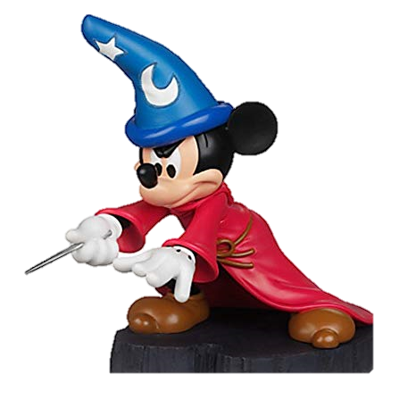
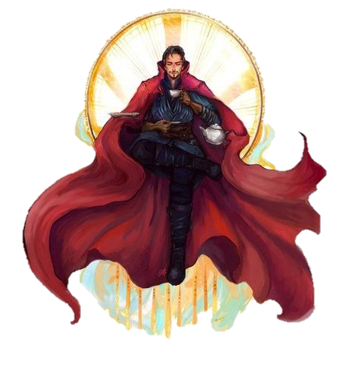
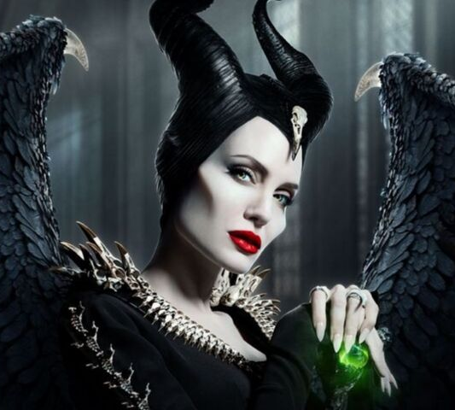
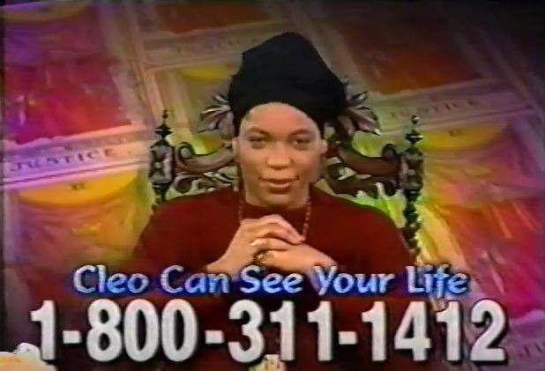
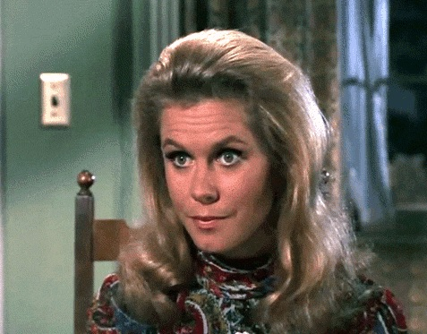
Daniel
4 . 1 - 37

Slide 7
Daniel
4 . 1 - 37

Slide 8
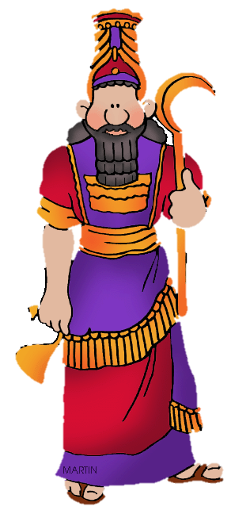
Daniel
4 . 1 - 37
Spirit of the Holy God ~ KJV, NIV, NASB, spirit of the holy gods (also v. 18)
I guess there’s nothing left to do but to pray!

Slide 9
Daniel
4 . 1 - 37

Slide 10
Daniel
4 . 1 - 37
times ~ idan – only in Daniel (13x)
i.e. 3:5 ~ that at the time when you hear the horn, flute, etc.
i.e. 7:25b ~ For a time and times and half a time.
From id only in Is. 64:6 ~ all our righteousnesses are like filthy rags.
Possibly seven months

Slide 11
Daniel
4 . 1 - 37

Slide 12
Daniel
4 . 1 - 37
astonished ~ KJV, astonied

Slide 13
Daniel
4 . 1 - 37

Slide 14
Daniel
4 . 1 - 37
Eccl. 8:11 ~ Because the sentence against an evil work is not executed speedily, therefore the heart of the sons of men is fully set in them to do evil.

Slide 15
Daniel
4 . 1 - 37

Slide 16
Daniel
4 . 1 - 37
In the
beginning, I created
the heavens and the earth!
I built one of
the seven wonders of the ancient world!

Slide 17
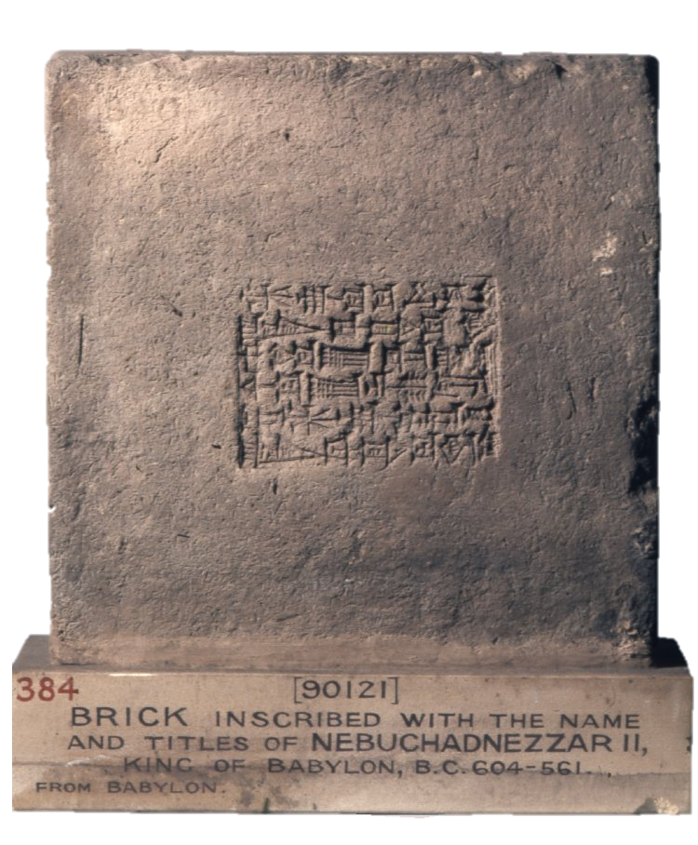
Daniel
4 . 1 - 37
15,000,000 bricks used in Babylon
British Museum

Slide 18
Daniel
4 . 1 - 37

Slide 19
Daniel
4 . 1 - 37
In the
beginning, I created
the heavens and the earth!

Slide 20
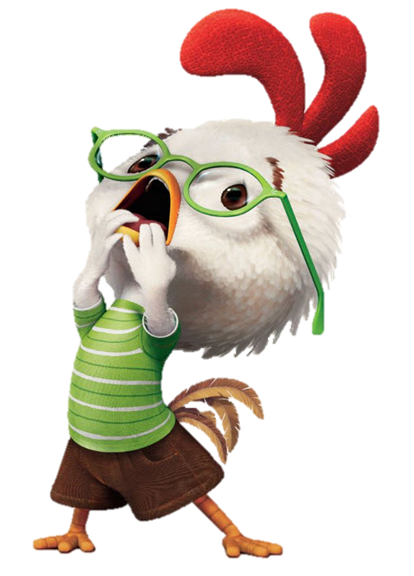
Daniel
4 . 1 - 37
If you luv
Jesus, you’ll send this to everyone in your contacts!
The sky is falling!
There’s not a moment to lose!
This Photo by Unknown Author is licensed under CC BY-SA-NC

Slide 21
Daniel
4 . 1 - 37

Slide 22
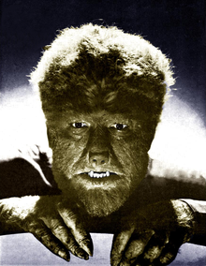
Daniel
4 . 1 - 37
Lycanthropy ~ (lī CAN thrǝ pē) n. 1. In folklore, the magical ability to assume the form and characteristics of a wolf.
2. A delusion that one has become or assumed the characteristics of a wolf or other animal.

Slide 23
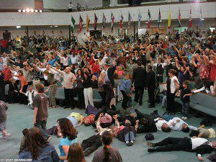
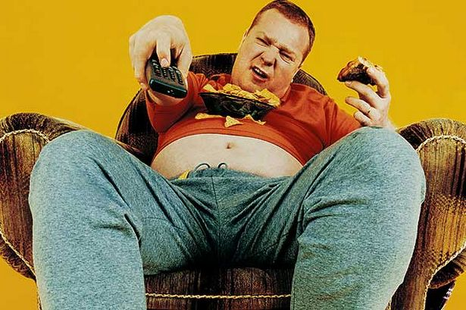
Daniel
4 . 1 - 37
Zoanthropy ~ (zō AN thrǝ pē) n. a mental disorder in which a person imagines that he or she is a beast.

Slide 24
Daniel
4 . 1 - 37
Boanthropy ~ (bō AN thrǝ pē) n. a psychologicl disorder in which a human believes himself or herself to be a bovine.
I am so coo … co … c … c …
moooooo!
Bob Marley dreads
Sophia Hadjipanteli unibrow
Howard Hughes claws

Slide 25
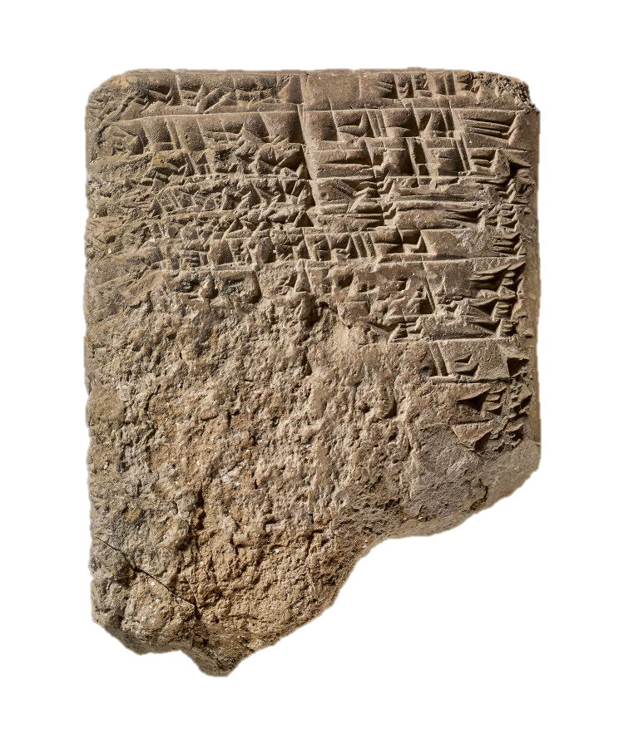
Daniel
4 . 1 - 37
A. K. Grayson ~ tablet published in 1975
British Museum

Slide 26
Daniel
4 . 1 - 37

