Slide 1
the Book of
Daniel
3 . 1 - 30
A free CD of the study will be available upon request following the service.
A podcast will be available later in the week at calvaryokc.com.
A videowill be available at facebook.com/CalvaryOKC and our YouTube channel (Calvary Chapel OKC)

Slide 2
Daniel
3 . 1 - 30
Dan. 2:47-49 ~ ⁴⁷ The king answered Daniel, and said, “Truly your God is the God of gods, the Lord of kings, and a revealer of secrets, since you could reveal this secret.” ⁴⁸ Then the king promoted Daniel and gave him many great gifts; and he made him ruler over the whole province of Babylon, and chief administrator over all the wise men of Babylon. ⁴⁹ Also Daniel petitioned the king, and he set Shadrach, Meshach, and Abed-Nego over the affairs of the province of Babylon; but Daniel sat in the gate of the king.

Slide 3
Daniel
3 . 1 - 30

Slide 4
Daniel
3 . 1 - 30

Slide 5
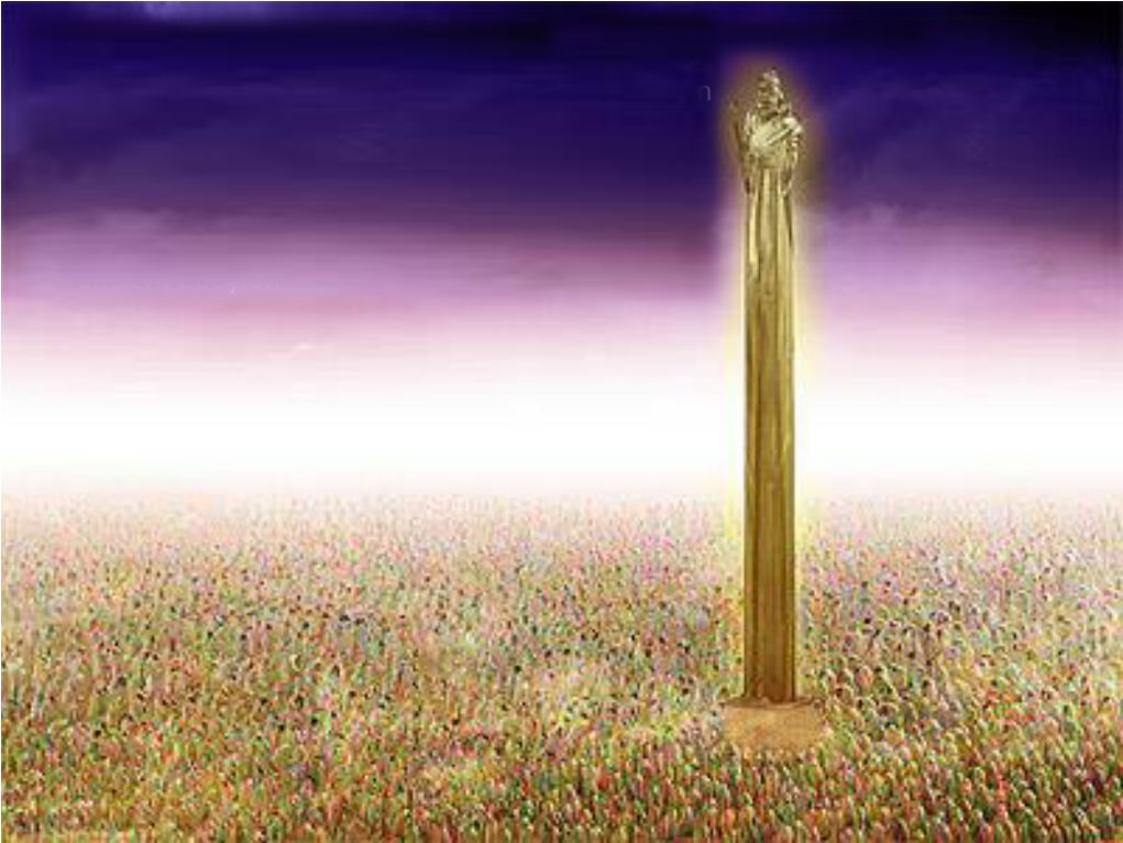
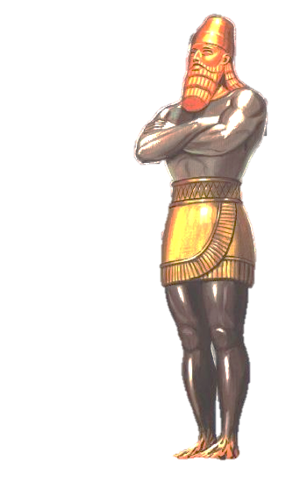
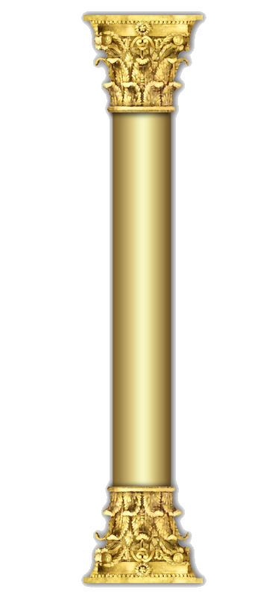
Daniel
3 . 1 - 30
60 X 6 cubits = 10:1
90’
9’

Slide 6
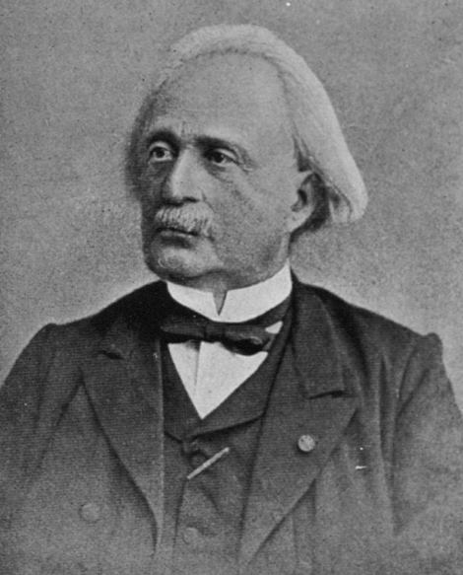
Daniel
3 . 1 - 30
Julius Oppert (1825-1905)
20’
45’
45’

Slide 7
Daniel
3 . 1 - 30

Slide 8
Daniel
3 . 1 - 30
harp
harp ~ (NLT, NIV) – zither
lyre ~ (NASB) – trigon
psaltery
psaltery ~ (NLT, NIV) – harp
symphony
symphony ~ (NASB) – bagpipes
Greek words from the 6th century BC

Slide 9
Daniel
3 . 1 - 30

Slide 10
Daniel
3 . 1 - 30
accused ~ devour the pieces

Slide 11
Daniel
3 . 1 - 30

Slide 12
Daniel
3 . 1 - 30
Dan. 2:47 ~ The king answered Daniel, and said, “Truly your God is the God of gods, the Lord of kings, and a revealer of secrets, since you could reveal this secret.”

Slide 13
Daniel
3 . 1 - 30

Slide 14
Daniel
3 . 1 - 30
NIV ~ “O Nebuchadnezzar, we do not need to defend ourselves before you in this matter.”

Slide 15
Daniel
3 . 1 - 30

Slide 16
Daniel
3 . 1 - 30
Merrihew Standard Version ~ ^{16b} With all due respect, our king, we don’t even have to think about it; ¹⁷ in answer to your question, our God, Yahweh is able to deliver us; and He will … whether in this life or the next one. ¹⁸ But if He chooses not to deliver us now, we want to let you know that we won’t/can’t/aren’t going to bow before any person/place/or thing other than Him.

Slide 17
Daniel
3 . 1 - 30
Matt. 10:28 ~ And do not fear those who kill the body but cannot kill the soul. But rather fear Him who is able to destroy both soul and body in hell.

Slide 18
Daniel
3 . 1 - 30

Slide 19
Daniel
3 . 1 - 30
the Son of God ~ (Aramaic) bar ‘elahh
NIV, NASB, ESV ~ a son of the gods
Matt. 28:20b ~ “Lo, I am with you always,”
Is. 43:2 ~ When you pass through the waters, I will be with you;
And through the rivers, they shall not overflow you.
When you walk through the fire, you shall not be burned,
Nor shall the flame scorch you.

Slide 20
Daniel
3 . 1 - 30

Slide 21
Daniel
3 . 1 - 30
144,000 (Rev. 7)
Meshach
Abed-Nego
Shadrach
the Church
Daniel

Slide 22
Daniel
3 . 1 - 30

