Slide 1
A C T S
of the apostles
6:1-15

Slide 2
A C T S
6:1-15
Methodist church:
4 new families
Presbyterian church:
10 worst troublemakers
Baptist church:
6 new families

Slide 3
A C T S
6:1-15

Slide 4
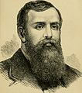
A C T S
6:1-15
D. L. Moody (1837-1899) ~ “It is better to set ten men to work than to do the work of ten men.”

Slide 5
A C T S
6:1-15

Slide 6
A C T S
6:1-15
distribution (v. 1) ~ diakonia – service, ministry (32x)
serve (v. 2) ~ diakoneō – to serve, to minister, to take care of (34x)
Phil. 1:1 and 1 Tim. 3 ~ transliterations of diakonos – one who serves (29x)

Slide 7
A C T S
6:1-15

Slide 8
A C T S
6:1-15
Matt. 25:21, 23 ~ His lord said to him, “Well done, good and faithful servant; you were faithful over a few things, I will make you ruler over many things. Enter into the joy of your lord.”
Zech. 4:10a ~ For who has despised the day of small things?

Slide 9
A C T S
6:1-15

Slide 10
A C T S
6:1-15
Service is the
rent we pay in life for the space we occupy
John Q. Anonymous

Slide 11
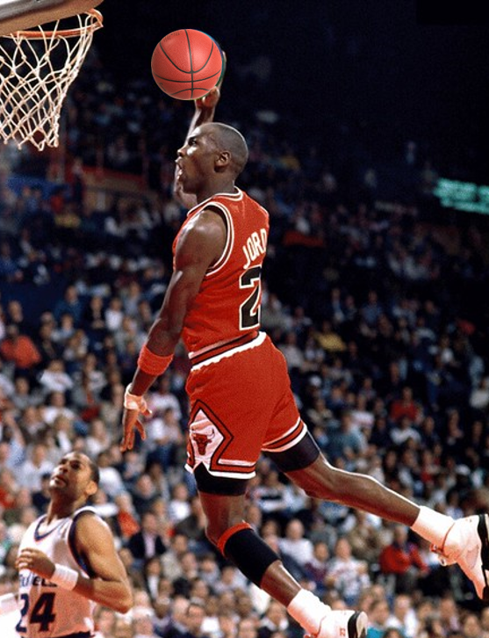
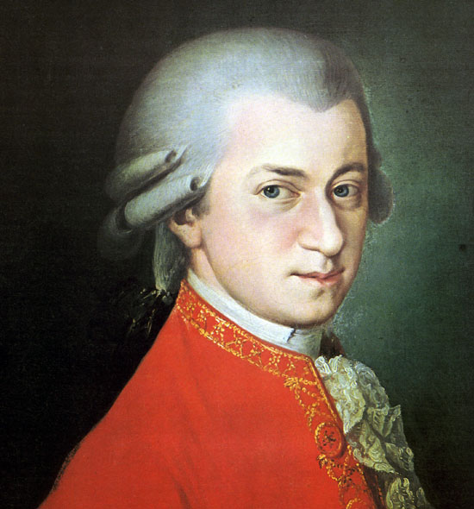
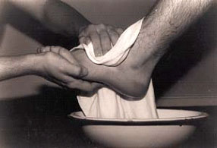
A C T S
6:1-15

Slide 12
A C T S
6:1-15

Slide 13
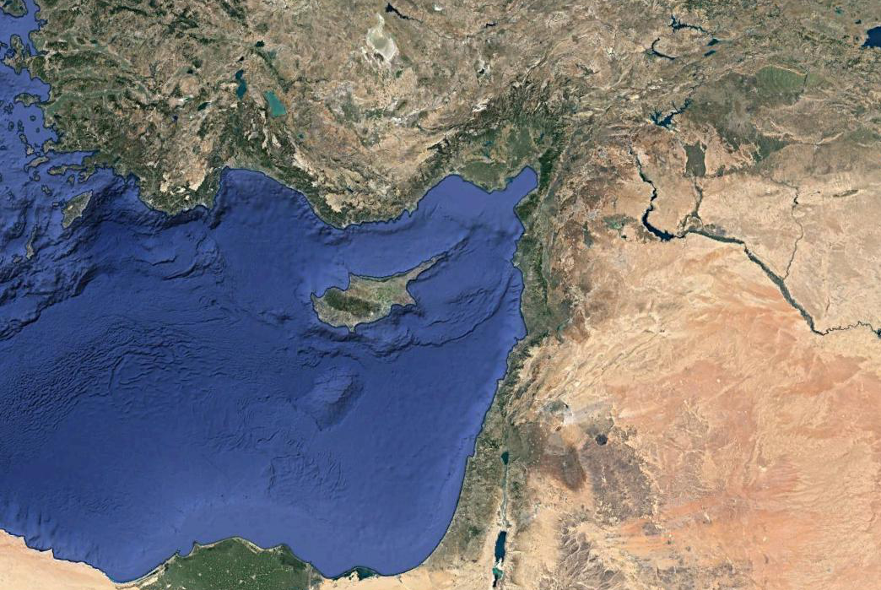
A C T S
6:1-15
Cilicia
Tarsus

Slide 14
A C T S
6:1-15

Slide 15
A C T S
6:1-15
Messiahtruth.com (no longer active site) ~ “Evangelical Christianity has spent over one billion dollars in the last decade to convert Jews to Christianity. Under the guise of “Jews for Jesus” and “Hebrew Christians,” a new threat of spiritual terrorism has emerged in the form of “Messianic Synagogues,” whose theological tenets are identical to the Christian fundamentalists who created them. Their ultimate goal is the eradication of the Jewish people through assimilation – it is our obligation to stop them.”

Slide 16
A C T S
6:1-15

Slide 17
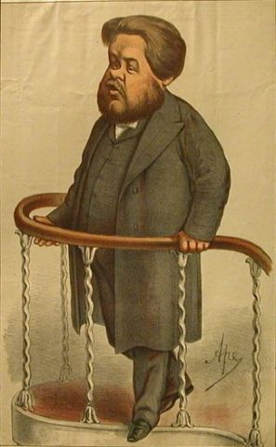
A C T S
6:1-15
Men, when
you teach on heaven, let there always be a
glow on your face, a gleam in your eye, and
a grin on your lips.
When you
teach on hell …
your normal face will do
C. H. Spurgeon (1834-1892)

Slide 18
A C T S
6:1-15

Slide 19
A C T S
6:1-15
The Parable
of the
Brother-in-law

Slide 20
A C T S
6:1-15

